Slide 1
Posters by students in the following District public and public charter schools: Browne Education Campus Cleveland Elementary Drew Elementary Friendship PCS Blow-Pierce Harriet Tubman Elementary KIPP DC Heights Academy Ludlow-Taylor Elementary Moten Elementary Peabody Early Childhood Campus Savoy Elementary Tree of Life PCS, and Wheatley Education Campus
Celebrate 2015 Children’s Mental Health Awareness Day
Posters on display May 4-May 30 in the Atrium of the John A. Wilson Building (City Hall) 1350 Pennsylvania NW, Washington, DC
DC Department of Behavioral Health

Slide 2
Browne Education Campus
Grade Pre-K

Slide 3
Cleveland Elementary
Grade 2

Slide 4
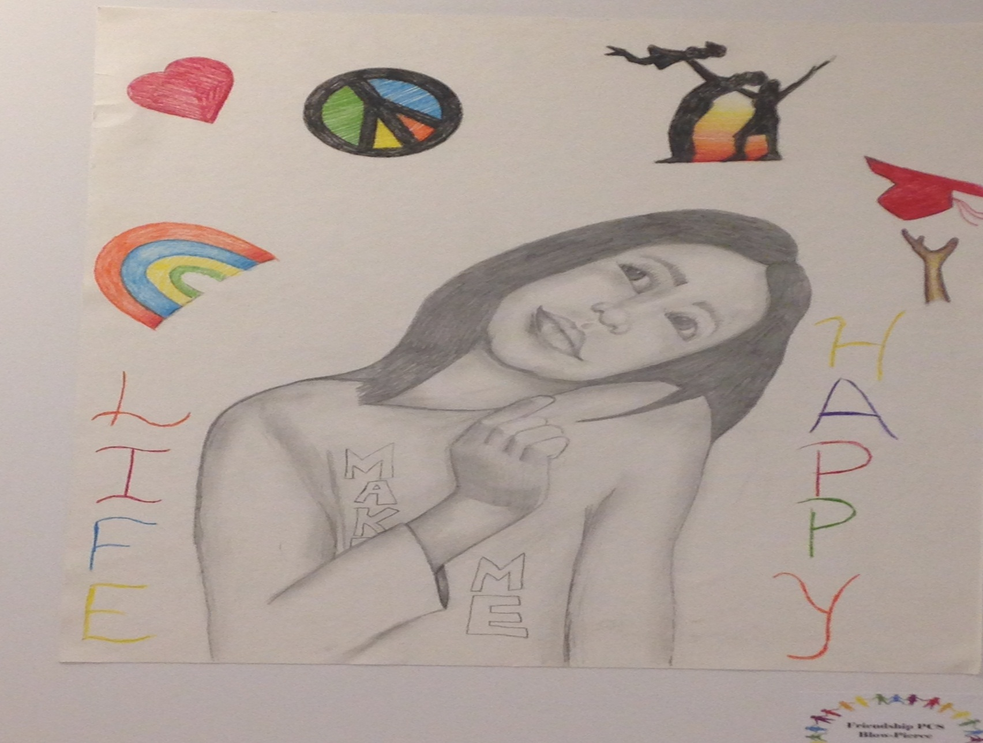
Friendship PCS Blow Pierce
Grade 6

Slide 5
Harriett Tubman Elementary
Grade 2

Slide 6
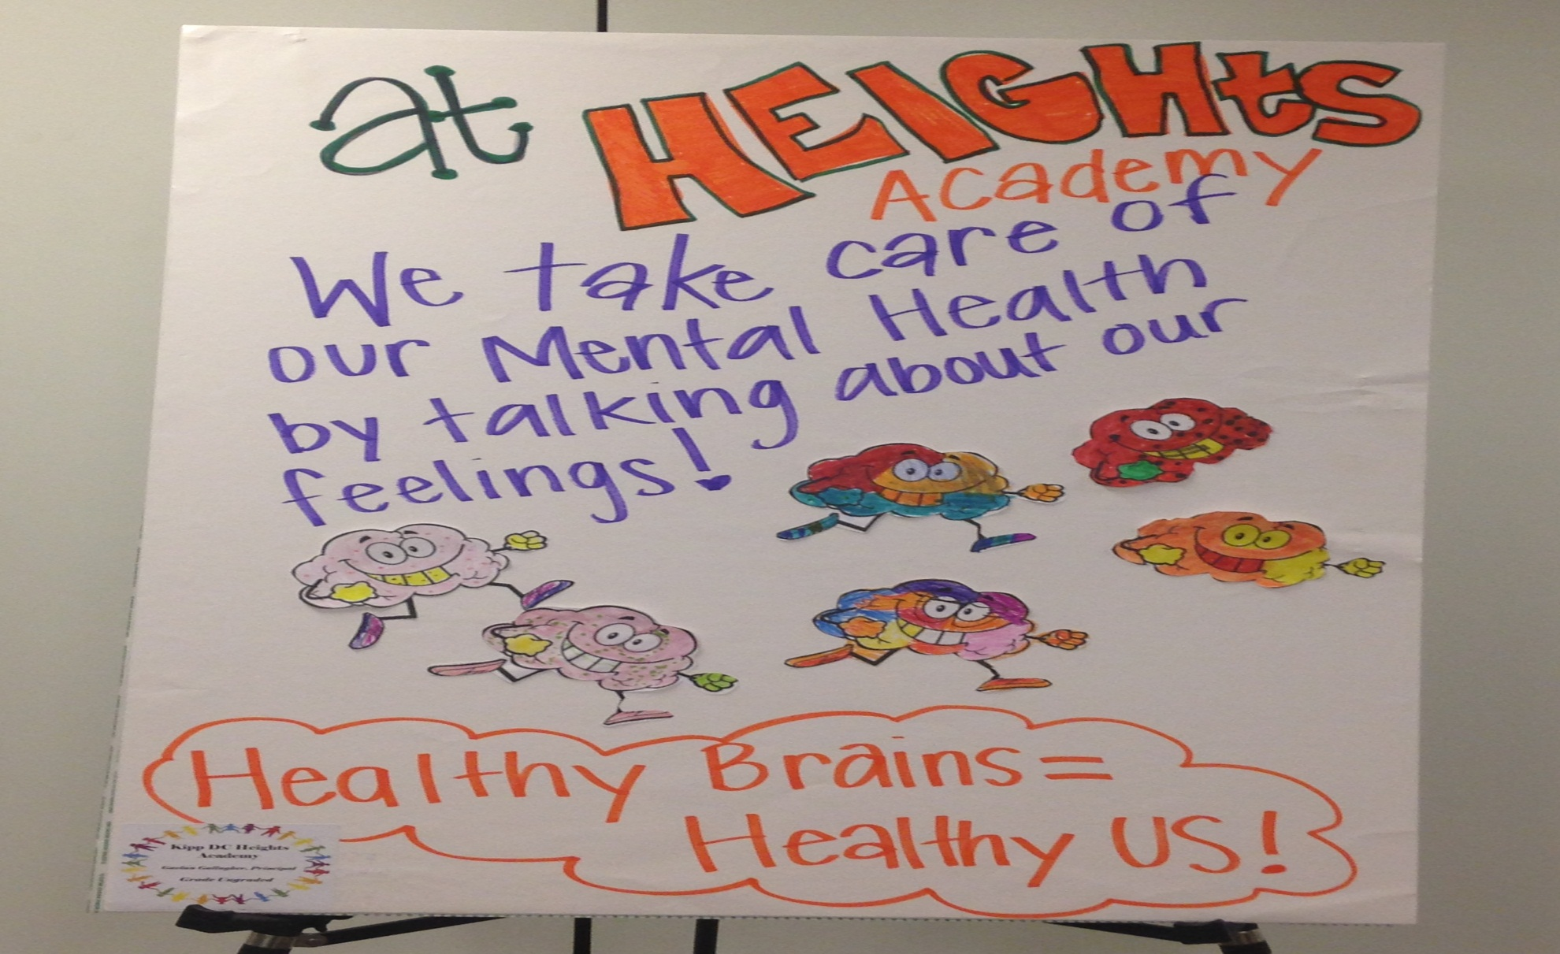
Kipp DC Height Academy
Grade Ungraded

Slide 7
Moten Elementary
Grade 2

Slide 8
Ludlow-Taylor Elementary
Grade 2

Slide 9
Peabody Early Childhood Campus
Grade K

Slide 10
Savoy Elementary
Grade 3

Slide 11
Tree of Life PCS
Grade 3

Slide 12
Wheatley Education Campus
Grade 2

Slide 13
Drew Elementary
Grade 1
DC Department of Behavioral Health

