Slide 1
Pre-Application Conference, RFA No. RM0 DCPC070723
DC Prevention Centers Program (DCPC)
Thursday, July 13, 2023 | 12:00 – 1:00PM
For attendance purposes, please use the chat function to type and send:
Name
Organization, and
Email Address
Thank you! We will be starting momentarily.

Slide 2
Today’s Agenda
Welcome
Presenters
Yasir Shah, Grants Specialist
Elyshe Vorhees. Public Health Analyst
Eric Chapman, SUD Branch Chief
General Information
Overview, Background, Purpose and Definitions
Award Information
Source of Grant Funding, Award Funding Available and Performance and Funding Period
Eligibility Requirements
Performance Requirement
Experience Criteria, Target Population, Location of Services, Scope of Services and Scope of Work
Application Requirements
Project Narrative
Project Attachments
Additional Attachments
Evaluation Criteria
Helpful Information
Key Dates, RFA Checklist, Tips and Contact Info
Questions & Answers

Slide 3
Overview (pg. 10)
The goal of the DCPCs is to prevent the early onset of alcohol, tobacco, and other drug (ATOD) use while reducing risk and increasing protective factors for children and youth. The geographical location and coverage area for the DCPCs are: one (1) serving Wards 1 & 2, one (1) serving Wards 3 & 4, one (1) serving Wards 5 & 6, and one (1) serving Wards 7 & 8. Organizations must have a physical office location within one of the two Wards they are proposing to serve.
This solicitation includes one (1) application opportunity under the District of Columbia Prevention Centers (DCPC) grant.

Slide 4
Background (pg. 11)
DBH supports specific prevention approaches that are designed to significantly contribute to the development of a sustainable prevention infrastructure in the District of Columbia. This infrastructure will help support efforts to prevent the onset, reduce the risk, interrupt the progression of use, and avoid the consequences of alcohol, tobacco, and other drug (ATOD) use in the District.
This includes DC Prevention Centers (DCPCs) that strengthen community capacity, address needed community and system changes, reduce substance use risk factors, and achieve target outcomes for District children and youth. These DCPCs are envisioned as dynamic hubs that engage, support, and help connect the many community elements that are needed for promoting healthy children, youth, and families as well as a drug-free city, while also serving as the front-end of the continuum of care that includes substance use treatment and recovery.

Slide 5
Definitions (pgs. 12-13)
Children and youth (including transitional aged youth) are defined as persons aged 0 through 25.
Community prevention is defined in terms of locations where people live, work, and play and often results in partnerships or “prevention networks.”
Community capacity refers to the ability of individuals at the local level to work together to affect conditions that increase risk for substance use among children and youth.

Slide 6
Definitions cont’d. (pgs. 12-13)
Community readiness includes but is not limited to a history of community cooperation on substance use prevention issues; financial and human resources dedicated to prevention; strength of community leadership; demonstrated commitment to working cooperatively in community partnerships; demonstrated leadership capacity for serving as catalysts for community change; and active prevention efforts already underway as demonstrated by community changes facilitated by multiple sectors, a variety of appropriate strategies, and data driven outcomes.

Slide 7
Definitions cont’d. (pgs. 12-13)
The Conceptual Framework (Attachment I) is a visual diagram based on the Theory of Change which describes the problem, the risk factor(s), the local conditions in the designated wards, and also helps identify and select strategies that address the core functions of Community Education, Community Leadership and Community Changes through the creation of local Community Prevention Networks (CPNs) which will address those specific risk factors and local conditions in their proposed wards.
Prevention is defined as creating conditions for healthy individuals, families, and communities to reduce risk of and increase protection from ATOD use among youth

Slide 8
Definitions cont’d. (pgs. 12-13)
Risk and Protective Factors: Research has identified risk and protective factors that place youth at risk for substance use disorders and interrelated adolescent problems. DBH is collecting District and ward data in order to measure levels of risk and protective factors which include the following:
- Availability of ATOD;
- Transitions and mobility;
- Low neighborhood attachment and community disorganization;
- Family history of substance use and family management
problems;
- Family conflict and low commitment to school; and
- Early initiation of alcohol, tobacco, and other drug use (before age
13]

Slide 9
Award Information (pg. 10)
Source of Grant Funding: Funding is made available from the United States Department of Health and Human Services (DHHS), Substance Abuse and Mental Health Services Administration (SAMHSA), Substance Use Block Grant (SABG).
Award Funding Available: This RFA will make available a total of $I,000,000 to fund four (4) DCPCs in the amount of $250,000.00 each.
Performance and Funding Period: The anticipated performance and funding period is October 2, 2023 – September 29, 2024. The number of awards, budget periods and award amounts are contingent upon the continued availability of funds and the recipient’s performance.
Notes:
Grant recipients will be expected to begin project implementation in October, 2020 or after the Conceptual Framework, Work Plan, Budget and Budget Narrative Justification have been approved by DBH.

Slide 10
Eligibility Requirements (p. 11)
All applicants must have the ability to enter into an agreement with DBH in compliance with all governing federal and District of Columbia laws and regulations, including Substance Use Disorders and Mental Health Grants (22-A DCMR Chapter 44).
Be a non-profit or community-based organization;
Be an organizations with an established physical presence (office location, program activities, etc.) in the District of Columbia within one of the proposed Wards; and
Be a current DCPC grant recipient, with an established physical presence within one of the proposed Wards

Slide 11
Performance Requirements (pgs. 13)
Experience Criteria:
Be an organization with experience in addressing community and public health, substance use, and behavioral health issues, in the District of Columbia, particularly in the proposed Wards.
Be an applicant with capacity to employ one (1) Full Time Equivalent (FTE) employee as DCPC Coordinator or Project Director and up to two (2) FTE Community Mobilization Specialists to implement the DBH approved work plan

Slide 12
Performance Requirements, cont’d (pgs. 13)
Target Population:
  Primary: Children, including transitional aged youth, between the ages of 0-25 residing in proposed wards.
  Secondary: Parents, caregivers, and/or influencers of the primary population residing in proposed wards
Location of Services:
  Each applicant proposing to develop a DCPC must serve all wards and neighborhoods that fall within one of the following geographic designations: Wards 1 & 2 or Wards 3 & 4 or Wards 5 & 6 or Wards 7 & 8
Scope of Services:
  Applicants are expected to address and provide evidence supporting their expertise in providing capacity building core functions in ways that address the unique characteristics and priorities of the geographic areas to be served.

Slide 13
Scope of Work - Core Functions: (pgs. 13-14)
Applicants are expected to provide the following capacity building core functions.
Core Functions
Community Education: This core function requires the DCPCs to serve as sources of current, comprehensive, and relevant prevention information for a wide range of audiences in their respective geographic areas; including members of the community, youth, families, service providers, and policymakers. In addition, the DCPCs should have the ability to consistently distribute this information to the community.
Community Leadership: This core function is designed to identify, engage, and strengthen the capacity of community prevention partnerships in order to address the areas that are placing children and youth at risk for alcohol, tobacco, and other drug use.
Community Changes: This core function increases opportunities for proactive prevention action planning around ward-specific risk and protective factors and measurable changes in policy, practice, and programs that reduce risk.

Slide 14
Application Requirements (pgs. 16-22)
Project Narrative (must not exceed 9 pages)
  A. Organizational Capacity (up to 3 pages)
  This section should describe how the applicant will organize, staff, and manage a DCPC in the proposed wards. The discussion must cover the organizational structure for the DCPC, types and qualifications of staff, and overall management approach.
  Project Need (up to 2 pages)
  This section must identify the selected geographic areas to be served by the DCPC, describe the applicant’s proposed facility and understanding of the communities that the DCPC will serve
  C. Project Description (up to 2 pages)
  This section should align with the Work Plan (see Attachment D) and provide a description on how the organization will establish the Prevention Center so as to successfully achieve the goal of the grant. This section should discuss the process the applicant will use to meet all requirements in the Scope of Work
  D. Project Evaluation (up to 2 page)
  This section should discuss the applicant’s approach to monitor processes and outcomes for evaluation of program deliverables within the proposed work plan.

Slide 15
Project Attachments, (pgs. 18-21)
(not counted in page limit)

Slide 16
Abstract
A one-page project abstract is required (see Attachment C, page 2).) Please provide a one-page abstract that is clear, accurate, concise, and without reference to other parts of the “Project Narrative”.
Include the following sections:
  Project Description: Briefly outline how the organization will implement the project in service of the goal and objectives.
  Performance Metrics: Outline the key outcome and process metrics and associated targets that will be used to assess grantee performance.

Slide 17
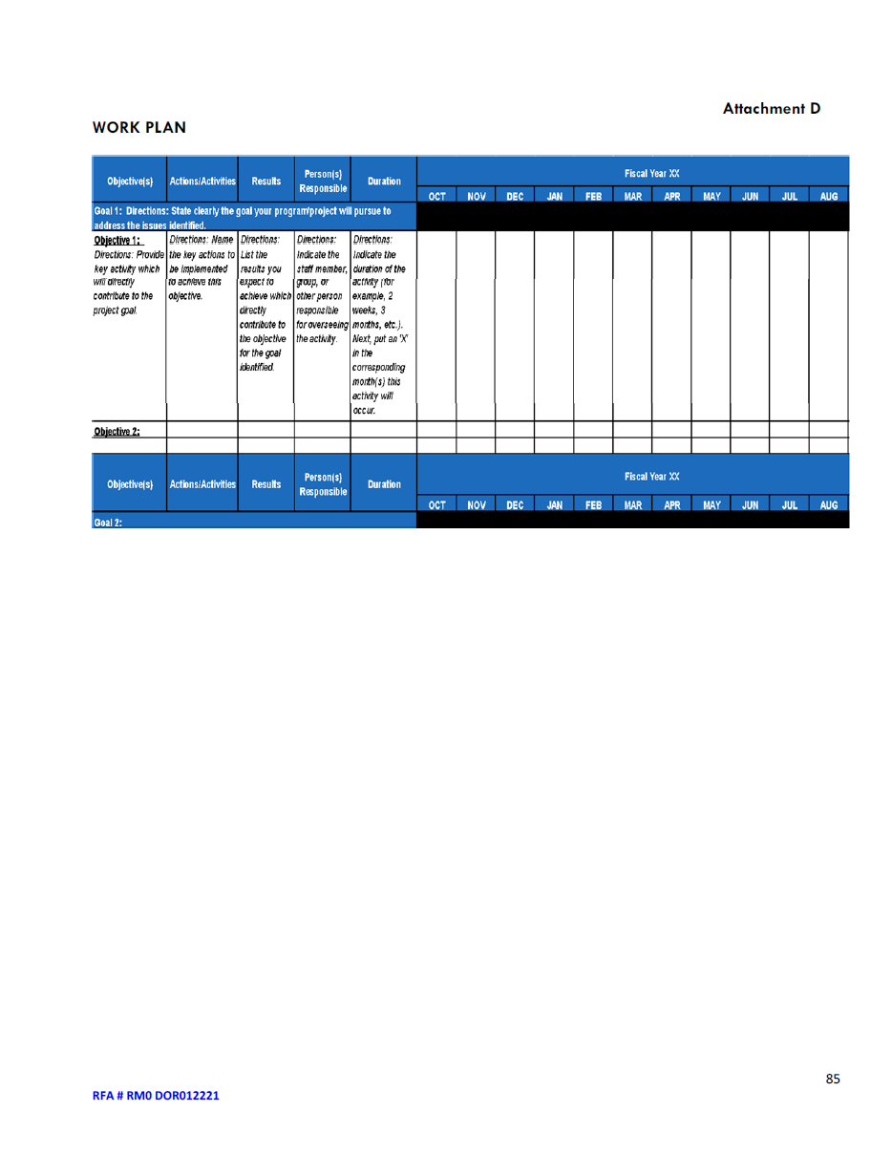
Work Plan
The work plan template (see Attachment D) provided by DBH is required. The work plan describes key activities and tasks to successfully deliver the (program/effort) scope of
services and aligns with the Project Description narrative under Application Requirements.
The activities and tasks should be organized chronologically, and each should have an
identified responsible staff, target completion date, and associated output.

Slide 18
Staffing Plan
The applicant’s staff plan template (see Attachment E) is required.
The staffing plan should describe staff duties, qualifications, and the percent of time to be spent on project activities, and whether the time will be charged to the grant.
The plan should clearly indicate which staff positions will need to be hired. Staff CVs, resumes, and position descriptions shall be submitted and will not count towards the page limit.
Position Title | Staff Name | Education / Experience Qualifications | Resume or CV Included | General Responsibilities | Annual Salary | Percent FTE | Amount Requested

Slide 19
Project Budget and Justification (pg. 19)
Project Budget and Justification
The application should include a project budget (see Attachment F) with justification using the provided template. The project budget and budget justification should be directly aligned with the work plan and project description. All expenses should relate directly to achieving the key grant outcomes and the scope of services.
The budget should reflect a 12-month period. Personnel charges must be based on actual, not budgeted labor. Salaries and other expenditures budgeted for in the grant must be for services that will occur during the 12-month grant period.
Restrictions:
No mini-grants or sub-grants are permitted for any entity that is awarded funding under this RFA.
Attendance at conferences and national workshops through DBH grant funds are limited to: 1) National Association of State Alcohol and Drug Abuse Directors (NASADAD) Annual Prevention Research Conference and 2) Substance Abuse and Mental Health Services Administration (SAMHSA) Community Prevention Day.
Staffing must include one (1) Full Time Equivalent (FTE) employee as DCPC Coordinator or Project Director and up to two (2) FTE Community Mobilization Specialists that implement the DBH approved work plan

Slide 20
Project Budget and Justification, cont’d
  The application should include a project budget (see Attachment F) with justification using the provided template. The project budget and budget justification should be directly aligned with the work plan and project description.
Personnel: Include the title of the position, name (or indicate vacancy), annual salary and level of effort (percentage of time) dedicated to this project.
Fringe: Provide the position, name (or indicate vacancy), total fringe benefit rate used.
Travel: Only local travel related to the DCPC grant and project staff will be approved in the grant budget/ Provide purpose, destination, and type of travel.
Equipment: Provide the item, quantity, amount, and percent charged to the grant.
Supplies: Include the items being requested and rate. Description should also include how the supplies directly support the project.

Slide 21
Project Budget and Justification(cont’d)
Contractual: Provide the name of entity and identify whether it’s a sub-recipient, contractor, consultant, or service. Also provide the entity’s rate.
Other Direct Costs: List any costs not included in any of the other cost categories.
Indirect Costs: Indirect costs should not exceed 10% of direct costs, unless the organization has a negotiated indirect cost rate agreement.
Please see pages 18-19 for more information on indirect costs calculation.
Program Income: If the possibility of generating program income as a result of DBH funding exists, list source and amount as budget line items.

Slide 22
Project Budget and Justification
(Attachment F)

Slide 23
Advances
An applicant seeking an advance, must submit a completed Advance Payment Request form (Attachment G) with the submitted application and be signed by the organization’s Chair of the Board of Directors and Executive Director, or equivalent positions.
Applicants must detail the amount requested per budget category in the budget and justification (see Attachment F).
Advance payments are optional and an applicant is not required to submit the Advance Payment Request form.
Failure to submit an Advance Payment Request form with the application eliminates the consideration for an advance payment.
An advance payment will not be provided without prior official request and approval.

Slide 24
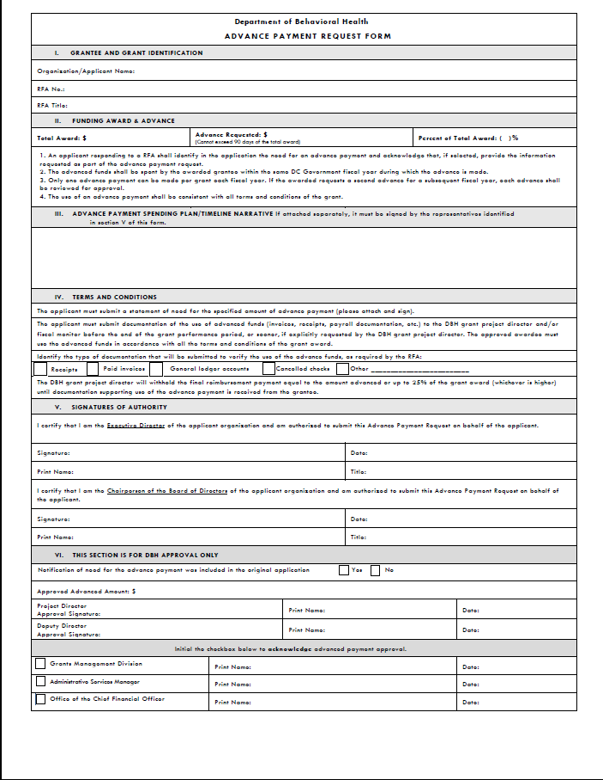
Advance Payment Request Form Template
(Attachment G)

Slide 25
Business License
The applicant must submit a current business license with Active Charitable Solicitation, if applicable issued by the District of Columbia Department of Consumer and Regulatory Affairs.
If the applicant does not have a current license, a copy of the business license application and receipt filed no later than the due date of the grant application may be submitted.

Slide 26
Clean Hands Certification
Each applicant must submit a current Certificate of Clean Hands from the District of Columbia Office of Tax and Revenue (OTR).
A Certificate of Clean Hands can be requested via OTR’s online portal, https://mytax.dc.gov/.
DBH requires that the submitted Certificate of Clean Hands reflect a date within a 60-day period immediately preceding the application’s submission.
Self-Certification and Certificates of Good Standing will not be accepted.

Slide 27
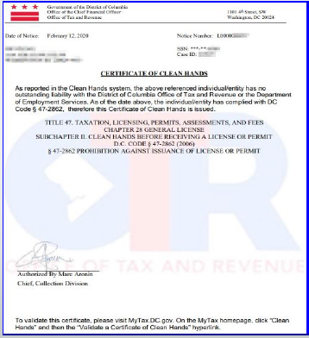
Example of Clean Hands Certification

Slide 28
IRS Tax-Exempt Determination Letter and 990 Form
(Non-Profits Only)
The applicant must submit the organization’s determination letter approving and/or confirming the tax-exempt status. Please see https://www.irs.gov/charities-non-profits/eo-operational-requirements-obtaining-copies-of-exemption-determination-letter-from-irs for more information. If relevant, for the applicant’s business status and any correspondence or other communication received from the IRS within the three (3) years before submission of grant application that relates to the applicant’s tax status.
The applicant must submit the organization’s 990 form from the most recent tax year. Please see https://www.irs.gov/forms-pubs/about-form-990 for more information.

Slide 29
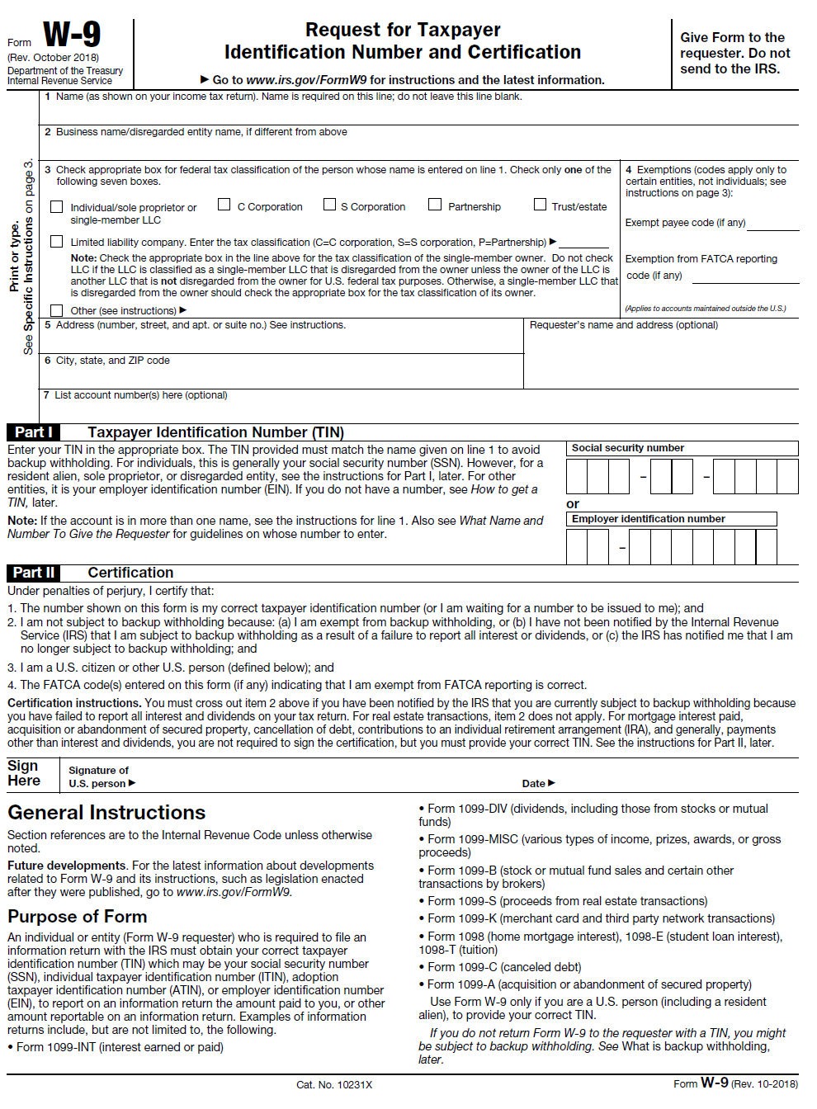
IRS W-9 Tax Form
If the applicant is not a current vendor (receiving funding) from the Department of Behavioral Health submit a completed W-9 form. The form can be found at https://www.irs.gov/pub/irs-pdf/fw9.pdf

Slide 30
Audited Financial Statements
If the applicant has undergone an audit or financial review, it must provide the most recent audited financial statements or reviews.
If audited financial statements or reviews are not available, the applicant must provide the Organizational Budget, Income Statement (Profit and Loss Statement) and Certified Balance Sheet certified by an authorized representative of the organization, and any letters, filings, etc. submitted to the IRS within the three (3) years before date of grant application.

Slide 31
Separation of Duties Policy
The applicant must state how the organization separates financial transactions and duties among people within the organization in order to prevent fraud or waste.
This may be a statement that already exists as a formal policy of the organization, or the applicant may create the statement for purposes of the application.
The applicant should state which of these situations apply and provide the following information:
1. Describe how financial transactions are handled and recorded;
2. Provide the names and titles of personnel involved in handling money;
Identify how many signatures the financial institution(s) require on the organization’s checks and withdrawal slips; and,
Address other limits on staff and board members’ handling of the organization’s money.

Slide 32
Board of Directors
The applicant must submit a separate official list of the current board of directors.
This document must be on applicant’s letterhead, signed and dated by the certified official from the Board (not the Executive Director).

Slide 33
Unique Entity ID
The Applicant must request and obtain a Unique Entity ID (UEI) number to apply for funding.
The Applicant must provide documentation of an active UEI or provide documentation that the UEI has been requested.
If awarded federal funding, documentation of an active UEI is required.
Visit www.sam.gov for more information.

Slide 34
Partner Documents
If applicable, the applicant must submit the partnering organization’s Clean Hands Certificate (from the Office of Tax and Revenue) and documentation of the partner’s tax-exempt status.

Slide 35
Proof of Insurance for: Commercial, General Liability, Professional Liability, Comprehensive Automobile and Worker’s Compensation
The applicant must provide in writing the name of all its insurance carriers and type of insurance provided (e.g., its general liability insurance carrier and automobile insurance carrier, worker’s compensation insurance carrier), fidelity bond holder (if applicable), and before execution of the grant award, a copy of the binder or cover sheet of the current policy for any policy that covers activities that might be undertaken in connection with performance of the grant award, showing the limits of coverage and endorsements.
All policies, except the Worker’s Compensation, Errors and Omissions, and Professional Liability policies that cover activities that might be undertaken in connection with the performance of the grant award.

Slide 36
Proof of Insurance for: Commercial, General Liability, Professional Liability, Comprehensive Automobile and Worker’s Compensation
All policies, except the Worker’s Compensation, Errors and Omissions, and Professional Liability policies that cover activities that might be undertaken in connection with the performance of the grant award shall contain additional endorsements naming the Government of the District of Columbia and its officers, employees, agents and volunteers as additional named insured with respect to liability abilities arising out of the performance of services under the grant award. The applicant shall require their insurance carrier of the required coverage to waive all rights of subrogation against the District, its officers, employees, agents, volunteers, contractors and subcontractors.
Please see Insurance section under General Terms and Conditions.

Slide 37
Additional Attachments
(not counted in page limit)

Slide 38
Attachments A, B and C (pgs. 29-31)
Notice of Eligibility and Experience Requirements
Intent to Apply Notification – due Friday, July 14 2023 to DBH.Grants@dc.gov
Applicant Profile

Slide 39
Attachments 1 – 9 (pgs. 48 -93)
DBH General Terms and Conditions, pg. 49
Assurances, Certifications and Disclosures, pg. 77
Program Income and Financial Disclosure, pg. 82
DC Contribution and Solicitation Certification, pg. 84
Federal Assurances and Certifications, pg. 86
Special Terms of Award Funding, pg. 90
Tax Certification, pg. 91
Sub-Grantee Single Audit Certification, pg. 92
DBH Grant Terms and Conditions (Form), pg. 93

Slide 40
Evaluation Criteria (p. 22-23)
Indicators have been developed for each review criterion to assist the applicant in presenting pertinent information and to provide the reviewer with a standard for evaluation. The four review criteria are outlined below with specific detail and scoring points. These criteria are the basis upon which the reviewers will evaluate the application. The entire proposal will be considered during objective review.
Criterion 1: Capacity (Corresponds to Organizational Capacity Section) – 27 points
Criterion 2: Need (Corresponds to Project Need Section) – 26 points
Criterion 3 : Strategic Approach (Corresponds to Project Description Section) – 27 points
Criterion 4: Evaluation(Corresponds to Project Evaluation Section) – 10 points
Criterion 5: Project Budget and Justification – 10 points
For more information on Review and Scoring of Application see pgs. 24-25
  Reference RFA page 45

Slide 41
Application Scoring (p. 24)
All applications for this RFA will be objectively reviewed and scored against the following key criteria.
Criterion 1 – Capacity (Total of 27 Points)
Criterion 2 – Need (Total of 26 Points)
Criterion 3 – Strategic Approach(Total of 27 Points)
Criterion 4 – Evaluation (Total of 10 Points)
Criterion 5 – Project Budget and Justification (Total of 10 Points)

Slide 42
Helpful Information

Slide 43
Key Dates (p. 10)
Notice of Funding Announcement Date: Friday July 7, 2023
Request for Application Release Date: Friday July 7, 2023
Letter of Intent Due Date: Friday July 14, 2023
Pre-Application Conference Date: Thursday July 13, 2023
12:00 PM - 1:00 PM ET
Application Submission Deadline: Monday August 7, 2023
no later than 12:00 PM ET
Anticipated Award Start Date: Monday, October 2, 2023

Slide 44
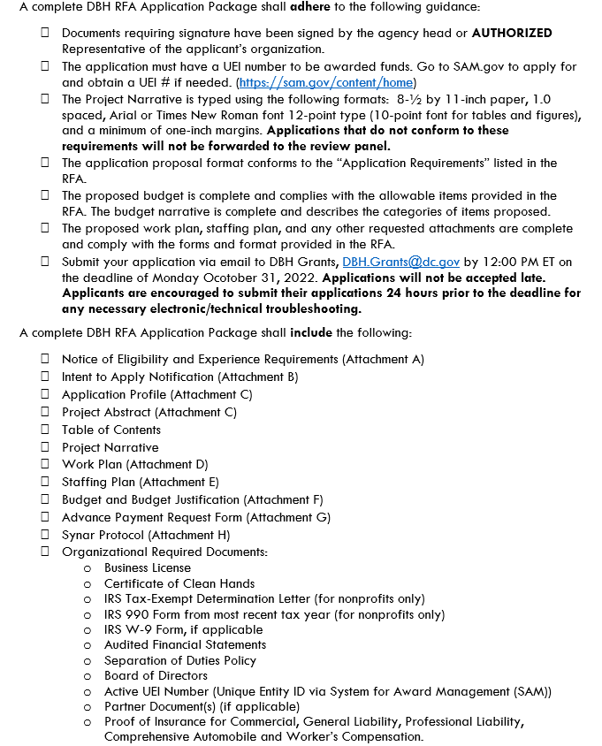
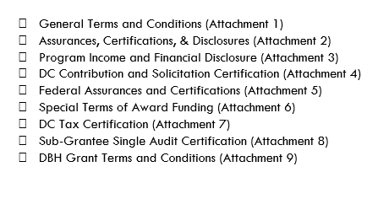
CHECKLIST FOR RFA APPLICATION (p. 8-9)

Slide 45
Tips
Read the RFA!
RFA and Attachments can be found on either the Mayor’s Office of Community Affairs or Department of Behavioral Health websites:
https://communityaffairs.dc.gov/content/community-grant-program#4
https://dbh.dc.gov/page/request-applications-01
Complete and sign attachments
Meet the submission deadline of no later than Friday August 7, 2023 at 12:00PM
Applications are to be emailed to DBH.Grants@dc.gov
Email subject line should include RFA # and File #.
For example, RM0 SCP010723, File #1 (see page 24 for more information on application submission)

Slide 46
Agency Contact Information (p. 27)
Program Contacts
  Yasir Shah (main point of contact for this funding effort)
  Grants Specialist
  (202) 727-860
  yasir.shah@dc.gov
  Elyshe Voorhees
  Public Health Analyst
  (202) 671-4074
  elsyhe.voorhees@dc.gov
Fiscal Management Office
  Tywana Reed
  (202) 673-3532
  tywana.reed@dc.gov
Grants Management Office
  Toussaint Tingling-Clemmons
  (202) 673-3426
  Toussaint.tingling-clemmons@dc.gov

Slide 47

Questions

