Slide 1
District of Columbia
Department of Behavioral Health (DBH)
Pre-Application Conference
RFA No. RM0 SBPP020224
School-Based Behavioral Health Student Peer Educator Pilot Program
Tuesday, February 6, 2024 | 1:00 PM – 2:00 PM

Slide 2
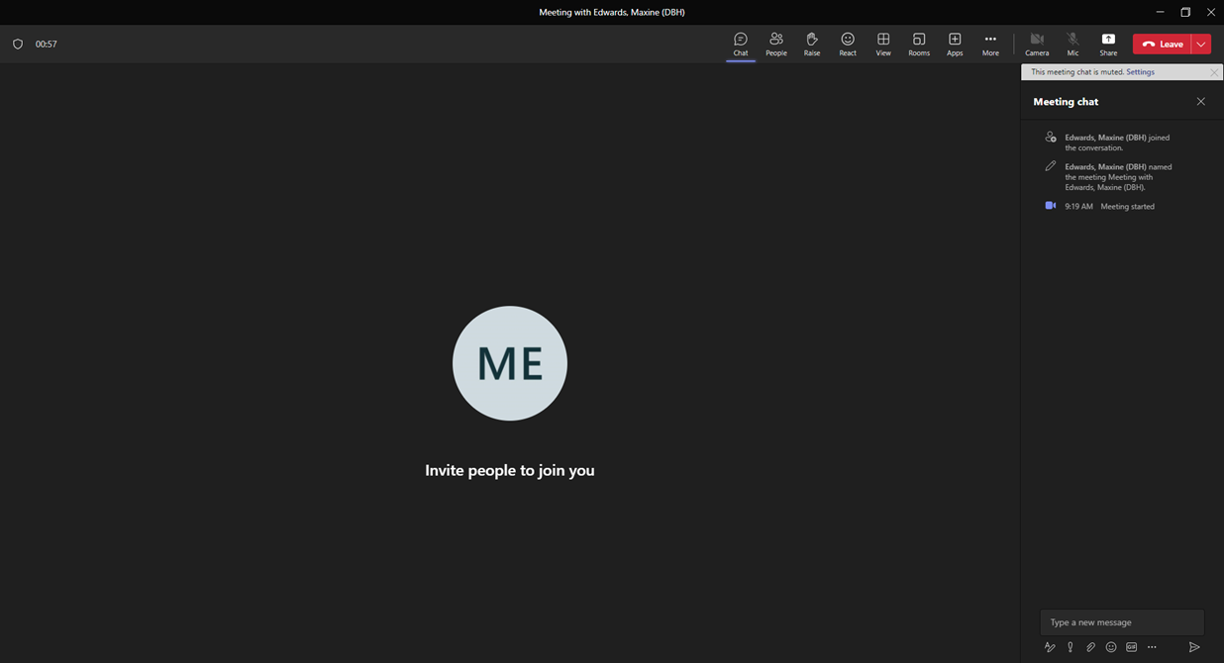
Please Note:
Video is your choice…
Please remain on “Mute”
Register attendance with your name, preferred email address, and phone number
By email to: charneta.scott@dc.gov
Add questions . . .

Slide 3
Today’s Agenda
Welcome
Presenters
Charneta C. Scott, Ph.D., Project Manager
Toussaint Tingling-Clemmons, Grant Management Specialist
General Information
Overview, Background, Purpose and Definitions
Award Information
Source of Grant Funding, Award Funding Available and Performance and Funding Period
Eligibility Requirements
Performance Requirement
Experience Criteria Target Population, Location of Services, Scope of Services ad Scope of Work
Application Requirements
Project Narrative
Evaluation Criteria
Successful Packaging
Additional/Fillable Attachments
Helpful Information
Key Dates, RFA Checklist, Tips, and Contact Info
Questions & Answers

Slide 4
Overview (p.10)
The Government of the District of Columbia, Department of Behavioral Health, Prevention and Early Intervention Division, is soliciting applications from qualified organizations to implement a School-Based Behavioral Health Student Peer Educator Pilot Program. The purpose of the School-Based Behavioral Health Student Peer Educator Pilot Program is to engage youth to become leaders, peer educators, and advocates for behavioral health services in the District. The peers will be trained in multiple topics and will demonstrate a working knowledge of basic behavioral health issues as well as what resources are available to youth/families across the District.

Slide 5
Background (p.10)
Peers will use working knowledge to help educate their peers on behavioral health topics and available resources. The goal is to help reduce the stigma associated with seeking behavioral health services and to increase youth knowledge of behavioral health information, available behavioral health resources and services, and how to access behavioral health services.
This solicitation includes one (1) application opportunity:
Each applicant is to indicate if the organization is applying to serve as the Coordinating Grantee Organization for the School-Based Behavioral Health Student Peer Educator Pilot Program.

Slide 6
Purpose (pg. 12)
School Behavioral Health Peer Education Program interventions cover various topics related to mental health and substance use issues. The goal of peer educators is to decrease stigma, increase knowledge within the school community regarding behavioral health topics, and increase available resources and how to access those services. The resulting impact should be more positive health outcomes for students, decrease in unmet behavioral health needs and an increase in students' ability to seek out help.

Slide 7
Definitions (p.12)
Coordinating Grantee Organization – a grantee within the School-Based Behavioral Health Student Peer Educator Pilot Program that, in the case of being one of two selected grantees or the only selected grantee, performs the following duties:
(A) Develop and collect behavioral health training curricula for peer educator training;
(B) Collect and share on a public dashboard or database data on peer educators' activities;
(C) Compile and maintain a public dashboard or database of information on the public and public charter schools in the pilot program, which shall include:
(i) The contact information and school location of clinicians and peer educators, which will provide a mechanism for students/families to contact behavioral health staff in the school
(ii) Information on school services and programs; and (iii) collaborate on a method for students and caregivers to make appointments with behavioral health staff and submit referrals for services.
If there is more than one grantee for the School-Based Behavioral Health Student Peer Educator Pilot Program, the coordinating grantee organization receives a grant award of $175,000 out of the grant’s total available $325,000 for up to two grant awards. And, if there is only one grant recipient, that one selected grantee will receive $325,000 and provide the duties of the coordinating grantee organization. Additionally, if there are two grantees, the coordinating grantee organization is to train at least 50 peer educators. And, if only one grantee is selected, the grantee shall agree to train and to work to train at least 100 peer educators.

Slide 8
Definitions (p.12)
Resilience building – the process by which individuals become better at reframing thought patterns and tapping into strengths-based approach to working through obstacles.
School Behavioral Health Coordinator – a public or public charter school employee who coordinates behavioral health services and referrals. The School Behavioral Health Coordinator often convenes and is the leader for the school’s behavior health team.
DC Prevention Center – a District of Columbia neighborhood-based center that promotes healthy, drug-free living.
Cohort 1 – Schools that are identified in the first group of DC public and public charter schools that were prioritized to receive supplemental school behavioral health resources within the first year of the Department of Behavioral Health’s implementation of the School Behavioral Health Expansion.
Fiscal Year – the District Government’s fiscal year runs from October 1– September 30.

Slide 9
Source of Grant Funding & Award Funding Available (p. 11)
Source of Grant Funding
Funding is made available under the District of Columbia Fiscal Year 2024 (FY24) Budget Support Act of 2024
Award Funding Available
This RFA will make available three hundred and twenty-five thousand dollars ($325,000) for up to two (2) awards.
Performance and Funding Period
The anticipated performance and funding period is February 29, 2024 through September 30, 2024.

Slide 10
Eligibility Requirements (p. 11)
Eligibility Criteria (pg. 11)
Eligible entities who can apply for grant funds under this RFA are:
1. Non-governmental entity.
2. Located within the District of Columbia.
3. Eligible to participate in District-funded programs (not debarred) as evidenced by an exclusion verification.
4. Agree to use these funds to supplement and not supplant existing behavioral health services.
5. Must be in good standing with the District of Columbia.
6. Must have a minimum of three (3) years of experience in the recruiting, training, and supervising student peer educators.

Slide 11
Performance Requirements (p. 13)
Experience Criteria (pg. 13)
Those applying should meet the following criteria:
Comply with all applicable District licensing, accreditation, and certification requirements, as of the due date of the application.
Identify and provide the names of schools with which the applicant intends to partner with at least 3 public and public charter school high schools, with a preference for schools identified in Cohort 1 of DBH’s first year of implementation of the expansion of school behavioral health services or schools located in Wards 5, 7, or 8.
Identify the types of interventions the applicant will train peer educators to perform and target numbers for each intervention type.
Identify the maximum number of peer educators the applicant plans to recruit, train, and supervise.
Have experience providing training, workshops, and programming to youth ages 14 to 21 on behavioral health, resiliency, and workforce readiness.
Have experience in training youth on how to engage with peers, how to provide training and collaborate within a school setting.

Slide 12
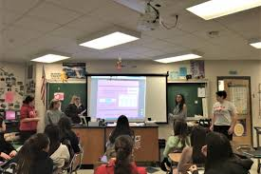
Target Population (p. 13)
The target population covers youth currently enrolled in High School within the District of Columbia public and public charter schools, with a preference for schools identified in Cohort 1 of the School Behavioral Health Expansion implemented by DBH or located in Wards 5, 7, or 8.

Slide 13
Location of Services (p.13)
Services associated with this grant must take place in the District of Columbia Public Schools and/or Public Charter Schools.

Slide 14
Scope of Services (pgs. 13-14)
The coordinating grantee organization shall:
A. Develop and collect behavioral health training curricula for peer educator training
B. Collect and share on the public dashboard or database data on the peer educators' activities
C. Compile and maintain a public dashboard or database of information on the public and public charter schools in the pilot program, which shall include:
(i) The contact information and school location of clinicians and peer educators; which will provide a mechanism for students/families to contact behavioral health staff in the school
(ii) Information on school services and programs; and (iii) collaborate on a method for students and caregivers to make appointments with behavioral health staff and submit referrals for services.
D. After receiving training - peer educators shall perform at least 3 of the following activities:
(i.) Conducting behavioral health classroom presentations and trainings in the
presence of a qualified practitioner;
(ii.) Work with school clinicians and staff to co-lead support groups;
(iii) After materials are vetted through the mental health team and school
administration, peer educators will distribute paper and electronic materials on
behavioral health services and resources and resilience-building topics.
(iv) Conducting individual education sessions with students on behavioral health and
resilience-building topics.

Slide 15
Scope of Work (p. 14)
E. Peer educators may perform the following additional activities:
(i) In collaboration with school personnel create and lead school and community events and programs related to behavioral health issues
(ii) With the permission of the school and mental health team, create a website that includes school behavioral health services and resources and behavioral health educational information (all information would be vetted by the mental health team in
the school);
(iii) Create a survey for students to help identify unmet behavioral health needs and
resources in the school and community.
(iv) Partnering with a DC Prevention Center to strategize how to increase youth access
to drug prevention programming and resources;
(v) Partnering with governmental and non-governmental youth and adult peer support specialists; and
(vi) Any other school approved activities or interventions that increase student access
to school and community based behavioral health services and resources, and
behavioral health information.

Slide 16
Scope of Work (p. 14)
The Applicant agrees to:
Create a plan to reach at least 25% of the students, calculated by the in-seat attendance rate, at each school the applicant partners with;
Recruit, train, and supervise at least 50 peer educators to work during the 2023-2024 school year; provided, that if only one grantee is selected, the grantee shall agree to train at least 100 peer educators;
Compensate peer educators with a monthly stipend of no less than $200 dependent on peer educator involvement in activities and training;
On a monthly basis, provide peer educators with training and supervision, including at least 4 hours of training or supervision in person, as follows:
(i) At least 8 hours of behavioral health training; (ii) At least 2 hours of training in workforce readiness, self- advocacy and personal agency, career exploration, life skills, and financial literacy; and (iii) At least 4 hours of supervision.

Slide 17
Project Narrative – Project Need (p. 15)
A. Project Need (up to 3 pages)
i. Provide a work plan detailing the steps to be taken, milestones and timelines for recruiting/identifying, hiring, training, and supervising peer educators. Identify the credentials, responsibilities and roles of persons who will train and supervise the peer educators. Provide an organizational chart. Identify the maximum number of peer educators the organization plans to recruit, train, and supervise. Include a chronological list and description of activities to be performed, the responsible person and target dates for completion, and anticipated outcomes along with a plan for sustainability.
ii. Describe the organization’s strategies for recruiting youth and how the organization fosters connections and cultural and linguistic responsiveness with youth who are being trained and supervised by the organization’s staff. Include how the proposed project and strategies strive to address stigma related to behavioral health.
iii. Describe the types of interventions the peer educators will be trained to implement and identify the target numbers for each intervention type. Include how the program intends to increase knowledge around behavioral health concerns and improve awareness on how students and families can access behavioral health services within the District of Columbia.
iv. Describe the organization’s strategies and practices for supporting the youth with whom the staff members are training and supervising, and how the youth are helped with experiencing agency, comfort, confidence, and decreasing youth becoming overwhelmed. Include examples of how in the past your organization has empowered youth to make a difference and serve as a change agent.
v. Describe the organization’s experience with providing workshops and programming to youth ages 14 to 21 on behavioral health, resiliency, and workforce readiness. Include information on any evidence-based programming that will be used to train the peer educators as well as any evidence-based programming that will be utilized by the peer educators at school.

Slide 18
Project Narrative – Project Need (p. 15 cont.,)
vi. Describe the organization’s approach to introduce and imbed the peer educator’s work into the large existing school environment to ensure successful integration.
vii. Identify at least 3 public and public charter high schools, with a preference for Cohort 1 schools from the DBH implementation of school behavioral health expansion or schools located in Wards 5, 7, or 8 that the organization intends to establish partnership.
viii. Describe the organization’s experience complying with submitting required outcome data and tools. Include how data will be collected for this program and how such data will be utilized to manage, monitor, and enhance the program and student outcomes.
ix. Describe the organization’s operational practice related to teaming and collaborating with youth and families.

Slide 19
Project Narrative – Project Description (p. 16)
B. Project Description (1 page)
i. Provide a line-item budget and budget narrative justification. Attachment F is the budget justification and budget narrative form. This form does not count towards the page limit. Complete a budget for FY24.
ii. The applicant should also outline the process measures and targets the applicant will use to track Grant funds that will support the monthly stipends for the peer educators, supervision, materials for presentations and outreach, and training to include training in behavioral health, workforce readiness, self-advocacy and personal agency, career exploration, life skills, and financial literary.

Slide 20
Evaluation Criteria (p. 24)
All applications for this RFA will be objectively reviewed and scored against the following key criteria.
Criterion 1 – Need (Total of 40 Points)
Criterion 2 – Capacity ( Total of 20 Points)
Criterion 3 – Evaluation ( Total of 20 Points)
Criterion 4 – Project Budget and Justification (Total of 20 Points)

Slide 21
Additional /Fillable Attachments–(p. 16)
Project Abstract (up to 1 page)
A one-page project abstract is required (see Attachment C). Please provide a one-page abstract that is clear, accurate, concise, and without reference to other parts of the Project Narrative. The project abstract must be written on 8 ½ by 11-inch paper, 1.0 spaced, Arial or Times New Roman font using 12-point type (10-point font for tables and figures) with a minimum of one-inch margins, limited to one page in length, and include the following sections (no template provided):
Project Description: Briefly outline how the organization will implement the project in service of the goal and objectives.
Performance Metrics: Outline the key outcome and process metrics and associated targets that will be used to assess grantee performance.

Slide 22
Application Scoring (p. 24)
Indicators have been developed for each review criterion to assist the applicant in presenting pertinent information and to provide the reviewer with a standard for evaluation. The review criteria are outlined below with specific detail and scoring points. These criteria are the basis upon which the reviewers will evaluate the application. The entire proposal will be considered during objective review.
Criterion 1 – Need (Total of 40 Points)
Criterion 2 – Capacity (Total of 20 Points)
Criterion 3 – Evaluation (Total of 20 Points)
Criterion 4 – Project Budget and Justification (Total of 20 Points)
  Reference RFA page 45

Slide 23
Application Scoring (cont.,)
Indicators have been developed for each review criterion to assist the applicant in presenting pertinent information and to provide the reviewer with a standard for evaluation. The review criteria are outlined below with specific detail and scoring points. These criteria are the basis upon which the reviewers will evaluate the application. The entire proposal will be considered during objective review.
Criterion 1: Need (Corresponds to Project Need Section) – 40 points
1.) Applicant provided a work plan detailing the steps to be taken, milestones and timelines for recruiting/identifying and hiring student peer educators. Applicant includes a chronological list and description of activities to be performed, the responsible person and target dates for completion, and anticipated outcomes, along with a plan for sustainability, and the qualifications of the individuals who will be supervising and providing training to the youth. (10 Points)
2.) Applicant explains in detail the proposed project and demonstrates how the proposed strategies strive to address stigma related to Behavioral Health. (4 Points)
3.) The Applicant provided how the program intends to increase knowledge around behavioral health concerns and improve awareness on how students and families can access services in the District of Columbia. (4 Points)
4.) Applicant described what methods their organization employed in the past to involve and empower youth as change agents. (4 Points)
5.) Applicant provided examples of how their organization in the past empowered youth to make a difference. (4 Points)
6.) Applicant provided details on the recruitment activities that will be used to engage youth in this initiative. (4 Points)
7.) Applicant described how youth will be supervised to prevent the student peer educators from becoming overwhelmed and getting involved in activities outside their scope of work.
Additionally, Applicant provided information on any evidence – based programming that will be used to train peer educators, as well as the evidence-based programming that will be utilized by the peer educators at school. (10 Points)

Slide 24
Application Scoring (cont.,)
Criterion 2: Capacity (Corresponds to Organizational Capacity Section) – 20 points
1.) Applicant identified responsible staff members for implementation and oversight. Applicant provided an organizational chart. (4 Points)
2.) Applicant described the supervision structure, capacity, and practice within the organization. (8 Points)
3.) Applicant described the organization’s operational practice related to teaming within the behavioral health work with youth and families. (8 Points)
Criterion 3: Evaluation (Corresponds to Project Evaluation Section) – 20 points
1.) The applicant discussed the approach to tracking the progress of the work plan which should include information about how data will be collected and how such data will be utilized to manage, monitor, and enhance the program and student outcomes. (20 Points)
Criterion 4: Budget and Budget Justification – 20 points
1.) The applicant provided a line-item budget and budget narrative justification regarding the organization’s implementation of the School-Based Behavioral Health Student Peer Educator Pilot Program. Attachment F is the budget justification and budget narrative form. This form does not count towards the page limit. Complete a seven (7) month budget. (20 Points)

Slide 25

Successful Packaging

Slide 26
Proposal Format and Content
  Notice of Eligibility and Experience Requirements (Attachment A) (Fillable-Word)
  Applicant Profile & Abstract (Attachment C) (Fillable-Word)
  Table of Contents
  Narrative
      Administrative
      Proposed Work Plan
      Fiscal and Financial Management
      Program Reporting
  Work Plan Template (Attachment D) (Fillable-PDF)
  Staffing Plan (Attachment E) (Fillable-PDF)
  Budget and Budget Justification (Attachment F) (Fillable-Excel)
  Required Documentation (see RFA pages 14 - 18)
  Signed Attachments 2 – 8 (Fillable-PDF)

Slide 27
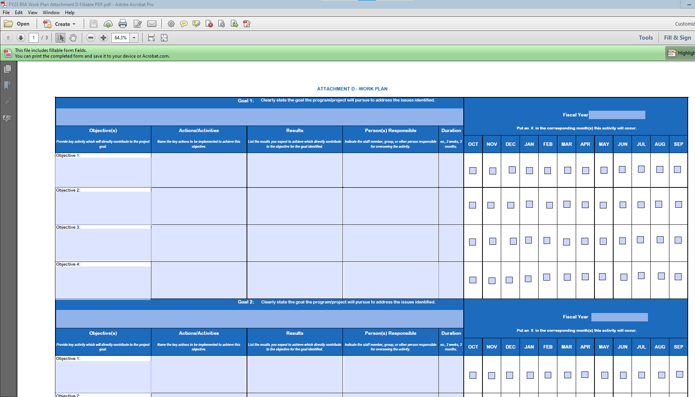
Work Plan (Attachment D)
The work plan template (see Attachment D) provided by DBH is required.

Slide 28
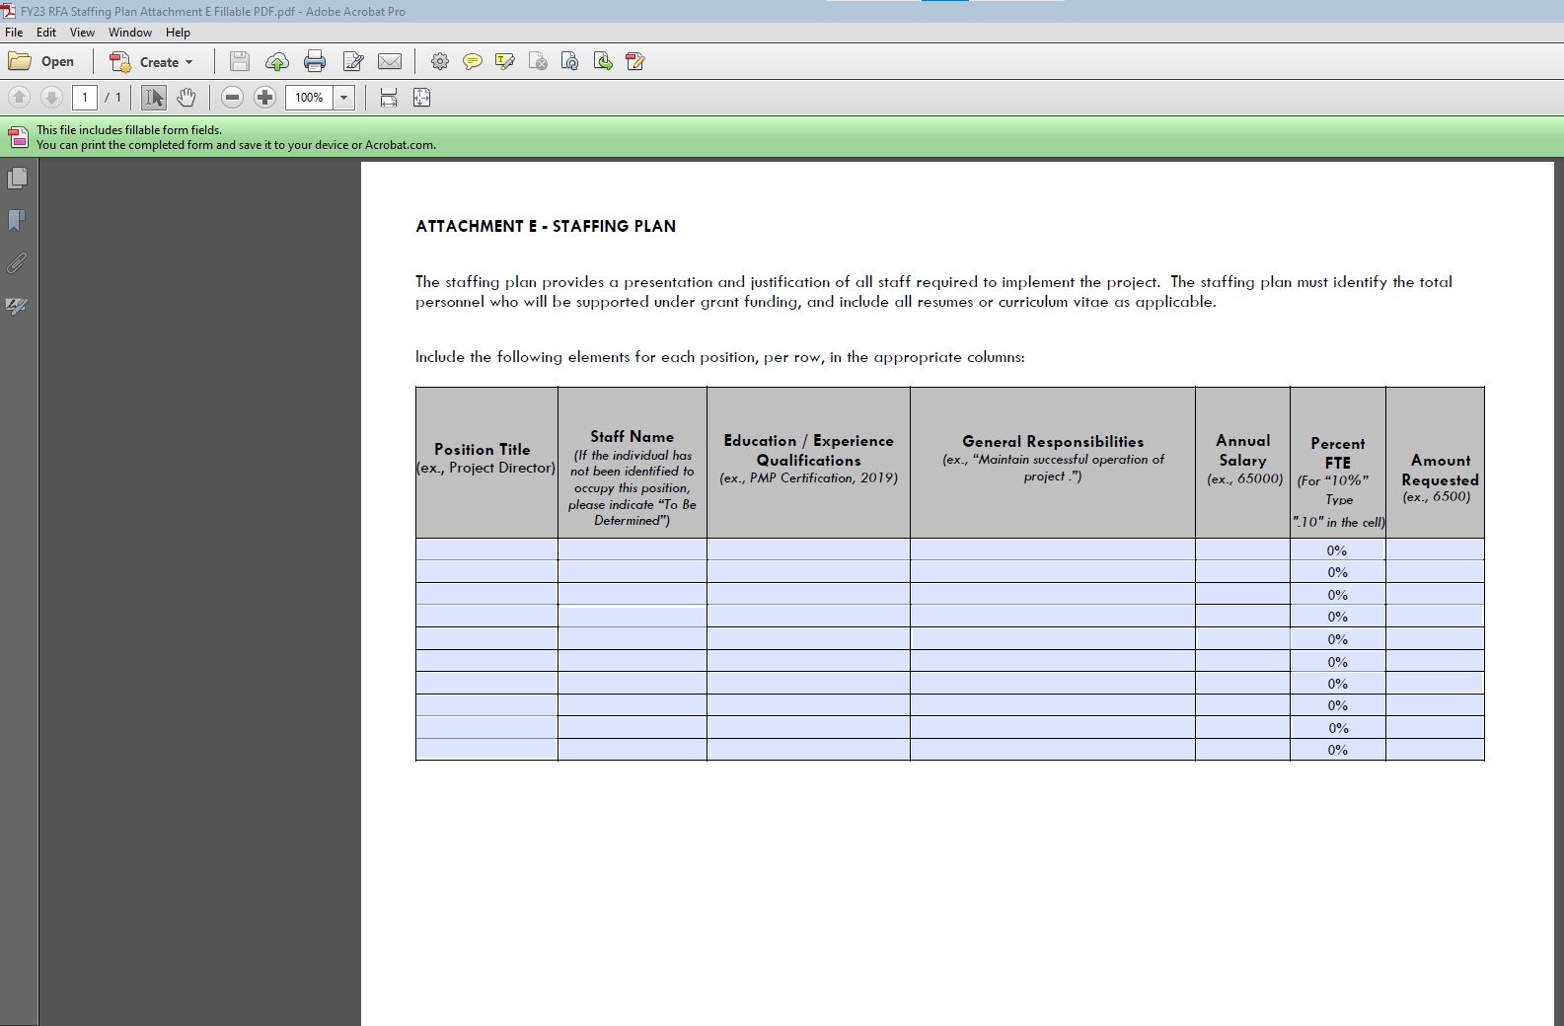
Staffing Plan (Attachment E)
The applicant’s staff plan template (see Attachment E) is required.

Slide 29
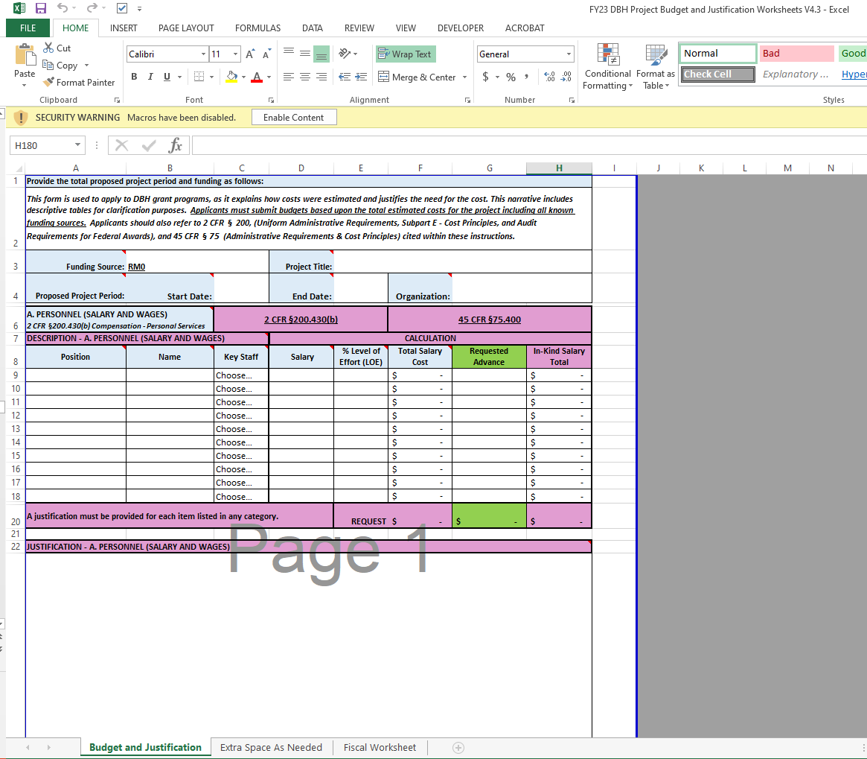
Project Budget and Justification (Attachment F)

Slide 30
Project Budget and Justification
The following categories and descriptions should be covered in the Budget/Justification:
  Personnel: Include the title of the position, name (or indicate vacancy), annual salary and level of effort (percentage of time) dedicated to this project.
  Fringe: Provide the position, name (or indicate vacancy), total fringe benefit rate used.
  Travel: Only local travel related to OTP and for the project staff will be approved in the grant budget. Provide purpose, destination, and type of travel.
  Equipment: Provide the item, quantity, amount, and percent charged to the grant.
  Supplies: Include the items being requested and rate. Description should also include how the supplies directly support the project.
  Contractual: Provide the name of entity and identify whether it’s a sub-recipient, contractor, consultant, or service. Also provide the entity’s rate.
  Other Direct Costs: List any costs not included in any of the other cost categories.
  Indirect Costs: Indirect costs should not exceed 10% of direct costs, unless the organization has a negotiated indirect cost rate agreement. Please reference 45 CFR §75.414.
  Program Income: If the possibility of generating program income as a result of DBH funding exists, list source and amount as budget line items.

Slide 31
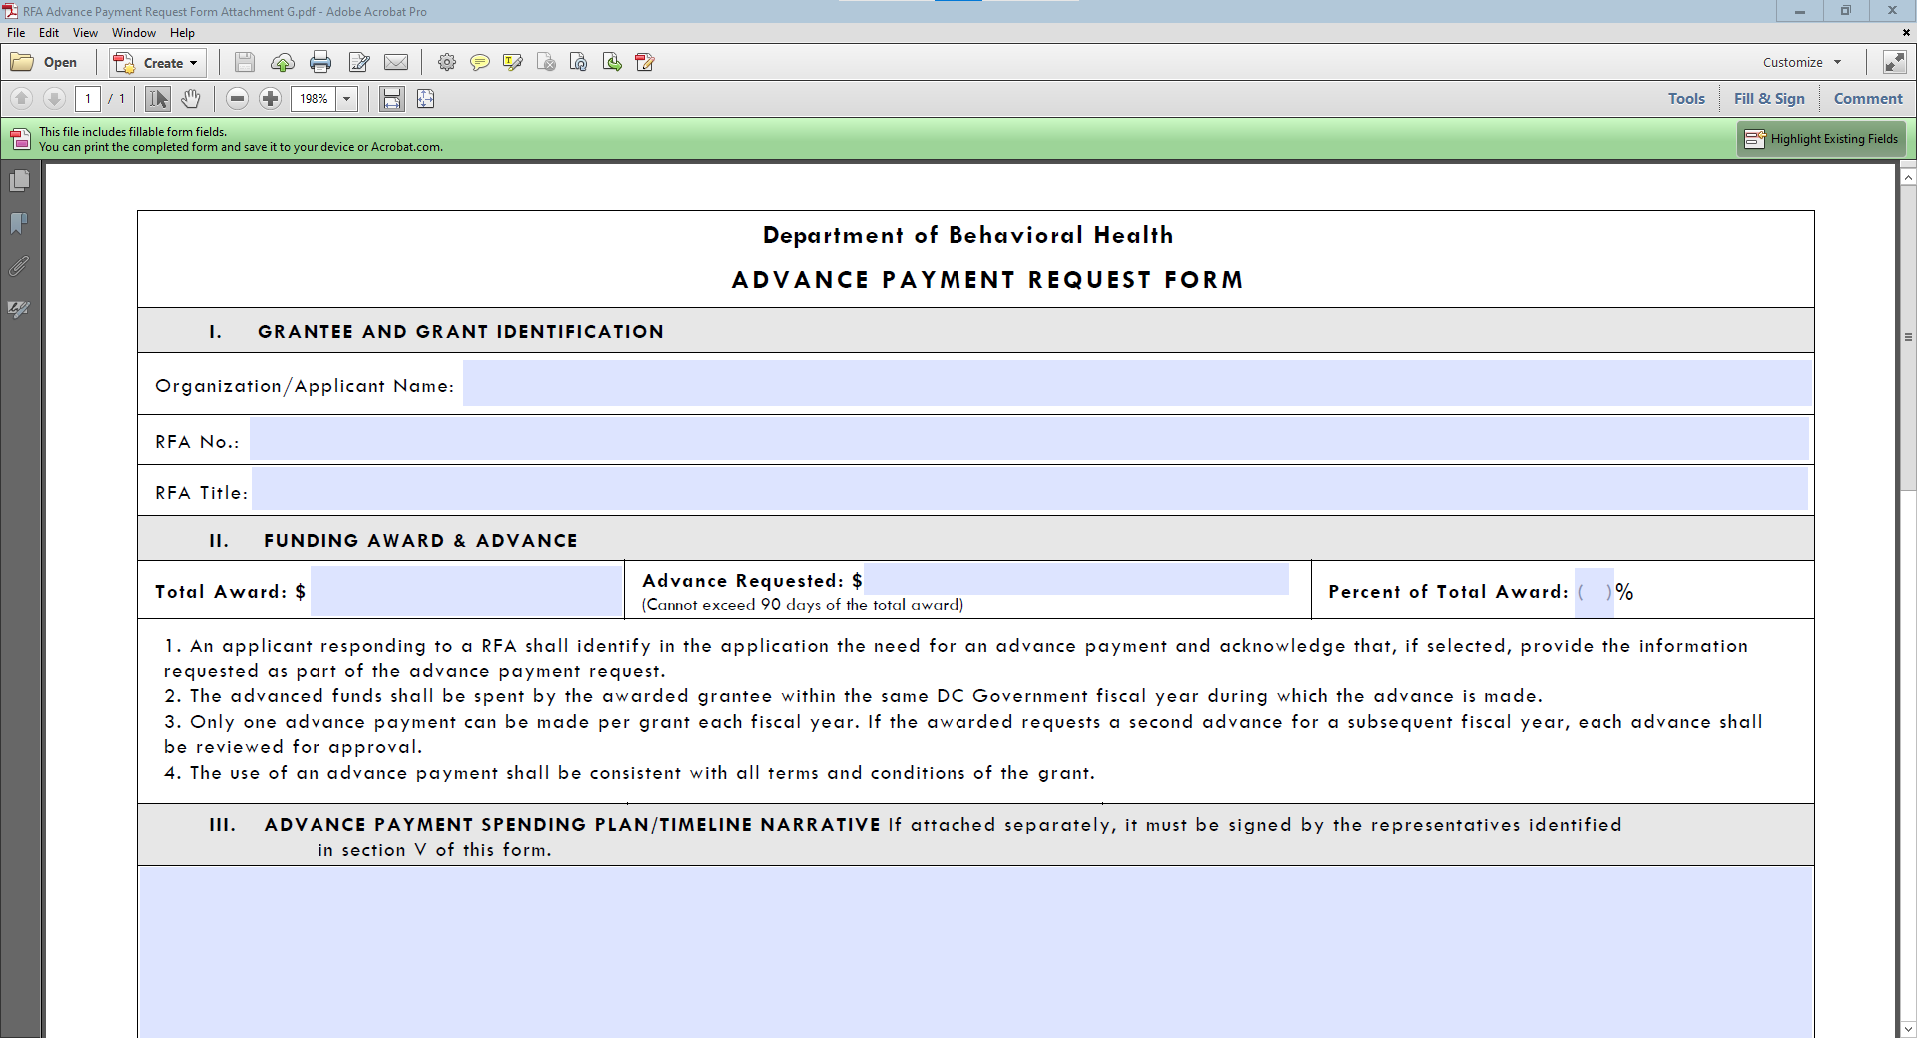
Advance Payment Form (Attachment G)

Slide 32
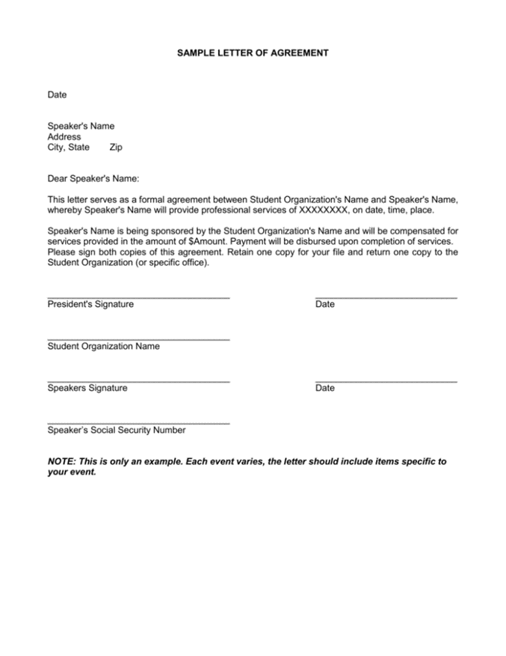
Letters of Agreement
(No Template Provided)

Slide 33
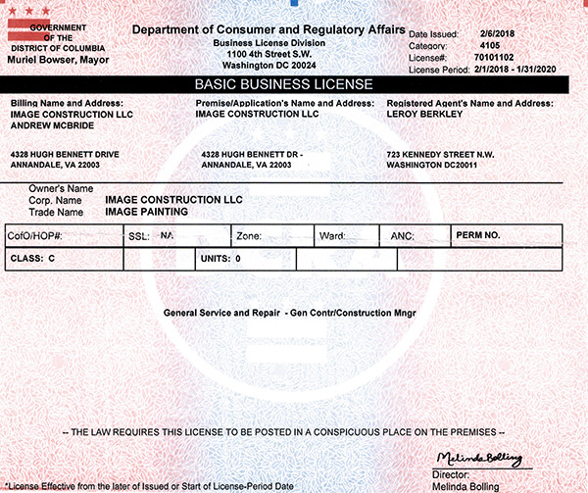
Business License

Slide 34
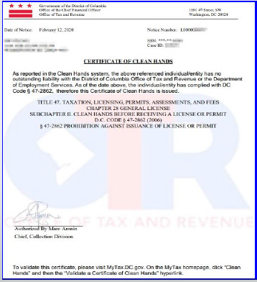
Clean Hands Certification
Self-Certification and Certificates of Good Standing will not be accepted.

Slide 35
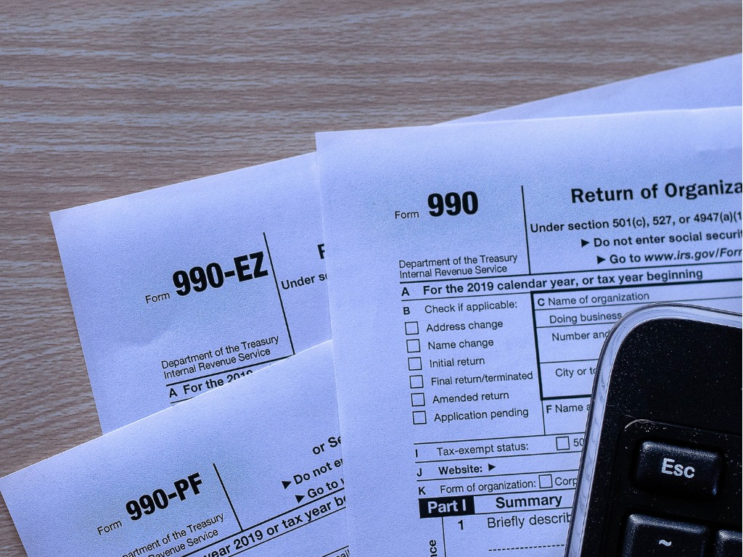
IRS 990 Form
(Non-Profits Only)
The applicant must submit the organization’s 990 form from the most recent tax year.
Please see https://www.irs.gov/forms-pubs/about-form-990
for more information.

Slide 36
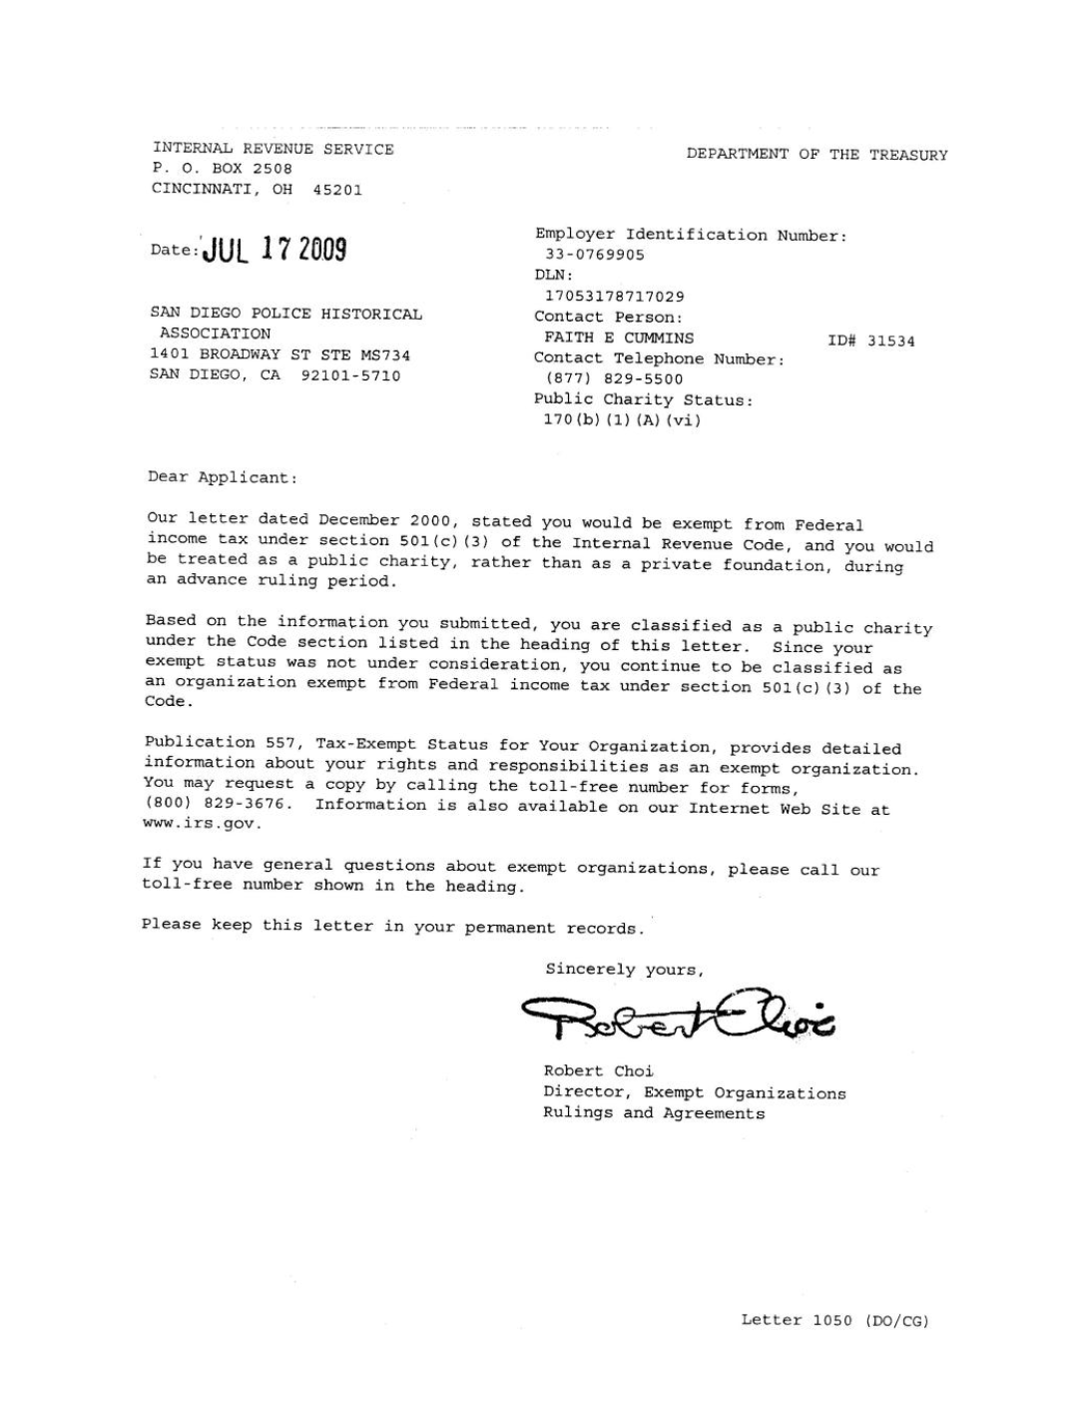

IRS Tax-Exempt Determination Letter & 501(c)(3) Letter
(Non-Profits Only)

Slide 37

RELIGIOUS ORGANIZATIONS
Best Evidence of IRS Tax Exemption Examples:
  A letter from the leader of the organization verifying that the organization is a religious group;
  A letter from the group’s board chair or similar official, verifying that the organization is a religious group;
  The applicant’s most recently submitted state sales or other tax exemption form, if it exists (Form 164 in the District of Columbia); or
  The state’s issued tax exemption certificate or card, if it exists. (See IRS publication no. 1828, Tax Guide for Churches and Religious Organizations).

Slide 38
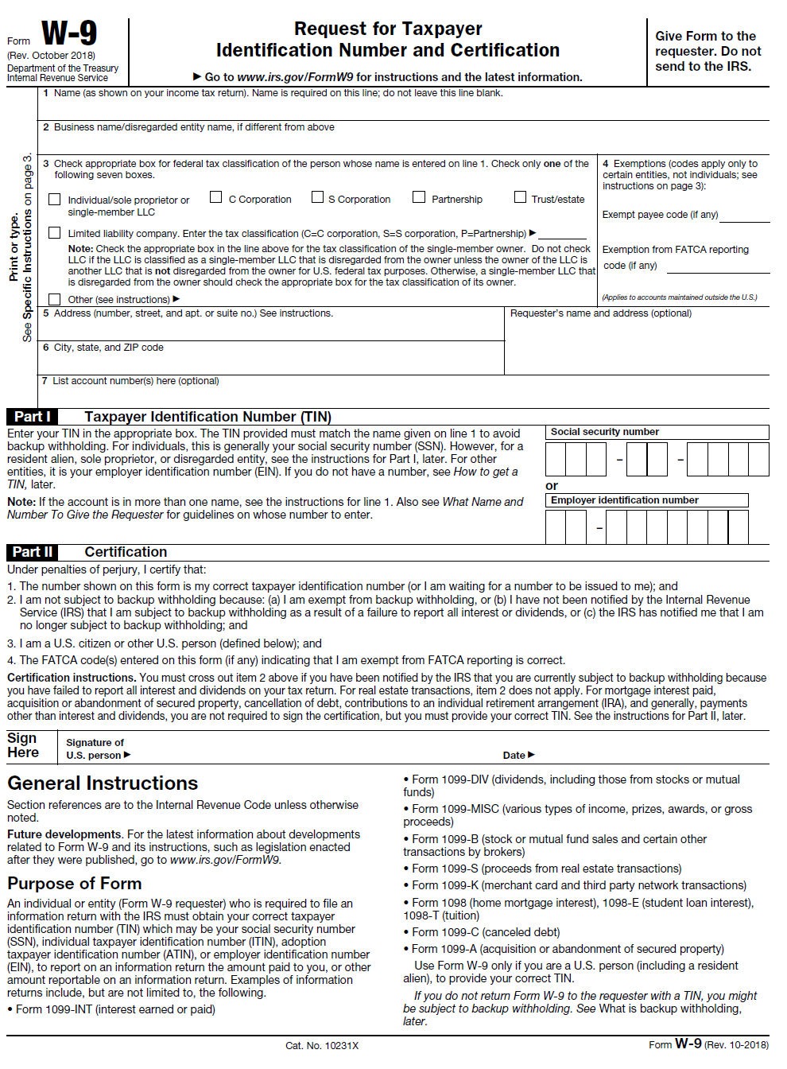
IRS W-9 Tax Form
CALENDAR YEAR 2023

Slide 39

Audited Financial Statements
If audited financial statements or reviews are not available, the applicant must provide:
    the Organizational Budget,
    Income Statement (Profit and Loss Statement),
    Certified Balance Sheet (certified by an authorized representative of the organization), and
    any letters, filings, etc. submitted to the IRS within the three (3) years before date of grant application.

Slide 40

Separation of Duties Policy
The applicant should state which of these situations apply and provide the following information
  Describe how financial transactions are handled and recorded;
  Provide the names and titles of personnel involved in handling money;
  Identify how many signatures the financial institution(s) require on the organization’s checks and withdrawal slips; and,
  Address other limits on staff and board members’ handling of the organization’s money.

Slide 41

Board of Directors
(No Template Provided)

Slide 42

System for Award Management (SAM) Registration
(Unique Entity ID )
Visit www.sam.gov for more information.

Slide 43

Partner Documents

Slide 44

Commercial, General Liability, Professional Liability, Comprehensive Automobile and Worker’s Compensation
During the term of the grant, all organizations will be required to obtain and keep in force insurance coverage as listed below and must provide in writing the name of all its insurance carriers and the type of insurance provided:
The Organization shall carry employer's liability coverage of at least one hundred thousand dollars ($100,000), if applicable.
The Organization shall carry bodily injury liability insurance coverage written on the comprehensive form of policy of at least five hundred thousand dollars ($500,000) per occurrence.
The Organization shall carry automobile liability insurance written on the comprehensive form of policy, if applicable. The policy shall provide for bodily injury and property damage liability covering the operation of all automobiles used in connection with performing grant activities. Policies covering automobiles shall provide coverage of at least two hundred thousand dollars ($200,000) per person and five hundred thousand dollars ($500,000) per occurrence for bodily injury and one hundred thousand dollars ($100,000) per occurrence for property damage.

Slide 45
Fillable Attachments 2 – 8 (pgs. 47-91)
Assurances, Certifications and Disclosures, pg. 76
Program Income and Financial Disclosure, pg. 81
DC Contribution and Solicitation Certification, pg. 83
Federal Assurances and Certifications, pg. 84
Tax Certification, pg. 89
Sub-Grantee Single Audit Certification, pg. 90
DBH Grant Terms and Conditions, pg. 91

Slide 46
CHECKLIST FOR RFA APPLICATION (p. 8-9)

Slide 47
Application Submission and Deadline (p. 26)
Applications Due: Friday, February 16, 2024 and must be submitted no later than 12:00 P.M. ET
Proper submission requires the applicant to attach all files as PDF’s and split documents within each as follows:
  File #1 – (Attachments A & C) Notice of Eligibility and Experience Requirements, Applicant Profile, Abstract, Table of Contents, and Project Narrative.
  File #2 – (Attachments D-F) Work Plan, Staffing Plan, and Budget & Budget Justification.
  File #3 – Letters of Agreement, Partner Documents, Business License, Active UEI Number, Certificate of Clean Hands, IRS Tax Exemption Letter, IRS W-9 Form, and IRS 990 Form.
  File #4 – Audited Financial Statements, Separation of Duties Policy, and Board of Directors.
  File #5 – (Attachment G & Attachments 2 - 8) Advance Payment Request Form* (if applicable), Attachment 2*, Attachment 3*, Attachment 4*, Attachment 5*, Attachment 6*, Attachment 7*, and Attachment 8*.
*These Attachments are in a fillable PDF. Complete the PDF, “Save As” with organization’s name, and send that PDF.

Slide 48
Review and Scoring (p. 25)
Application submissions will be confirmed according to the date and time received in the Grants inbox.
*An automated reply email message will be sent to the submitting email address confirming only the “receipt” of a submission.

Slide 49
Remember!
Read the entire RFA, including the attachments!
The last opportunity to submit questions is Friday February 9 , 2024, one week prior to the RFA’s closing. (February 16, 2024)
(When emailing questions please copy DBH.Grants@dc.gov )
Before submitting, review the Checklist found on pages 8-9 and the Submission Requirements found on pg. 25.
Have a second reader to review your application before submitting.
Don’t wait until the last minute to submit!

Slide 50
Remember!
RFA and Attachments can be found on either the Mayor’s Office of Community Affairs or Department of Behavioral Health websites:
  https://communityaffairs.dc.gov/content/community-grant-program#4
  https://dbh.dc.gov/page/request-applications-01
Complete and sign attachments as requested.
Email subject line should include RFA # and File #.
Applications are to be emailed to DBH.Grants@dc.gov
Meet the submission deadline by Friday, February 16, 2024 at 12:00PM

Slide 51
Upcoming Key Dates
FAQ Submission Deadline: Friday, February 9, 2024
Application Submission Deadline: Friday, February 16, 2024
by 12:00 PM ET
Anticipated Award Start Date: Thursday, February 29, 2024

Slide 52
Program Contact Information
Charneta C. Scott, Ph.D.
Project Manager, Prevention and Early Intervention Division
charneta.scott@dc.gov
Tywana Reed
Fiscal Management Office
tywana.reed@dc.gov
Renee Evans Jackman
Grants Management Office
(202) 673-3536
renee.evans@dc.gov

Slide 53
QUESTIONS ?

Slide 54
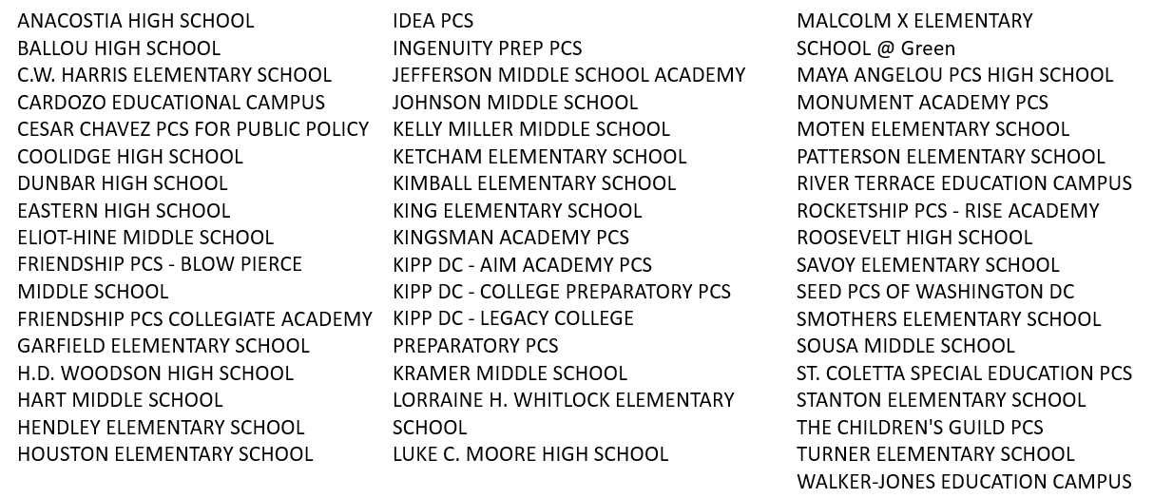
Cohort 1 Schools

