Slide 1
District of Columbia
Department of Behavioral Health (DBH)
Pre-Application Conference
Friday, August 8, 2025 | 10:00 a.m. - 11:00 a.m.

Slide 2
District of Columbia
Department of Behavioral Health (DBH)
Pre-Application Conference
RFA Number: RM0 SBH072525_Pilot 1B Continued
RFA Title: FY26 School Behavioral Health Services Comprehensive Expansion

Slide 3
Today’s Agenda
Welcome
Presenters
Charneta C. Scott, Ph.D.
Renee Evans Jackman
General Information
Overview, Background, and Purpose
Award Information
Source of Grant Funding, Award Funding Available and Performance and Funding Period
Eligibility Requirements
Performance Requirement
Experience Criteria, Target Population, Location of Services, Scope of Services and Scope of Work
Application Requirements
Project Narrative
Evaluation Criteria
Successful Packaging
Additional /Fillable Attachments
Evaluation Criteria & Helpful Information
Key Dates, RFA Checklist, Tips and Contact Info
Questions & Answers

Slide 4



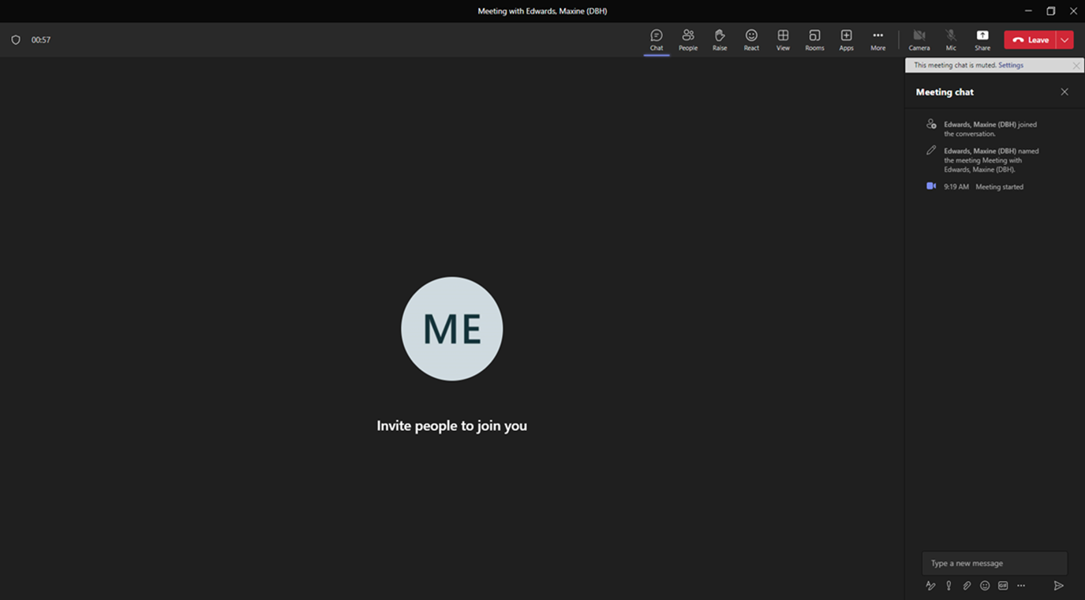




Please Note:

Slide 5
Overview (pgs. 10-11)
The Government of the District of Columbia, Department of Behavioral Health, Child, Adolescent, and Family Services is soliciting applications from current DC public charter Local Education Agencies (LEAs) awarded to hire a full-time or part-time licensed clinician to implement the Comprehensive School Behavioral health model in the LEA’s selected schools. The purpose of the Comprehensive School Behavioral health model is to provide school-based behavioral health services in District of Columbia Public Charter Schools (DCPCS).
A current Pilot 1B DC public charter LEA awarded under DBH RM0 SBH102723 may apply to recruit and hire either a full-time or part-time licensed clinician based on its assessment of school need. The school-hired, licensed clinician shall be responsible for providing prevention, early intervention and treatment services. This position is to supplement and not supplant existing school behavioral health services and the services provided by the licensed clinician are not identified in an IEP nor 504 Plan. School leadership must ensure that the licensed clinician receives clinical supervision in alignment with the clinician's licensing board requirements.
Core funding for a full-time licensed clinician is $120,000. A full-time clinician provides services 40 hours per week in one school. However, it is allowed to request funding for a part-time clinician. For a part-time clinician providing services 20 hours per week in one school, the core funding is $60,000. If the DBH grant-funded clinician is not hired by November 15, 2025, the LEA must return the funds back to DBH. The total amount for FY26 is $960,000. The ceiling amount of the awards is $240,000.
This solicitation includes one (1) application opportunity.

Slide 6
Purpose (pg. 13)
DBH will allocate funding to develop and further expand the District’s Comprehensive School- Based Behavioral Health System in the District’s schools. The school behavioral health services will be aligned with the behavioral health unmet needs/gaps within the school. And the array of services include prevention, early intervention and treatment. The selected LEAs/schools will participate in the overall evaluation of the implementation.

Slide 7
Purpose (pg. 14)
Each School Behavioral Health Program (SBHP) licensed Clinician will partner with the school behavioral health team to develop the school-centric assessment and School Strengthening Work Plan (SSWP) for the school to incorporate the following:
At a minimum meet with school wellness/behavioral health team bi-weekly for the duration of the school year. The clinician should inform his/her supervisor if the team meets less frequently than bi-weekly.
At a minimum identify and implement three (3) activities focused on engagement and integrating into the school. Engagement activities may include sending a letter home to parents with a picture, classroom introductions, and introduction presentations at Back to School Night, etc.
At a minimum frequency of weekly, implement an evidence-based program or a created prevention curriculum targeting students’ needs throughout the academic year (August thru June) with a change in programming to be conducted at a minimum frequency of quarterly. The programming should vary in both grade level and/or content. At least one (1) evidence-based program shall be implemented during the school year. Evidence-based programs are to be completed to fidelity. Any changes to programming identified on the School Strengthening Work Plan (SSWP) should be discussed with the supervisor.

Slide 8
Purpose, cont’d (pg.14)
At a minimum implement two (2} early intervention groups throughout the school year. The groups can meet weekly for one month, biweekly for two months, or meet for the duration of the school year. (Note: Minimum number of early intervention group sessions is four (4) sessions)
At a minimum conduct one (1) teacher workshop during each quarter (Note: Clinician will inform supervisor if the school does not allow staff workshops/Professional Development sessions to be delivered by the clinician).
At a minimum, the clinician will facilitate one (1) parent workshop or participate/support a school sponsored parent activity each school quarter.
7. Clinicians will have a treatment caseload of at least 15 students and a maximum of 25 students for more than half of the school year. The clinicians will meet with the students according to their treatment plans.

Slide 9
Source of Grant Funding & Award Funding Available (pg.11)
Source of Grant Funding for competition is made available from District of Columbia Local Appropriated Funds.
This RFA will make available $960,000 for up to six (6) awards.

Slide 10
Eligibility Requirements (pg. 11)
Eligible entities who can apply for grant funds under this RFA are/have:
1. A LEA awarded under DBH RM0 SBH102723.

Slide 11
Performance Requirements (pgs. 14-15)
Experience Criteria
Those applying should meet the following criteria:
Have demonstrated experience providing school-based prevention, early intervention and treatment services based upon the needs of the school.
Have demonstrated experience to quickly recruit and select licensed clinicians and clinical supervisors who are dedicated to providing culturally and linguistically competent services to children and their families.
Have demonstrated clinical supervisory experience and capacity to supervise the prevention, and early intervention and treatment services within the comprehensive school behavioral health model.
Have demonstrated experience collecting and reporting utilization, outcome data, and supervision activities. Demonstrated ability to meet deadlines related to data reports weekly, monthly, quarterly, annually, and as needed.
Have demonstrated experience complying with grant reporting requirements and program evaluation.

Slide 12
Target Population (pg. 15)
The target populations will include students in traditional DC Public Charter Schools.

Slide 13
Location of Services (pg. 15)
Services associated with this grant must take place in the District of Columbia. While most services are provided onsite in a school building, clinicians need to be flexible as some services may be implemented in the home setting.

Slide 14
Scope of Services (pg. 15)
A current Pilot 1B DC public charter Local Education Agency (LEA) may apply to provide services based on the LEA’s current schools selected for Pilot 1B to recruit and hire either a full-time or part-time licensed clinician based on its assessment of school need. The school-hired, licensed clinician shall be responsible for providing prevention, early intervention and treatment services. This position is to supplement and not supplant existing school behavioral health services and the services provided by the licensed clinician are not identified in an IEP nor 504 Plan. School leadership must ensure that the licensed clinician receives clinical supervision in alignment with the clinician's licensing board requirements. If the DBH grant-funded clinician is not hired by November 15, 2025, the LEA must return the funds back to DBH.
Licensed clinicians shall provide school-based behavioral health services that are aligned with the Public Health Model which include prevention, early intervention, and treatment. Examples of prevention and early intervention include but are not limited to teacher and parent workshops, whole classroom delivery of evidence-based manualized curriculums, and small groups such as social skills building and problem-solving groups.

Slide 15
Scope of Work (Pgs. 15-16)
Data Collection and Reporting
Grantees will be required to collect, track, and report information on all grant activities, services provided, and individuals served.
Reporting Frequency ranges from daily to monthly depending on the data being reported and prescribed by DBH. Grantee shall report on grant activities utilizing the form/format prescribed by DBH and within the timeframe prescribed by DBH for the data being reported.
Grantees will be required to collect, track, and report information on all grant activities, services provided, and individuals served.
I. Daily reporting includes clinician service activity which is reported through the SBHP Activity Tracker.
II. Weekly Staffing reports shall consist of administrative data including hiring date of clinician(s), clinician resignation dates, school assignments, level of licensure , date of clinician placement in school, and schools pending clinician hire. The Weekly Staffing Report shall include the clinicians’ email and phone number and assigned supervisor, supervisors’ credentials and email address, and noting if the clinician speaks another language other than English. The Weekly Staffing reports are due to DBH each Monday by 12:00 PM.
III. Supervisors’ Monthly reports include Supervisor Activity Logs outlining supervisory activities within the provided supervision framework and meetings with school leadership. These activity logs are entered in the SBHP Activity Tracker and must be entered by the 15th day of the following month.
IV. Monthly Expenditure reports along with supporting documentation for allowable costs, are to be submitted to the Monitor by the 15th of the month.

Slide 16
Scope of Work (Cont’d) (Pg. 16)
When a staffing change occurs, a personnel amendment form must be submitted to the Monitor immediately.
Monthly report of billing/claims submitted for reimbursement for School Behavioral Health Services are to be submitted to the Monitor by the 15th of the month.
The Grantee shall adhere to the DBH Policy 480.1A, Reporting a Major Unusual Incident (MUI) and an Unusual Incident (UI), and any succeeding policy, for reporting major unusual incidents and unusual incidents to DBH. Clinicians and supervisors will be trained in how to access and complete required reporting in the DBH E-Risk system. Please note that for each suicidal/homicidal risk assessment completed, an MUI report is required.
Clinicians shall complete an initial Child and Adolescent Functional Assessment Scale (CAFAS)/Preschool and Early Childhood Functional Assessment Scale (PECFAS) outcome tool for each child or youth on the treatment caseload. Follow-up assessments must be completed every 90 days and at discharge.

Slide 17
Scope of Work (Cont’d) (Pgs. 16-17)
Data Collection and Tracking
Grantees will be responsible for ensuring that all individuals who received services under this funding opportunity were serviced within the provided supervision framework.
Grantees must also be able to internally track required reporting, expenditure data, and grantee performance (e.g. service delivery data, accomplishments, challenges).
Grantees must be able to track the cost of any services provided, billed and reimbursed.

Slide 18
Project Narrative (pg. 17)
Organizational Capacity - Applicants should include the following information to highlight their experience and capacity to maintain the grant activities:
1. Identify the staff member responsible for maintaining services and oversight and provide organizational chart.
2. Identify the licensed clinician and licensed, clinical supervisor in alignment with the clinician's licensing board’s requirements, the credentials, responsibilities and roles of persons who will implement the school behavioral health program. Include position descriptions, copies of licenses, and resumes for the identified individuals. If staffing is not yet established, discuss the plan to ensure staff are in place by November 15, 2025.

Slide 19
Project Narrative (pg. 17)
B. Project Need - Briefly outline how the organization will maintain the initiative in service of the goal and objectives.
  Describe the understanding of clinical supervision structure, supervisor capacity to provide supervision, and the importance of the license of supervisor aligning with the clinician's licensing board's requirements.
  Describe the school’s strategies for implementing the school behavioral health services utilizing a culturally and linguistically competent approach.
  Describe the school’s experience complying with submitting required outcome data and tools.
  Describe a plan to address promotion of mental health literacy and why there is a need to enhance mental health literacy in students and their parents/caregivers.
  Describe major school behavioral health challenges currently facing students and identify targeted strategies to address those school behavioral health challenges.
  Describe a plan designed to enhance students' feelings of connection to their peers, teachers, and the school community.

Slide 20
Project Narrative (pgs. 17-18)
Project Description
1. Outline the process measures and targets to be used to track grant funds that will support the school to provide interventions and supports integral to a multi-tiered school- based behavioral health program, including but not limited to, teacher and parent consultation; whole classroom delivery of evidence-based manualized curriculum; social skills- building and problem-solving groups; school team meetings; care coordination, and crisis management.

Slide 21
Evaluation Criteria (pgs. 23-24)
Indicators have been developed for each review criterion to assist the applicant in presenting pertinent information and to provide the reviewer with a standard for evaluation. The five review criteria are outlined below with specific detail and scoring points. These criteria are the basis upon which the reviewers will evaluate the application. The entire proposal will be considered during objective review.

Slide 22
Evaluation Criteria (Cont’d)
  Criterion 1: Capacity (Corresponds to Organizational Capacity Section) – 20 points
  Applicants should:
  The applicant identified the staff member responsible for maintaining services and oversight and provided organizational chart. (10 points)
  The applicant identified the licensed clinician and licensed, clinical supervisor in alignment with the clinician's licensing board's requirements, the credentials, responsibilities and roles of persons who will implement the school behavioral health program. Included position descriptions, copies of licenses, and resumes for the identified individuals. If staffing is not yet established, discussed the plan to ensure staff are in place by November 15, 2025. (10 points)
Criterion 2: Need (Corresponds to Project Need Section) – 60 points
1. The applicant described the understanding of clinical supervision structure, supervisor capacity to provide supervision, and the importance of the license of supervisor aligning with the clinician's licensing board's requirements. (10 points)
2. The applicant described the school’s strategies for implementing the school behavioral health services utilizing a culturally and linguistically competent approach. (10 points)
3. The applicant described the school’s experience complying with submitting required outcome data and tools. (10 points)
4. The applicant described a plan to address promotion of mental health literacy and why there is a need to enhance mental health literacy in students and their parents/caregivers. (10 points)
5. The applicant described the major school behavioral health challenges currently facing students and identify targeted strategies to address those school behavioral health challenges. (10 points)
6. The applicant described a plan designed to enhance students' feelings of connection to their peers, teachers, and the school community. (10 points)

Slide 23
Evaluation Criteria (Cont’d)
  Criterion 3: Strategic Approach (Corresponds to Project Description Section) – 10 points
  The applicant outlined the process measures and targets to be used to track grant funds that will support the school to provide interventions and supports integral to a multi-tiered school-based behavioral health program, including but not limited to, teacher and parent consultation; whole classroom delivery of evidence-based manualized curriculum; social skills- building and problem-solving groups; school team meetings; care coordination, and crisis management. (10 points)
  Criterion 4: Project Budget and Justification – 10 points
  1. The applicant provided a line-item budget and budget narrative justification regarding the school's rate for Personnel, Prevention, Early Intervention activities (including sub-contractual agreements, or consultants, if applicable). (10 points)

Slide 24
Application Scoring (pgs. 24-25)
Pre-Screening Technical Review
All submitted applications will initially be reviewed by DBH Grants Management Office personnel for completeness, formatting, and eligibility requirements prior to being forwarded to the review panel. Applications that did not adhere to the complete guidance, formatting provided, and eligibility requirements will be considered “Incomplete”, and will not advance to be reviewed. You may not request updates to this process, as DBH will notify applicants of all results after the review panel has closed.
Review Panel
The review panel will be composed of neutral, qualified, professional individuals who have been selected for their unique experiences in behavioral health fields, and the administrative requirements mandated by the source of funds, as applicable. The panel will review, score and rank each applicant’s proposal based on the criteria outlined in the RFA. Reviewers are required to provide a summary of strengths and weaknesses found in the application.
Internal Review Panel
DBH program managers will evaluate the individual and summary recommendations of the review panel. Program Managers will weigh the results of the review panel against other factors such as but not limited to; a past performance review, risk assessment and eligibility assessment, including a review of assurances and certification, and business documents submitted by the applicant, as required in the RFA in making the final decision.

Slide 25

Successful Packaging

Slide 26
Proposal Format and Content
  Notice of Eligibility and Experience Requirements (Attachment A) (Fillable-Word)
  Applicant Profile & Abstract (Attachment C) (Fillable-Word)
  Table of Contents
  Narrative
      Administrative
      Proposed Work Plan
      Fiscal and Financial Management
      Program Reporting
  Work Plan Template (Attachment D) (Fillable-PDF)
  Staffing Plan (Attachment E) (Fillable-PDF)
  Budget and Budget Justification (Attachment F) (Fillable-Excel)
  Required Documentation (see RFA pages 17 - 22)
  Signed Attachments 2 – 8 (Fillable-PDF)

Slide 27
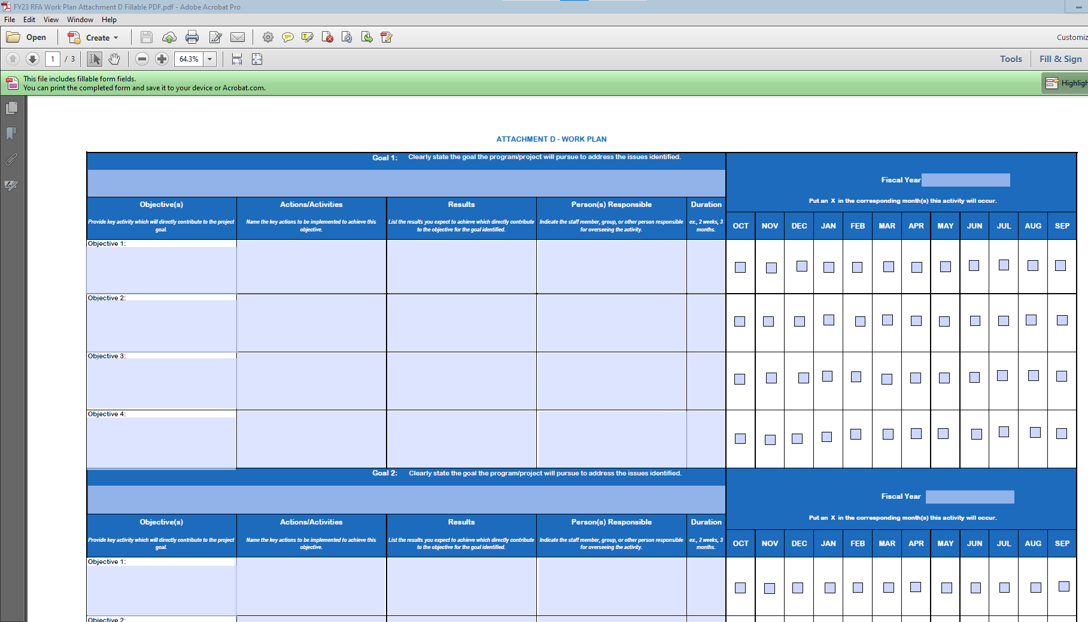
Work Plan (Attachment D)
The work plan template (see Attachment D) provided DBH is required.

Slide 28
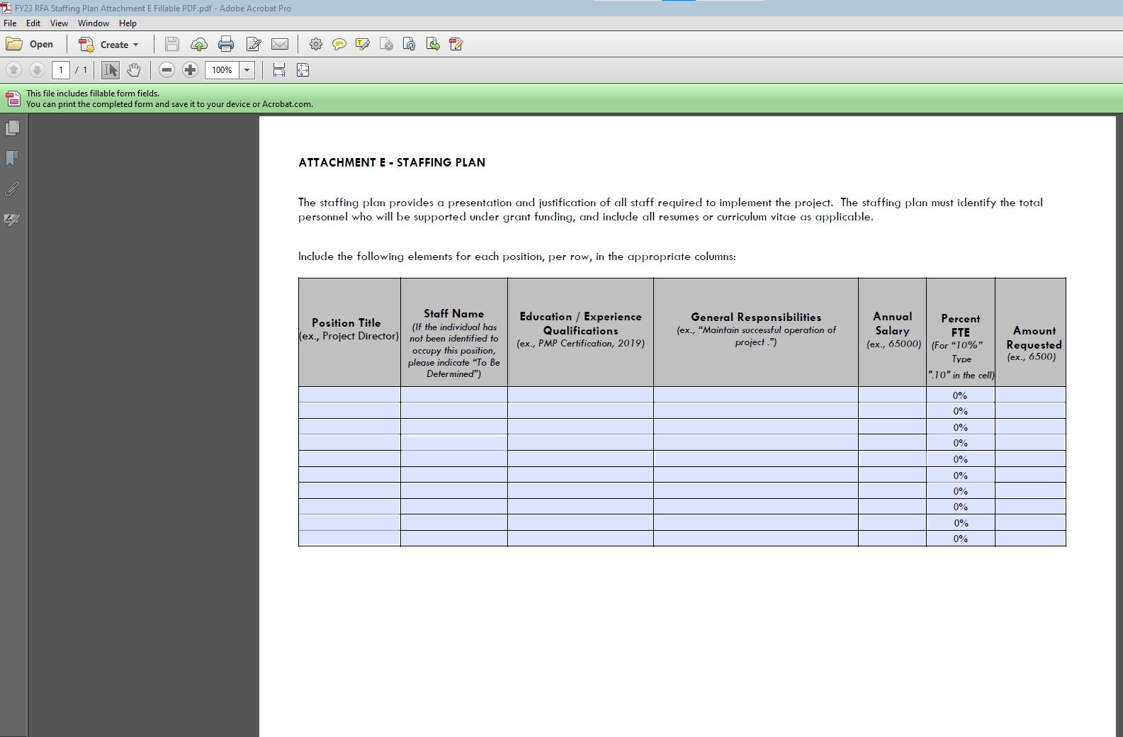
Staffing Plan (Attachment E)
The applicant’s staff plan template (See Attachment E) is required.

Slide 29
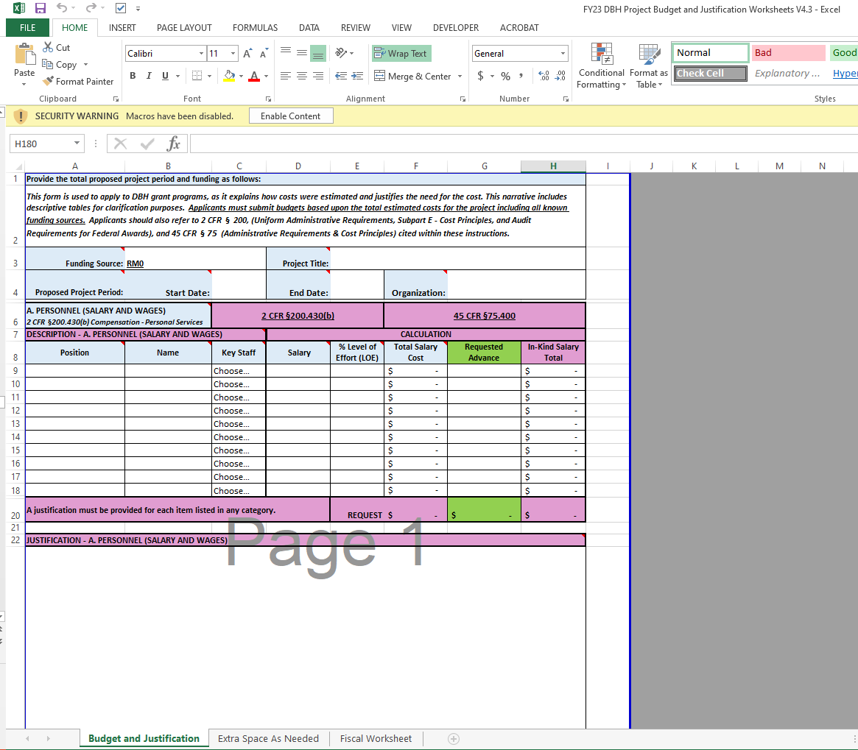
Project Budget and Justification (Attachment F)

Slide 30
Project Budget and Justification (pg.19)
The following categories and descriptions should be covered in the Budget/Justification:
  Personnel: Include the title of the position, name (or indicate vacancy), annual salary and level of effort (percentage of time) dedicated to this project.
  Fringe: Provide the position, name (or indicate vacancy), total fringe benefit rate used.
  Travel: Only local travel related to OTP and for the project staff will be approved in the grant budget. Provide purpose, destination, and type of travel. (Not applicable to this grant)
  Equipment: Provide the item, quantity, amount, and percent charged to the grant. (Not applicable to this grant)
  Supplies: Include the items being requested and rate. Description should also include how the supplies directly support the project. (Not applicable to this grant)
  Contractual: Provide the name of entity and identify whether it’s a sub-recipient, contractor, consultant, or service. Also provide the entity’s rate.
  Other Direct Costs: List any costs not included in any of the other cost categories.
  Indirect Costs: Indirect costs should not exceed 10% of direct costs, unless the organization has a negotiated indirect cost rate agreement. Please reference 45 CFR §75.414.
  Program Income: If the possibility of generating program income as a result of DBH funding exists, list source and amount as budget line items.

Slide 31
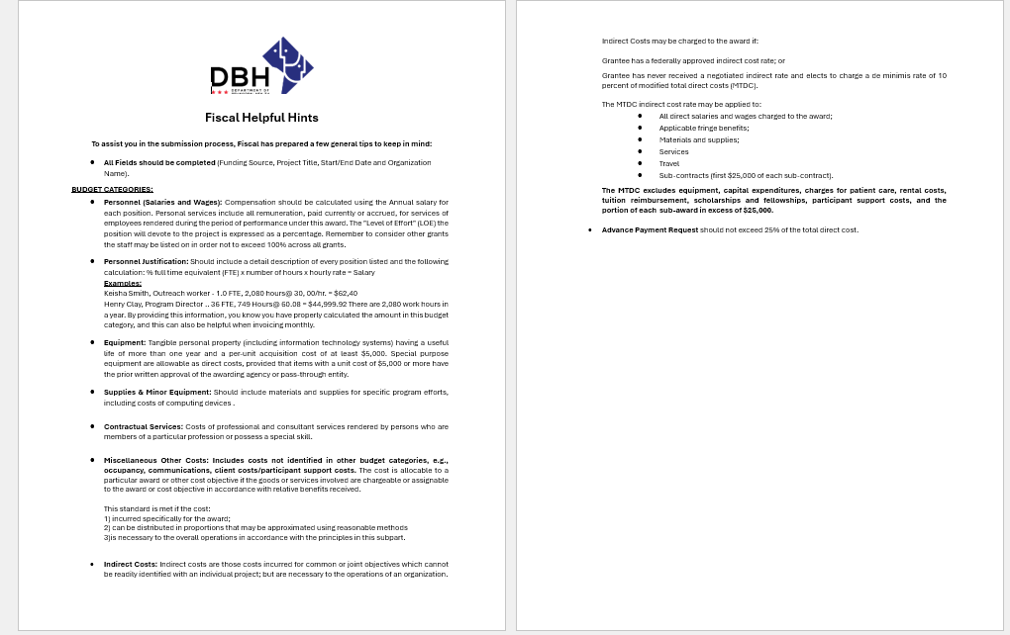
Fiscal Helpful Hints

Slide 32
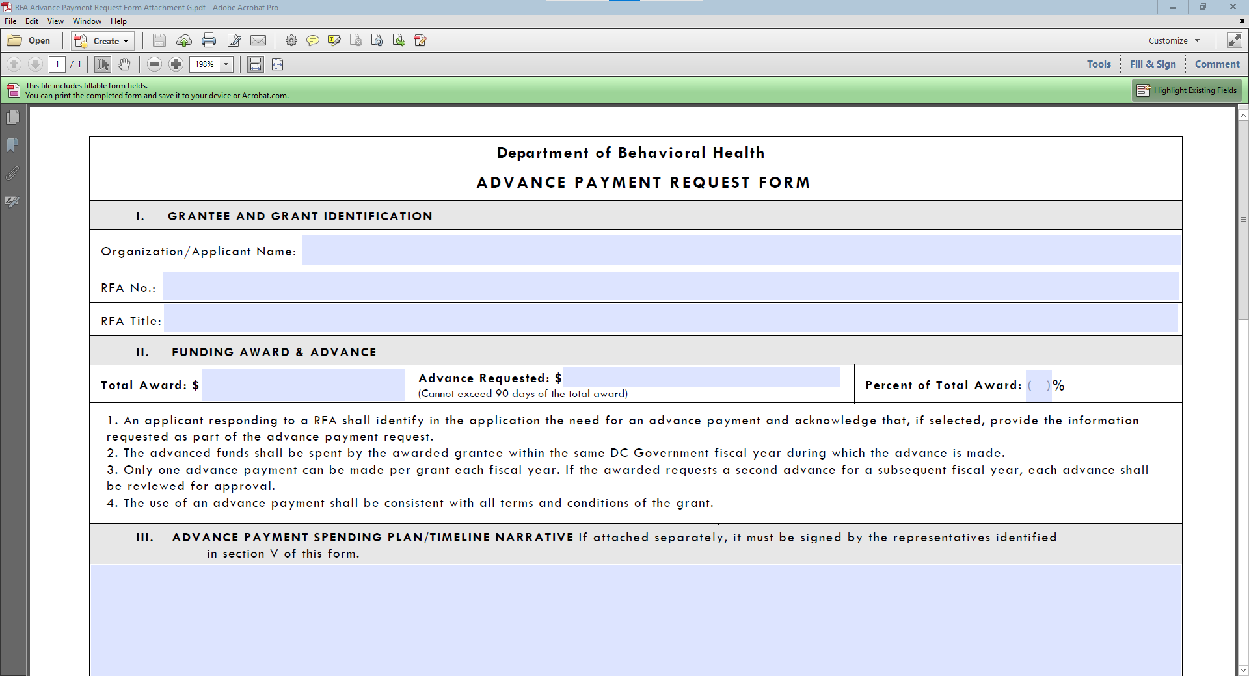
Advance Payment Form (Attachment G)

Slide 33
Advance Payment
An applicant seeking an advance, must submit a completed Advance Payment Request form (Attachment G) with the submitted application and be signed by the organization’s Chair of the Board of Directors and Executive Director, or equivalent positions. Applicants must detail the amount requested per budget category in the budget and justification (see Attachment F).
Advance payments are optional and an applicant is not required to submit the Advance Payment Request form. Failure to submit an Advance Payment Request form with the application eliminates the consideration for an advance payment. An advance payment will not be provided without prior official request and approval.
  Please note: The advance payment for the grant should not exceed 25% of the total grant amount.

Slide 34
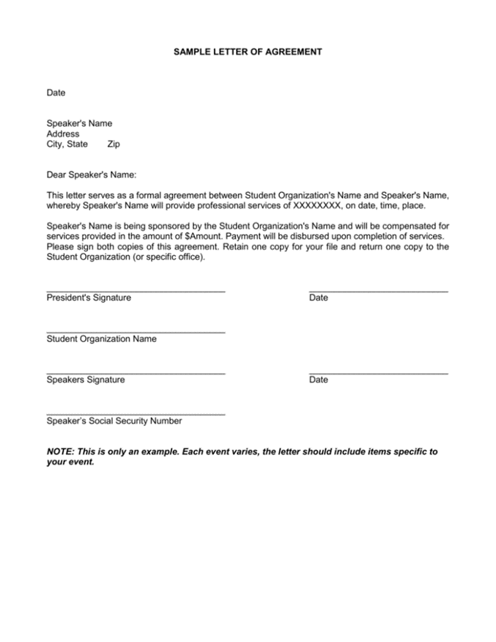
Letters of Agreement
(No Template Provided)

Slide 35
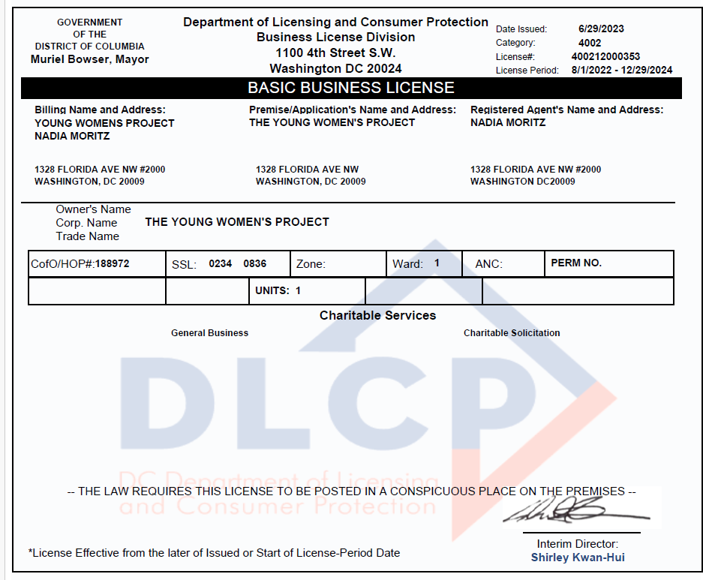

Business License

Slide 36
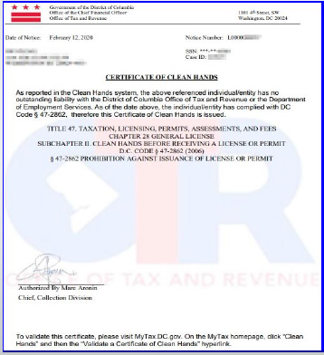
Clean Hands Certification
Each applicant must submit a current Clean Hands Certification from the District of Columbia Office of Tax Revenue. DBH requires that the submitted Clean Hands Certification reflect a date within a thirty-day period immediately preceding the application’s submission. Self-Certification is not acceptable.

Slide 37
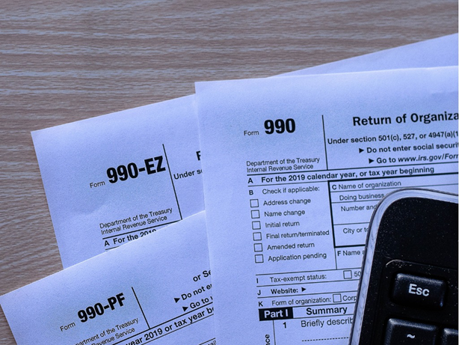
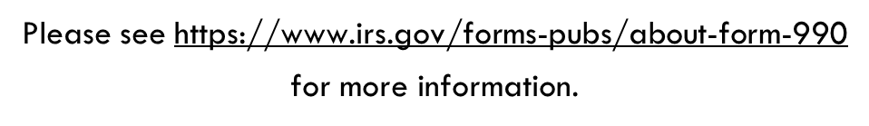
IRS 990 FORM
(Non-Profits Only)
The applicant must submit the organization’s 990 form from the most recent tax year.

Slide 38
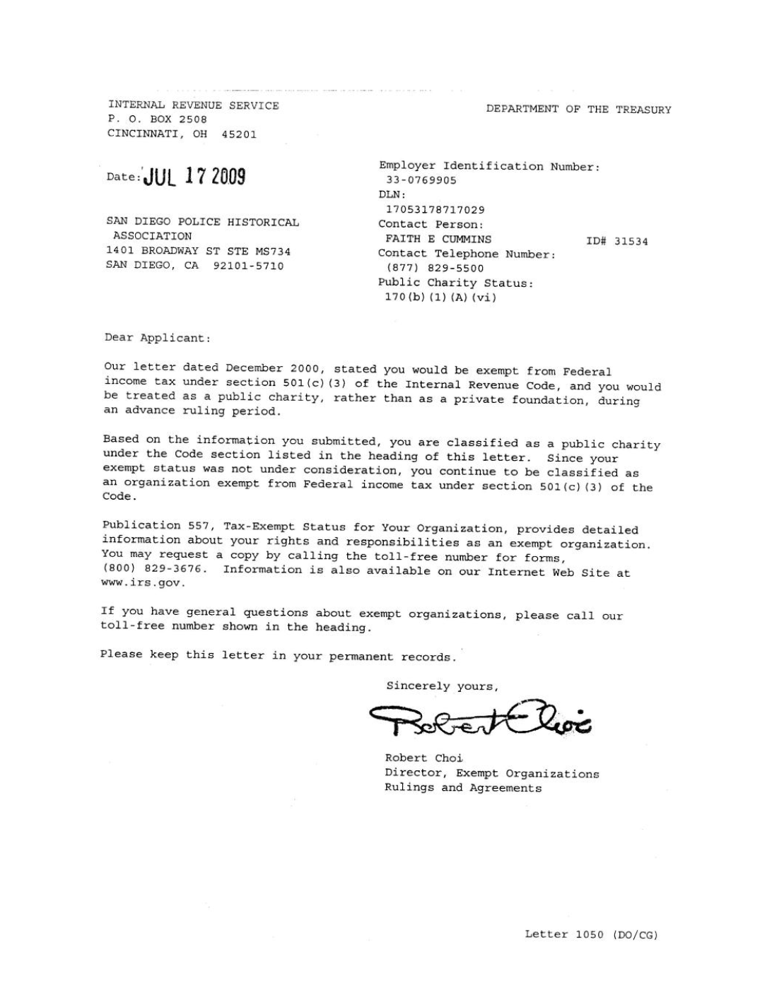

IRS Tax –Exempt Determination Letter & 501 (c)(3) Letter (Non-Profits Only)

Slide 39

Religious Organizations
Best Evidence of IRS Tax Exemption Examples:
  A letter from the leader of the organization verifying that the organization is a religious group;
  A letter from the group’s board chair or similar official, verifying that the organization is a religious group;
  The applicant’s most recently submitted state sales or other tax exemption form, if it exists (Form 164 in the District of Columbia); or
  The state’s issued tax exemption certificate or card, if it exists. (See IRS publication no. 1828, Tax Guide for Churches and Religious Organizations).

Slide 40
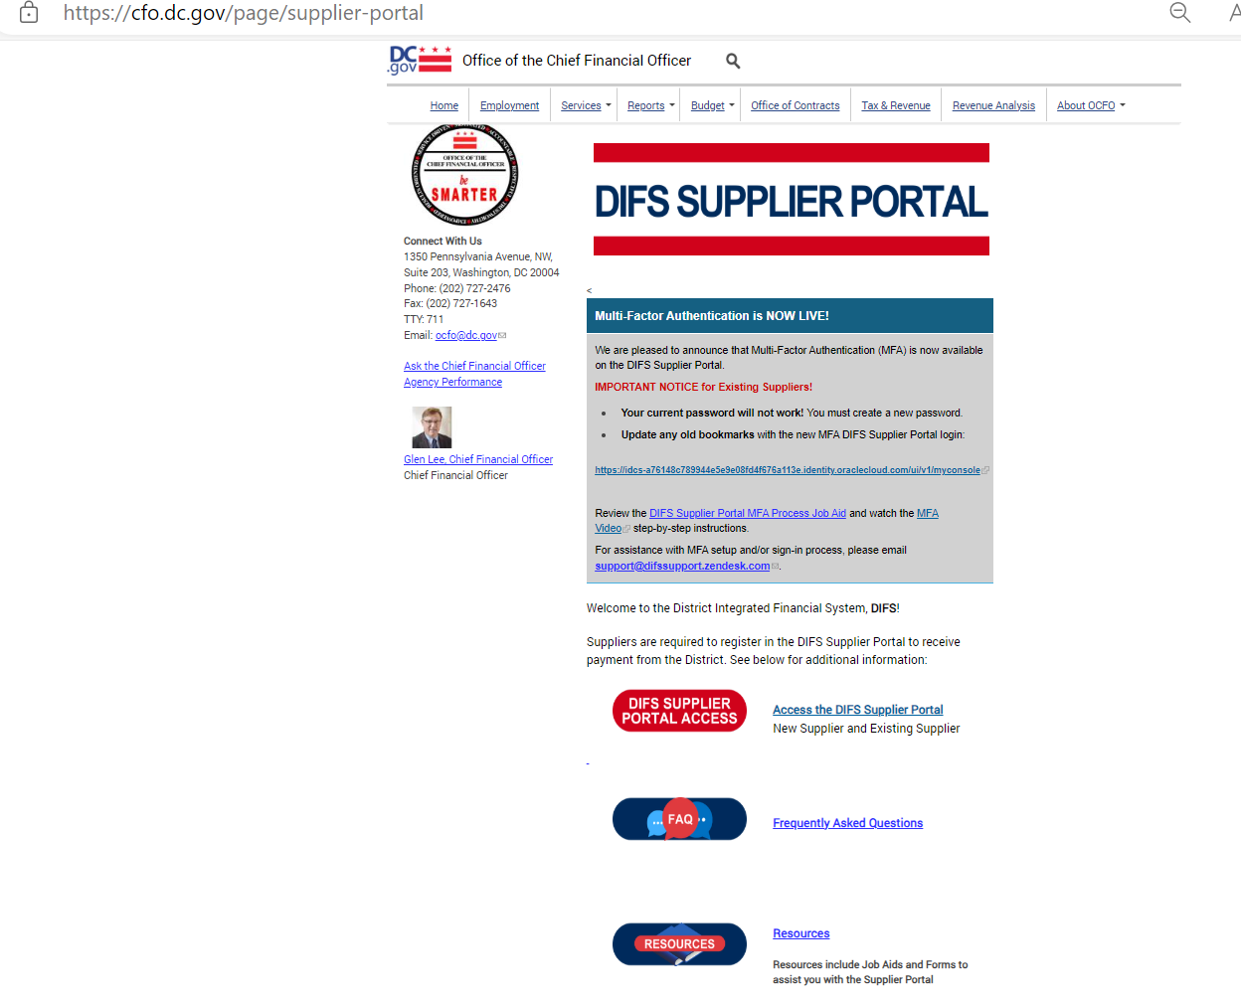

IRS W-9 Tax
If you are not currently registered as a vendor with DBH or if your existing information has changed, please visit the DIFS Supplier Portal at https://cfo.dc.gov/page/supplier-portal
to register or update your details.

Slide 41

Audited Financial Statements
If audited financial statements or reviews are not available, the applicant must provide:
    the Organizational Budget,
    Income Statement (Profit and Loss Statement),
    Certified Balance Sheet (certified by an authorized representative of the organization), and
    any letters, filings, etc. submitted to the IRS within the three (3) years before date of grant application.

Slide 42

Separation of Duties Policy
The applicant should state which of these situations apply and provide the following information
  Describe how financial transactions are handled and recorded;
  Provide the names and titles of personnel involved in handling money;
  Identify how many signatures the financial institution(s) require on the organization’s checks and withdrawal slips; and,
  Address other limits on staff and board members’ handling of the organization’s money.

Slide 43

Board of Directors
(No Template Provided)

Slide 44

System for Award Management (SAM)
Registration
(Unique Entity ID)
Visit www.sam.gov for more information

Slide 45

Partner Documents

Slide 46

Commercial, General Liability, Professional Liability, Comprehensive Automobile and Worker’s Compensation
During the term of the grant, all organizations will be required to obtain and keep in force insurance coverage as listed below and must provide in writing the name of all its insurance carriers and the type of insurance provided:
The Organization shall carry employer's liability coverage of at least one hundred thousand dollars ($100,000), if applicable.
The Organization shall carry bodily injury liability insurance coverage written on the comprehensive form of policy of at least five hundred thousand dollars ($500,000) per occurrence.
The Organization shall carry automobile liability insurance written on the comprehensive form of policy, if applicable. The policy shall provide for bodily injury and property damage liability covering the operation of all automobiles used in connection with performing grant activities. Policies covering automobiles shall provide coverage of at least two hundred thousand dollars ($200,000) per person and five hundred thousand dollars ($500,000) per occurrence for bodily injury and one hundred thousand dollars ($100,000) per occurrence for property damage.

Slide 47
Fillable Attachments 2-8
Assurances, Certifications and Disclosures
Program Income and Financial Disclosure
DC Contribution and Solicitation Certification
Federal Assurances and Certifications
Tax Certification
Sub-Grantee Single Audit Certification
DBH Grant Terms and Conditions

Slide 48
Checklist For RFA Application
CHECKLIST FOR RFA APPLICATION
A complete DBH RFA Application Package shall adhere to the following guidance:
Documents requiring signature have been signed by the agency head or AUTHORIZED Representative of the applicant’s organization.
The application must have a UEI number to be awarded funds. Go to SAM.gov to apply for and obtain a UEI # if needed. (https://sam.gov/content/home)(https://sam.gov/content/home)
The Project Narrative is typed using the following formats: 8-½ by 11-inch paper, 1.0 spaced, Arial or Times New Roman font 12-point type (10-point font for tables and figures), and a minimum of one-inch margins. Applications that do not conform to these requirements will not be forwarded to the review panel.
The application proposal format conforms to the “Application Requirements” listed in the RFA.
The proposed budget is complete and complies with the allowable items provided in the RFA. All data is captured using the “Budget and Budget Justification” (Attachment F) provided with the RFA. The budget justifications are complete and describe the items proposed in each category.
The proposed work plan, staffing plan, Work Plan (Attachment D), Staffing Plan (Attachment E), and any other requested attachments are complete and comply with the forms and format provided in the RFA.
Submit your application via email to DBH Grants, DBH.Grants@dc.gov by ET on the deadline of . Applications will not be accepted late. Applicants are encouraged to submit their applications 24 hours prior to the deadline for any necessary electronic/technical troubleshooting.
A complete DBH RFA Application Package shall include the following:
Notice of Eligibility and Experience Requirements (Attachment A)
Application Profile (Attachment C)
Project Abstract (Attachment C)
Table of Contents
Project Narrative
Work Plan (Attachment D)
Staffing Plan (Attachment E)
Budget and Budget Justification (Attachment F)
Advance Payment Request Form (Attachment G)
Letters of Agreement
Organizational Required Documents:
  Business License
  Certificate of Clean Hands
  IRS Tax-Exempt Determination Letter (for nonprofits only)
  IRS 990 Form from most recent tax year (for nonprofits only)
  IRS W-9 Form, if applicable
  Audited Financial Statements
  Separation of Duties Policy
  Board of Directors
  Active UEI Number (Unique Entity ID via System for Award Management (SAM))
  Partner Document(s) (if applicable)
  Proof of Insurance for Commercial, General Liability, Professional Liability, Comprehensive Automobile and Worker’s Compensation
General Terms and Conditions (Attachment 1)
Assurances, Certifications, & Disclosures (Attachment 2)
Program Income and Financial Disclosure (Attachment 3)
DC Contribution and Solicitation Certification (Attachment 4)
Federal Assurances and Certifications (Attachment 5)
Special Terms of Award Funding (Attachment 6)
DC Tax Certification (Attachment 7)
Sub-Grantee Single Audit Certification (Attachment 8)
DBH Grant Terms and Conditions (Attachment 9)

Slide 49
Application Submission and Deadline
Applications are Due: Friday, August 15, 2025, must be submitted no later than 3:00 PM.
Proper submission requires the applicant to attach all files as PDF’s and split documents within each as follows:
File #1 – Table of Contents, Notice of Eligibility and Experience Requirements, Applicant Profile, Abstract and Project Narrative.
File #2 – Work Plan, Staffing Plan, Budget & Budget Justification and Advance Payment Request Form (if applicable).
File #3 – Letters of Agreement (if applicable), Partner Documents (if applicable), Business License, Active UEI Number, Certificate of Clean Hands.
File #4 – 501(c)(3) Letter, IRS W-9 Form (if applicable), IRS Tax Exemption Letter, Current Fiscal Year Budget, Financial Statements, Separation of Duties Policy, Board of Directors and Certificate of Insurance.
File #5 – Attachment 2*, Attachment 3*, Attachment 4*, Attachment 5*, Attachment 6*, Attachment 7*, and Attachment 8*.
*These Attachments are in a fillable PDF. Complete the PDF, “Save” and provide PDF.
Please note: Attachment 1, Terms and Conditions does not have to be provided in the application submission.
*These Attachments are in a fillable PDF. Complete the PDF, “Save As” with organization’s name, and send that PDF.

Slide 50
Review and Scoring
Application submissions will be confirmed according to the date and time received in the Grants inbox.
*An automated reply email message will be sent to the submitting email address confirming only the “receipt” of a submission.

Slide 51
Remember!
Read the entire RFA, including the attachments!
The last opportunity to submit questions is Monday, August 11, 2025, four days prior to the RFA’s closing. Friday, August 15, 2025
(When emailing questions please copy DBH.Grants@dc.gov )
Before submitting, review the Checklist and the Submission Requirements.
Have a second reader to review your application before submitting.
Don’t wait until the last minute to submit!

Slide 52
Remember!
RFA and Attachments can be found on either the Mayor’s Office of Community Affairs or Department of Behavioral Health websites:
  https://communityaffairs.dc.gov/content/community-grant-program#4
  https://dbh.dc.gov/page/request-applications-01
Complete and sign attachments as requested.
Email subject line should include RFA # and File #.
Applications are to be emailed to DBH.Grants@dc.gov
Meet the submission deadline Friday, August 15, 2025, by 3:00 P.M. ET

Slide 53

Upcoming Key Dates
Application Submission Deadline:
August 15, 2025, by 3:00pm ET
Anticipated Award Start Date:
October 1, 2025

Slide 54
Program Contact Information
Charneta C. Scott, Ph.D.
Prevention and Early Intervention Division
charneta.scott@dc.gov
Tywana Reed
Fiscal Management Office
tywana.reed@dc.gov
Renee Evans Jackman
Grants Management Office
renee.evans@dc.gov

Slide 55

Questions

