Slide 1
District of Columbia Department of Behavioral Health (DBH) Pre-Application Conference
Tuesday, December 9, 2025 | 12:00 p.m. - 1:00 p.m.

Slide 2
District of Columbia Department of Behavioral Health (DBH) Pre-Application Conference
RFA Number: RM0 SBHTS120525
RFA Title: FY26 School Behavioral Health Telehealth Services Pilot Program

Slide 3
Today’s Agenda
Welcome
Presenters
Charneta C. Scott, Ph.D.
Renee Evans Jackman
General Information
Overview, Background, and Purpose
Award Information
Source of Grant Funding, Award Funding Available and Performance and Funding Period
Eligibility Requirements
Performance Requirement
Experience Criteria, Target Population, Location of Services, Scope of Services and Scope of Work
Application Requirements
Project Narrative
Evaluation Criteria
Successful Packaging
Additional /Fillable Attachments
Evaluation Criteria & Helpful Information
Key Dates, RFA Checklist, Tips and Contact Info
Questions & Answers

Slide 4



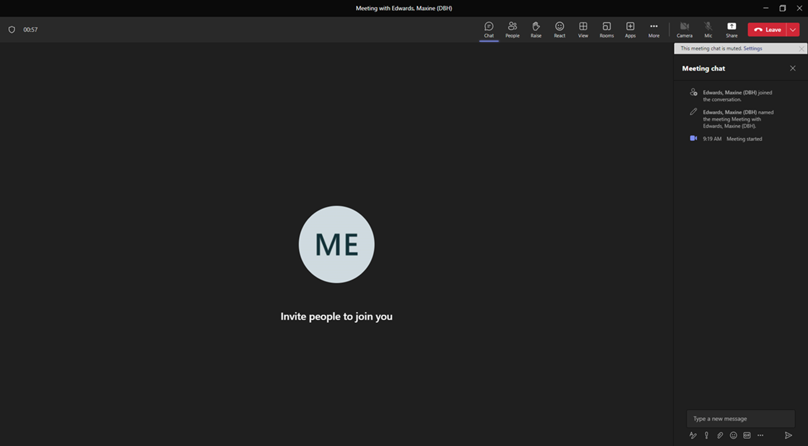




Please Note:

Slide 5
Overview (pgs. 12-13)
The Government of the District of Columbia, Department of Behavioral Health, Child, Adolescent, and Family Services, is soliciting applications from qualified organizations to implement school behavioral health telehealth services. The purpose is to implement efficient and effective school behavioral health telehealth services and support the integration of telehealth services into the school community. Only clinical treatment (Tier 3) services will be provided through this effort. The grantee shall ensure that linkages to community resources are made based on student and family needs. The Grantee shall be responsible for the implementation of school behavioral health telehealth services for high school, adult learners, or on-line school students who attend District of Columbia Public Schools (DCPS) or District of Columbia Public Charter Schools (DCPCS). Eligible residents are covered under DHCF Medicaid and DBH benefit plans.

Slide 6
Overview (pgs. 12-13)
The schools that will receive telehealth services are those that do not have a current DBH-funded clinician placement and are eligible to participate in a pilot program for the implementation of school behavioral health telehealth services for high school, adult learners, or on-line school students attending DCPS or DCPCS schools. Telehealth services must be provided virtually in the home or community through a HIPPA-compliant smart device. The licensed clinician positions for the school behavioral health telehealth services are to supplement and not supplant existing school behavioral health services. The clinical services provided by the licensed telehealth clinicians cannot be used to fulfill the requirements in a student’s IEP nor 504 Plan.

Slide 7
Purpose (pg. 15)
DBH will allocate funding to implement efficient and effective school behavioral health telehealth services and support the integration of telehealth services and the Grantee's team into the school community. The Grantee is expected to establish linkages to community resources based on student and family needs. The Grantee shall be responsible for the implementation of school behavioral health telehealth services for high school, adult learners, and on-line school students who attend DCPS or DCPCS and do not have a current DBH-funded clinician placement.

Slide 8
Source of Grant Funding & Award Funding Available (pg.13)
Source of Grant Funding
Funding for competition is made available from District of Columbia Local Appropriated Funds.
Award Funding Available
This RFA will make available $325,000 for one (1) award.

Slide 9
Eligibility and Experience Performance Criteria (pgs. 13-14)
Eligible and experience entities who who can apply for grant funds under this RFA include:
An organization that is a 501(c)(3) non-profit status, not for-profit or for-profit status.
Have at least five years of demonstrated experience (as of the due date of the application) providing school behavioral health telehealth services with students who live and attend schools in an urban setting.
Have at least five years of demonstrated infrastructure to execute school behavior health telehealth services with students in the home and community.
Be contracted with all Medicaid Managed Care Organizations or demonstrate the capacity to become contracted up to 90 days after the award.
Have demonstrated experience contracting with private insurance plans.
Be enrolled as a Medicaid provider and a participating provider with the Department of Health Care Finance (DHCF) within 90 days of the award.
Have an active organizational National Provider Identifier (NPI) number through National Plan & Provider Enumeration System within 90 days of the award. All treating clinicians must also have NPI numbers.
Funds cannot be used to supplant existing behavioral health services.

Slide 10
Eligibility and Experience Performance Criteria continued (pg. 14)
Eligible and experience entities who who can apply for grant funds under this RFA include:
Have demonstrated capacity to quickly recruit and hire staff who have the skills to provide culturally and linguistically responsive services to students and their families.
Have demonstrated experience complying with established outcome measures.
Have the resources and skills to provide supervision for clinical staff consistent with the requirements of the relevant licensing board.
Demonstrate the capacity to supervise the school behavioral health telehealth treatment services.
Have demonstrated adherence to all Grantee reporting requirements and deadlines.
Have at least five years of experience establishing and utilizing crisis protocols to coordinate crisis intervention services as needed for students.

Slide 11
Target Population (pg. 15)
The target populations are high school, adult learners, and on-line school students who attend DC Public and Public Charter schools that do not have a current DBH-funded clinician placement, and the students attend a school that is eligible to participate in a pilot program for the implementation of school behavioral health telehealth services.

Slide 12
Location of Services (pg. 15)
In accordance with telehealth laws and pursuant to D.C. Official Code § 3–1201.05, clinicians must be licensed in the state where the student is physically located during the session. It is preferred that the Grantee or the designated representative has flexibility for in-person participation to attend school team meetings, participate in the development of the school-centric assessment, and School Strengthening Work Plan development as required.

Slide 13
Scope of Services (pgs. 15-16)
Services to be provided under the FY26 School Behavioral Health Telehealth Services Pilot Program include the following:
Scope of Services will apply to high school, adult learners, and on-line school students who attend schools that do not have a current DBH-funded clinician placement. Services will be based on behavioral health services provided virtually through a HIPPA-compliant telehealth platform and device in accordance with current regulations and guidelines from DC Department of Health pursuant to D.C. Official Code § 3–1201.05.
Services are to be provided to students and families regardless of insurance and ability to pay. Services may include and are not limited to:
Diagnostic Assessments and Treatment plans
Brief, solution-focused, and evidence-based therapy with individuals, families and/or groups
Office hours for drop in consultations and therapeutic support
Services are provided virtually and supervised by the Grantee
Grantee complies with the District's rules and regulations related to clinical documentation

Slide 14
Scope of Services continu’d (pg. 16)
Grantee utilizes a practice management system to ensure compliance with the District's rules and regulations related to clinical documentation of telehealth services.
Eligible residents are covered under DHCF Medicaid and DBH benefit Plans.
Available hours for services include hours ranging from 7am to 6pm M-F
Grantee ensures that designated a representative attends school team meetings, participates in the development of the school-centric assessment, and the services provided by the Grantee are included in the School Strengthening Work Plan
Providers of the telehealth services are required to be currently licensed in the District of Columbia within the DBH approved professional discipline field
Obtain all required signed consents for treatment and as required for other school-based services
Obtain signed authorization for disclosures to allow for collaboration and support among the Grantee, provider and school staff
Establish crisis protocol in collaboration with school staff to coordinate crisis intervention as needed for students
Provide information sessions and materials for schools, students and families regarding telehealth services
Provide students and families information on how to access crisis services and intervention after hours
Grantee will utilize language lines (including ASL) as necessary to provide competent and culturally responsive care

Slide 15
Scope of Work (Pgs. 16-17)
Data Collection and Reporting
Grantees will be required to collect, track, and report information on all grant activities, services provided, and individuals served.
Reporting frequency ranges from daily to monthly depending on the data being reported and prescribed by DBH. Grantee shall report on grant activities utilizing the form/format prescribed by DBH and within the timeframe prescribed by DBH for the data being reported.
Grantees will be required to collect, track, and report information on all grant activities, services provided, and individuals served.
Daily reporting includes clinician service activity which is reported through the SBHP Activity Tracker.
Monthly reporting includes clinician caseload reports which are reported through the SBHP Activity Tracker.
Weekly Staffing reports shall consist of administrative data including hiring date of clinician(s)/supervisors, clinician/supervisor resignation dates, level of licensure, and pending clinician hire.
The Weekly Staffing Report shall include the clinicians’ email, phone number and assigned supervisor along with the supervisors' email and phone number, and noting if the clinician speaks another language other than English.
Weekly Staffing reports are due to DBH each Monday by 12:00 PM.

Slide 16
Scope of Work (Cont’d) (pg. 17)
Data Collection and Reporting (contin’d)
Supervisors’ Monthly reports include Supervisor Activity Logs outlining activities within the provided supervision framework and meetings with school leadership. These activity logs are entered in the SBHP Activity Tracker and are due by the 15th day of the following month.
Monthly Expenditure reports, with allowable expenditures, are to be submitted to the Monitor by the 15th of the month.
The Grantee must immediately inform the Monitor of any staffing change.

Slide 17
Scope of Work (Cont’d) (Pg. 17)
Data Collection and Tracking
Grantees will be responsible for ensuring quality, clinical supervision, and availability for timely consultation, of clinicians who are providing services under this funding opportunity.
Grantees must also be able to internally track required reporting, expenditure data, and grantee performance (e.g. service delivery data, accomplishments, challenges).
Grantees must be able to track the cost of any services provided, billed and reimbursed.

Slide 18
Project Narrative (pgs. 17-18)
Organizational Capacity
This section should provide information and data that demonstrates the organization has the experience and capacity to implement the grant activites. This should include, but not limited to, information on the organization:
Identify a responsible staff member for implementation and oversight and provide an organizational chart.
Identify the program manager/coordinator, supervisor, and clinicians along with the credentials, responsibilities and roles of persons who will implement the school behavioral health telehealth services. Included are position descriptions, Manage Care Organization contracts, list of contracted commercial insurance plans that the Grantee is credentialed with, copies of licenses, and resumes for the identified individuals.
If staffing is not yet established, discuss the plan to ensure staff are in place 45 days after award.

Slide 19
Project Narrative (pgs. 17-18)
Project Need
This section should describe the need for the specific approach outlined in the Project Description. The description should be based on the organization’s own research and data (e.g. provide examples related to the project) with reference made to publicly- available sources of needs assessment data where applicable.
Provide a work plan detailing the steps to be taken, milestones and timelines for recruiting/identifying and hiring qualified clinicians for school behavioral health telehealth services.
Based on lessons learned, describe any potential challenges to implementing school behavioral health telehealth services and contingency plans for addressing these challenges. For example, how would you respond if clinician’s billable treatment caseload was lower than expected? (i.e., obtaining contracts for private insurance)
Describe Grantee's compliance with the District's rules and regulations related to clinical documentation and the Grantee's practice management system.
Describe the Grantee’s experience complying with submitting required data and reports in an accurate and timely manner.
Describe how the Grantee utilizes data to inform workforce development need.

Slide 20
Project Narrative (pg. 18)
Project Description
This section should provide a description on how the organization will implement the (program/effort) so as to successfully achieve the goal of the grant:
Discuss the approach to implementing school behavioral health telehealth services (i.e., treatment services and crisis intervention).
Discuss how to support the integration of telehealth services and Grantee's team into the school community in order to function as a collaborating team member within the school behavioral health team.
Discuss how the Grantee's team contributes to the efficient and effective delivery of school behavioral health telehealth services and ensures linkages to community resources based on student and family needs.
Project Evaluation Discuss the approach to tracking the progress of the work plan which should include information about how data will be collected and how such data will be utilized to manage, monitor, and enhance the school behavioral health telehealth services and student outcomes.

Slide 21
Evaluation Criteria (pg. 24)
Indicators have been developed for each review criterion to assist the applicant in presenting pertinent information and to provide the reviewer with a standard for evaluation. The five review criteria are outlined below with specific detail and scoring points. These criteria are the basis upon which the reviewers will evaluate the application. The entire proposal will be considered during objective review.

Slide 22
Evaluation Criteria Cont’d (pg. 24)
Criterion 1: Capacity (Corresponds to Organizational Capacity Section) – 20
Applicants should:
The applicant identified a responsible staff member for implementation and oversight and provided organizational chart. (3 points)
Identified the program manager/coordinator, supervisor, and clinicians along with the credentials, responsibilities and roles of persons who will implement the school behavioral health telehealth services. Included are position descriptions, Manage Care Organization contracts, list of contracted commercial insurance plans that the Grantee is credentialed with, copies of licenses, and resumes for the identified individuals. (10 points)
If staffing is not yet established, discussed the plan to ensure staff are in place 45 days after award. (7 points)
Criterion 2: Need (Corresponds to Need Section) – 53 points
Provided a work plan detailing the steps to be taken, milestones and timelines for recruiting/identifying and hiring qualified clinicians for school behavioral health telehealth services. (10 points)
Based on lessons learned, described any potential challenges to implementing school behavioral health telehealth services and contingency plans for addressing these challenges. For example, how would you respond if clinician’s billable treatment caseload was lower than expected? (i.e., obtaining contracts for private insurance) (10 points)
Described Grantee's compliance with the District's rules and regulations related to clinical documentation and the Grantee's practice management system. (10 points)
Described the Grantee’s experience complying with submitting required data and reports in an accurate and timely manner. (10 points)
Described how the Grantee utilizes data to inform workforce development need. (13 points)

Slide 23
Evaluation Criteria Cont’d (pgs. 24-25)
Criterion 3: Strategic Approach (Corresponds to Project Description Section) – 10 points
The applicant discussed the approach to implementing school behavioral health telehealth services (i.e., treatment and crisis intervention). (4 points)
The applicant discussed how to support the integration of the telehealth services and Grantee's team into the school community in order to function as a collaborating team member within the school behavioral health team. (3 points)
The applicant discussed how the Grantee's team contributes to the efficient and effective delivery of school behavioral health telehealth services and ensures linkages to community resources based on student and family needs. (3 points)
Criterion 4: Evaluation (Corresponds to Project Evaluation Section) – 7 points
The applicant discussed the approach to tracking the progress of the work plan which should include information about how data will be collected and how such data will be utilized to manage, monitor, and enhance the school behavioral health telehealth services and student outcomes. (7 points)
Criterion 5 : Budget (Corresponds to Project Budget Section) – 10 points
The applicant provided a line-item budget and budget narrative justification regarding the Grantee's rate for personnel, billable and non-billable treatment services, equipment, HIPPA compliant telehealth platform applications, required software, and informational materials for students, families and school staff. (10 points)

Slide 24
Application Scoring (pgs. 25-26)
Pre-Screening Technical Review
All submitted applications will initially be reviewed by DBH Grants Management Office personnel for completeness, formatting, and eligibility requirements prior to being forwarded to the review panel. Applications that did not adhere to the complete guidance, formatting provided, and eligibility requirements will be considered “Incomplete”, and will not advance to be reviewed. You may not request updates to this process, as DBH will notify applicants of all results after the review panel has closed.
Review Panel
The review panel will be composed of neutral, qualified, professional individuals who have been selected for their unique experiences in behavioral health fields, and the administrative requirements mandated by the source of funds, as applicable. The panel will review, score and rank each applicant’s proposal based on the criteria outlined in the RFA. Reviewers are required to provide a summary of strengths and weaknesses found in the application.
Internal Review Panel
DBH program managers will evaluate the individual and summary recommendations of the review panel. Program Managers will weigh the results of the review panel against other factors such as but not limited to; a past performance review, risk assessment and eligibility assessment, including a review of assurances and certification, and business documents submitted by the applicant, as required in the RFA in making the final decision.

Slide 25

Successful Packaging

Slide 26
Proposal Format and Content
Notice of Eligibility and Experience Requirements (Attachment A) (Fillable-Word)
Applicant Profile & Abstract (Attachment C) (Fillable-Word)
Table of Contents
Narrative
Administrative
Proposed Work Plan
Fiscal and Financial Management
Program Reporting
Work Plan Template (Attachment D) (Fillable-PDF)
Staffing Plan (Attachment E) (Fillable-PDF)
Budget and Budget Justification (Attachment F) (Fillable-Excel)
Required Documentation (see RFA pages 17 - 22)
Signed Attachments 2 – 8 (Fillable-PDF)

Slide 27
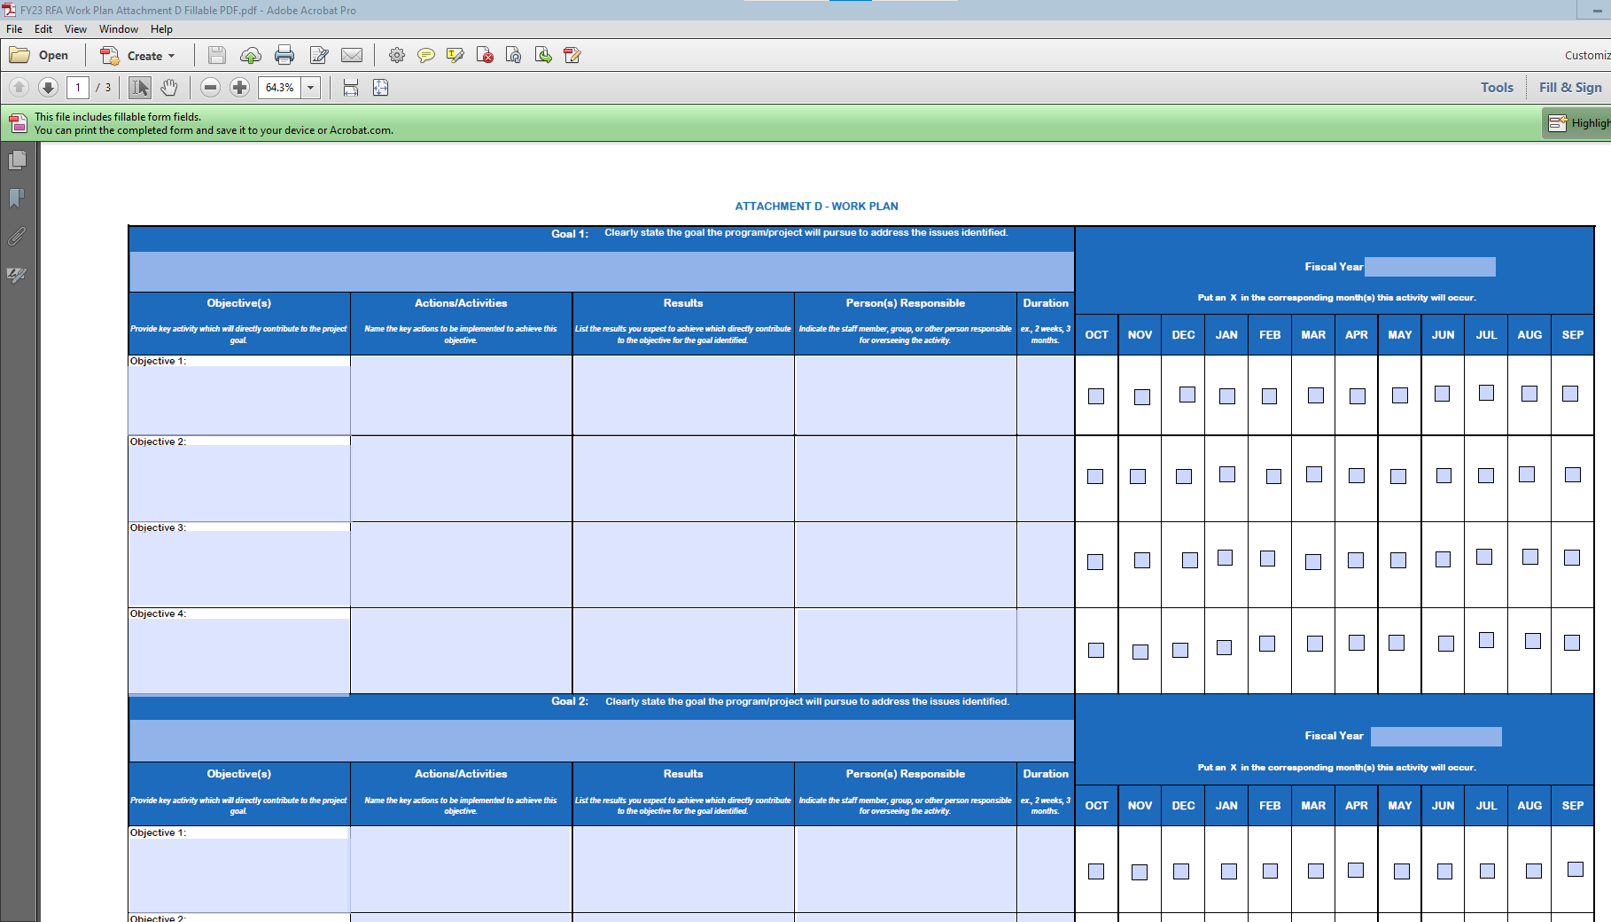
Work Plan (Attachment D)
The work plan template (see Attachment D) provided DBH is required.

Slide 28
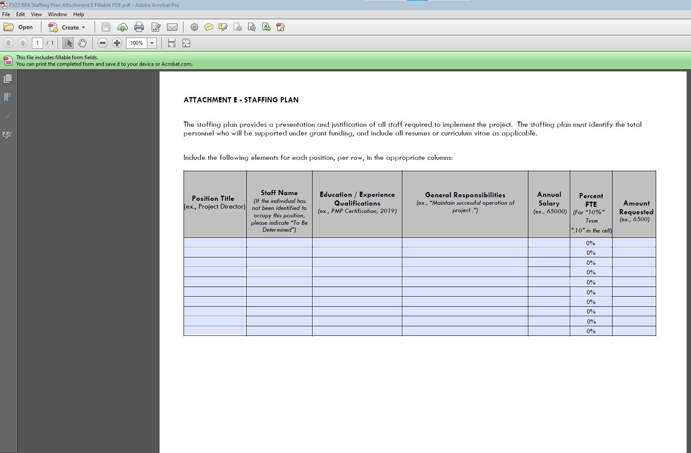
Staffing Plan (Attachment E)
The applicant’s staff plan template (See Attachment E) is required.

Slide 29
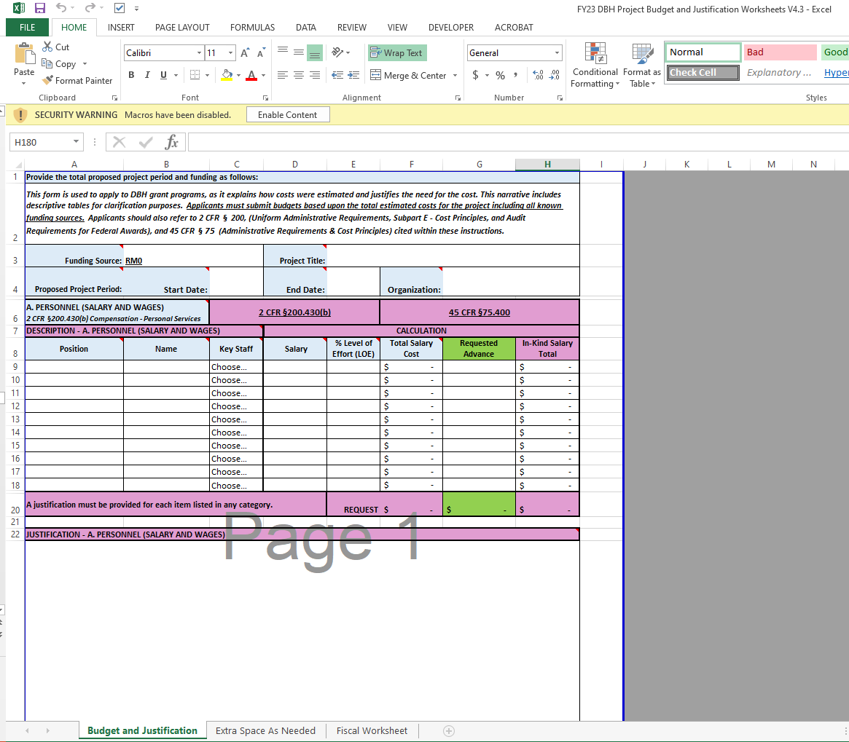
Project Budget and Justification (Attachment F)

Slide 30
Project Budget and Justification (pg. 20)
The following categories and descriptions should be covered in the Budget/Justification:
Personnel: Include the title of the position, name (or indicate vacancy), annual salary and level of effort (percentage of time) dedicated to this project.
Fringe: Provide the position, name (or indicate vacancy), total fringe benefit rate used.
Travel: Only local travel related to OTP and for the project staff will be approved in the grant budget. Provide purpose, destination, and type of travel. (Not applicable to this grant)
Equipment: Provide the item, quantity, amount, and percent charged to the grant.
Supplies: Include the items being requested and rate. Description should also include how the supplies directly support the project.
Contractual: Provide the name of entity and identify whether it’s a sub-recipient, contractor, consultant, or service. Also provide the entity’s rate.
Other Direct Costs: List any costs not included in any of the other cost categories.
Indirect Costs: Indirect costs should not exceed 10% of direct costs, unless the organization has a negotiated indirect cost rate agreement. Please reference 45 CFR §75.414.
Program Income: If the possibility of generating program income as a result of DBH funding exists, list source and amount as budget line items.

Slide 31
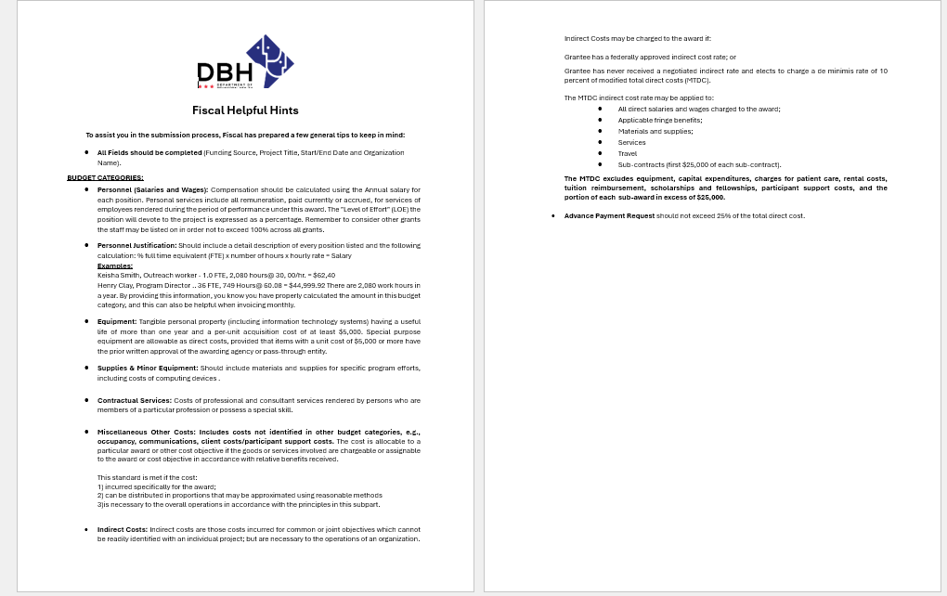
Fiscal Helpful Hints

Slide 32
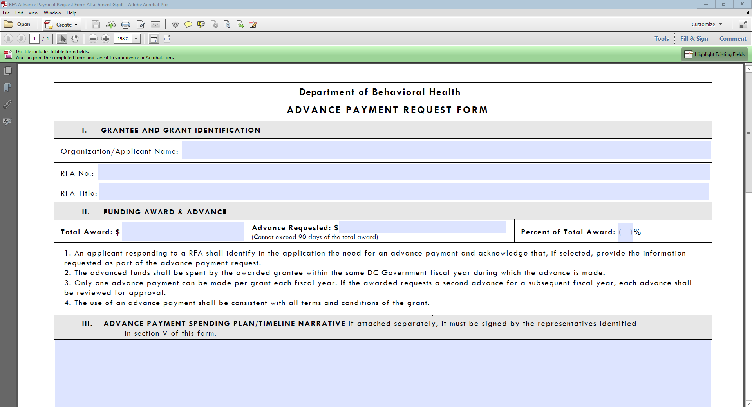
Advance Payment Form (Attachment G)

Slide 33
Advance Payment
An applicant seeking an advance, must submit a completed Advance Payment Request form (Attachment G) with the submitted application and be signed by the organization’s Chair of the Board of Directors and Executive Director, or equivalent positions. Applicants must detail the amount requested per budget category in the budget and justification (see Attachment F).
Advance payments are optional and an applicant is not required to submit the Advance Payment Request form. Failure to submit an Advance Payment Request form with the application eliminates the consideration for an advance payment. An advance payment will not be provided without prior official request and approval.
Please note: The advance payment for the grant should not exceed 25% of the total grant amount.

Slide 34
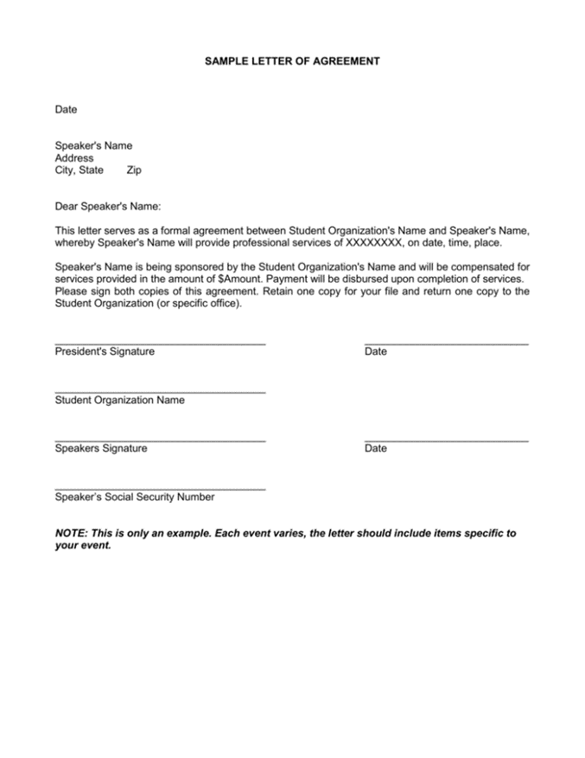
Letters of Agreement
(No Template Provided)

Slide 35
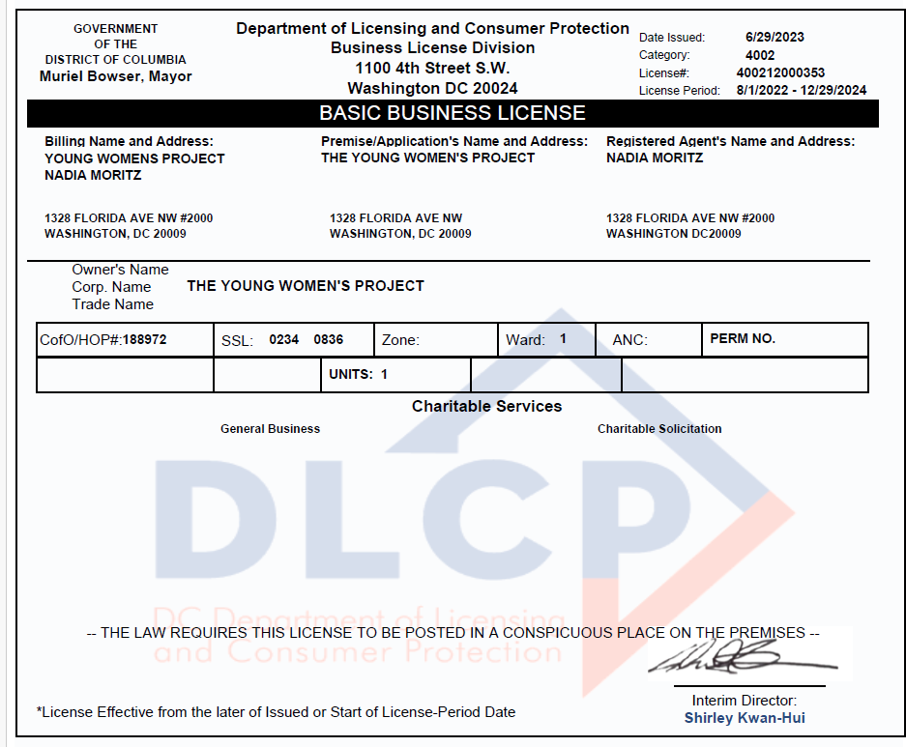

Business License

Slide 36
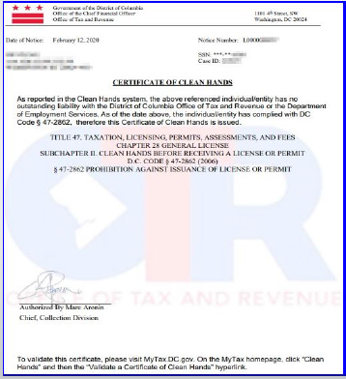
Clean Hands Certification
Each applicant must submit a current Clean Hands Certification from the District of Columbia Office of Tax Revenue. DBH requires that the submitted Clean Hands Certification reflect a date within a thirty-day period immediately preceding the application’s submission. Self-Certification is not acceptable.

Slide 37
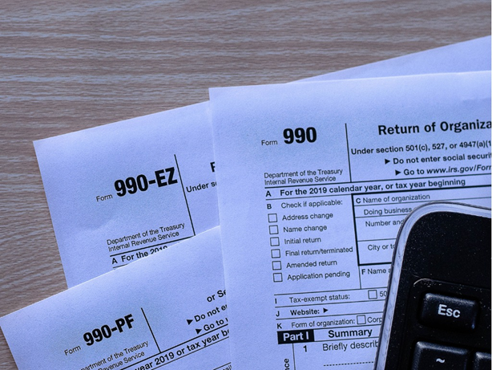

IRS 990 FORM (Non-Profits Only)
The applicant must submit the organization’s 990 form from the most recent tax year.

Slide 38
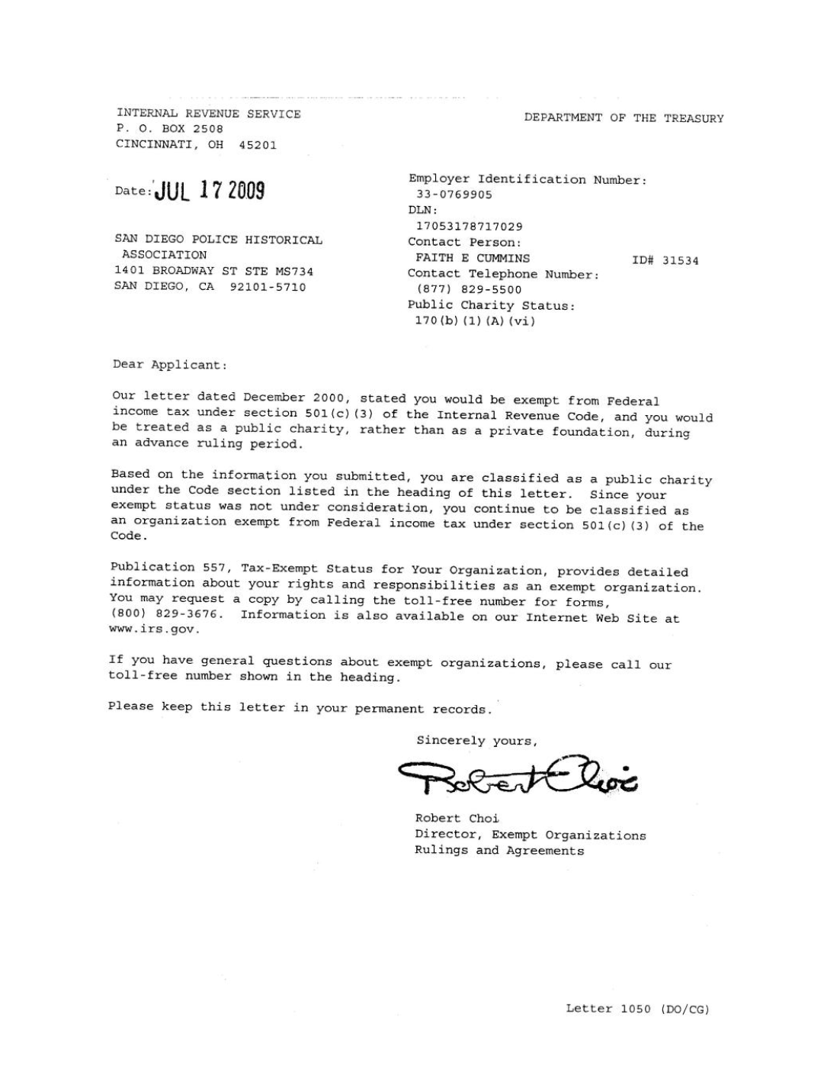

IRS Tax –Exempt Determination Letter & 501 (c)(3) Letter (Non-Profits Only)

Slide 39

Religious Organizations
Best Evidence of IRS Tax Exemption Examples:
A letter from the leader of the organization verifying that the organization is a religious group;
A letter from the group’s board chair or similar official, verifying that the organization is a religious group;
The applicant’s most recently submitted state sales or other tax exemption form, if it exists (Form 164 in the District of Columbia); or
The state’s issued tax exemption certificate or card, if it exists. (See IRS publication no. 1828, Tax Guide for Churches and Religious Organizations).

Slide 40
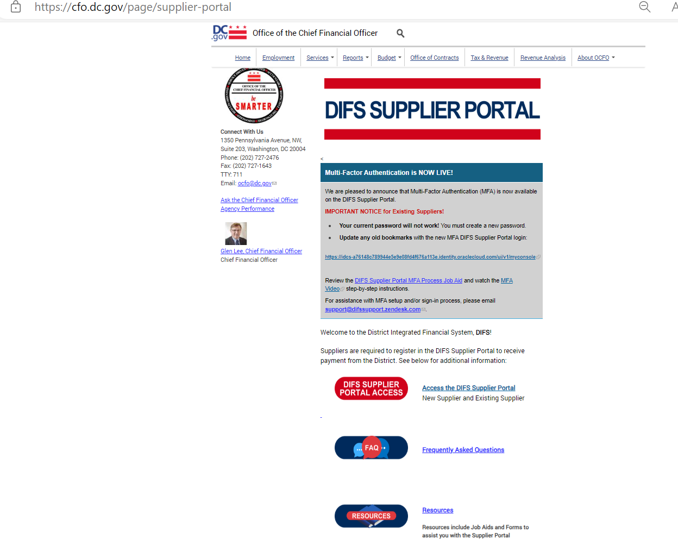

IRS W-9 Tax
If you are not currently registered as a vendor with DBH or if your existing information has changed, please visit the DIFS Supplier Portal at https://cfo.dc.gov/page/supplier-portal
to register or update your details.

Slide 41

Audited Financial Statements
If audited financial statements or reviews are not available, the applicant must provide:
the Organizational Budget,
Income Statement (Profit and Loss Statement),
Certified Balance Sheet (certified by an authorized representative of the organization), and
any letters, filings, etc. submitted to the IRS within the three (3) years before date of grant application.

Slide 42

Separation of Duties Policy
The applicant should state which of these situations apply and provide the following information
Describe how financial transactions are handled and recorded;
Provide the names and titles of personnel involved in handling money;
Identify how many signatures the financial institution(s) require on the organization’s checks and withdrawal slips; and,
Address other limits on staff and board members’ handling of the organization’s money.

Slide 43

Board of Directors
(No Template Provided)

Slide 44

System for Award Management (SAM) Registration (Unique Entity ID)
Visit www.sam.gov for more information

Slide 45

Partner Documents

Slide 46

Commercial, General Liability, Professional Liability, Comprehensive Automobile and Worker’s Compensation
During the term of the grant, all organizations will be required to obtain and keep in force insurance coverage as listed below and must provide in writing the name of all its insurance carriers and the type of insurance provided:
The Organization shall carry employer's liability coverage of at least one hundred thousand dollars ($100,000), if applicable.
The Organization shall carry bodily injury liability insurance coverage written on the comprehensive form of policy of at least five hundred thousand dollars ($500,000) per occurrence.
The Organization shall carry automobile liability insurance written on the comprehensive form of policy, if applicable. The policy shall provide for bodily injury and property damage liability covering the operation of all automobiles used in connection with performing grant activities. Policies covering automobiles shall provide coverage of at least two hundred thousand dollars ($200,000) per person and five hundred thousand dollars ($500,000) per occurrence for bodily injury and one hundred thousand dollars ($100,000) per occurrence for property damage.

Slide 47
Fillable Attachments 2-8
Assurances, Certifications and Disclosures
Program Income and Financial Disclosure
DC Contribution and Solicitation Certification
Federal Assurances and Certifications
Tax Certification
Sub-Grantee Single Audit Certification
DBH Grant Terms and Conditions

Slide 48
Checklist For RFA Application
CHECKLIST FOR RFA APPLICATION
A complete DBH RFA Application Package shall adhere to the following guidance:
Documents requiring signature have been signed by the agency head or AUTHORIZED Representative of the applicant’s organization.
The application must have a UEI number to be awarded funds. Go to SAM.gov to apply for and obtain a UEI # if needed. (https://sam.gov/content/home)(https://sam.gov/content/home)
The Project Narrative is typed using the following formats: 8-½ by 11-inch paper, 1.0 spaced, Arial or Times New Roman font 12-point type (10-point font for tables and figures), and a minimum of one-inch margins. Applications that do not conform to these requirements will not be forwarded to the review panel.
The application proposal format conforms to the “Application Requirements” listed in the RFA.
The proposed budget is complete and complies with the allowable items provided in the RFA. All data is captured using the “Budget and Budget Justification” (Attachment F) provided with the RFA. The budget justifications are complete and describe the items proposed in each category.
The proposed work plan, staffing plan, Work Plan (Attachment D), Staffing Plan (Attachment E), and any other requested attachments are complete and comply with the forms and format provided in the RFA.
Submit your application via email to DBH Grants, DBH.Grants@dc.gov by ET on the deadline of . Applications will not be accepted late. Applicants are encouraged to submit their applications 24 hours prior to the deadline for any necessary electronic/technical troubleshooting.
A complete DBH RFA Application Package shall include the following:
Notice of Eligibility and Experience Requirements (Attachment A)
Application Profile (Attachment C)
Project Abstract (Attachment C)
Table of Contents
Project Narrative
Work Plan (Attachment D)
Staffing Plan (Attachment E)
Budget and Budget Justification (Attachment F)
Advance Payment Request Form (Attachment G)
Letters of Agreement
Organizational Required Documents:
Business License
Certificate of Clean Hands
IRS Tax-Exempt Determination Letter (for nonprofits only)
IRS 990 Form from most recent tax year (for nonprofits only)
IRS W-9 Form, if applicable
Audited Financial Statements
Separation of Duties Policy
Board of Directors
Active UEI Number (Unique Entity ID via System for Award Management (SAM))
Partner Document(s) (if applicable)
Proof of Insurance for Commercial, General Liability, Professional Liability, Comprehensive Automobile and Worker’s Compensation
General Terms and Conditions (Attachment 1)
Assurances, Certifications, & Disclosures (Attachment 2)
Program Income and Financial Disclosure (Attachment 3)
DC Contribution and Solicitation Certification (Attachment 4)
Federal Assurances and Certifications (Attachment 5)
Special Terms of Award Funding (Attachment 6)
DC Tax Certification (Attachment 7)
Sub-Grantee Single Audit Certification (Attachment 8)
DBH Grant Terms and Conditions (Attachment 9)

Slide 49
Application Submission and Deadline
Applications are Due: Friday, December 19, 2025, must be submitted no later than 12:00 PM.
Proper submission requires the applicant to attach all files as PDF’s and split documents within each as follows:
File #1 – Table of Contents, Notice of Eligibility and Experience Requirements, Applicant Profile, Abstract and Project Narrative.
File #2 – Work Plan, Staffing Plan, Budget & Budget Justification and Advance Payment Request Form (if applicable).
File #3 – Letters of Agreement (if applicable), Partner Documents (if applicable), Business License, Active UEI Number, Certificate of Clean Hands.
File #4 – 501(c)(3) Letter, IRS W-9 Form (if applicable), IRS Tax Exemption Letter, Current Fiscal Year Budget, Financial Statements, Separation of Duties Policy, Board of Directors and Certificate of Insurance.
File #5 – Attachment 2*, Attachment 3*, Attachment 4*, Attachment 5*, Attachment 6*, Attachment 7*, and Attachment 8*. *These Attachments are in a fillable PDF. Complete the PDF, “Save” and provide PDF.
Please note: Attachment 1, Terms and Conditions does not have to be provided in the application submission.
*These Attachments are in a fillable PDF. Complete the PDF, “Save As” with organization’s name, and send that PDF.

Slide 50
Review and Scoring
Application submissions will be confirmed according to the date and time received in the Grants inbox.
*An automated reply email message will be sent to the submitting email address confirming only the “receipt” of a submission.

Slide 51
Remember!
Read the entire RFA, including the attachments!
The last opportunity to submit questions is Monday, December 15, 2025, four days prior to the RFA’s closing. Friday, December 19, 2025
(When emailing questions please copy DBH.Grants@dc.gov )
Before submitting, review the Checklist and the Submission Requirements.
Have a second reader to review your application before submitting.
Don’t wait until the last minute to submit!

Slide 52
Remember!
RFA and Attachments can be found on either the Mayor’s Office of Community Affairs or Department of Behavioral Health websites:
https://communityaffairs.dc.gov/content/community-grant-program#4 https://dbh.dc.gov/page/request-applications-01
Complete and sign attachments as requested.
Email subject line should include RFA # and File #.
Applications are to be emailed to DBH.Grants@dc.gov
Meet the submission deadline Friday, December 19, 2025, by 12:00 P.M. ET

Slide 53

Upcoming Key Dates
Application Submission Deadline:
December 19, 2025, by 12:00pm ET
Anticipated Award Start Date:
January 5, 2026

Slide 54
Program Contact Information
Charneta C. Scott, Ph.D.
Prevention and Early Intervention Division
charneta.scott@dc.gov
Tywana Reed
Fiscal Management Office
tywana.reed@dc.gov
Renee Evans Jackman
Grants Management Office
renee.evans@dc.gov

Slide 55

Questions

