Slide 1
Coordinating Council ON School mental Health
Monday, March 18, 2019
10:00 am – 12:00 pm
64 New York Avenue NE
Room 284

Slide 2
School-Based Behavioral Health Goal
To create a coordinated and responsive behavioral health system for all students in all public and public charter schools.

Slide 3
Coordinating Council Charge
To hold agencies and participating stakeholders accountable for timely implementation of the expanded School-based Behavioral Health System.

Slide 4
Agenda
Welcome & Introductions
Mission
News, Updates, and Public Comment
New agenda format
New DBH Director of Prevention & Early Intervention
DBH School Mental Health Program Update
Co-Chair Updates
Public Invitation to Share (5-10 minutes)
Coordinating Council Business
Timely Implementation
Year 1 Implementation
Year 2 Planning
Guide Implementation of All Elements of the Expansion
Provider Standards & Training
Evaluation– March meeting
Family & Youth-Family Engagement Across stakeholders
Provider model sustainability-DBH Updates
Comprehensive Inventory
Cross-Systems Linkages and Coordination
Workforce Development
Next Steps
VI. Adjourn

Slide 5
Monthly Meeting Calendar
3rd Monday 10:00 am – 12:00 noon
March 18 August 19
April 15 September 16
May 20 October 21
June 17 November 18
July 15 December 15

Slide 6
New Agenda Format
The work needed to realize the expansion of the school-based behavioral health systems to all District Public and Public Charter Schools can be organized within the priority areas of the Coordinating Council’s Charge:
1. Timely Implementation
2. Elements of Implementation
3. Comprehensive Resource Inventory
4. Cross-System Linkages & Coordination
5. Workforce Development

Slide 7
Public Invitation To Share
The public is invited to share resources, provide feedback, ask questions for the Council’s consideration.

Slide 8
Timely Implementation
A. Year 1 Implementation
Providers in School Status
MOA/Grant Funding Status
MOA Funding Status
Second Year Planning
Data Committee - School Prioritization
Recommendation
Implementation Committee – Provider/
School/Grant Timeline (HANDOUT)
 | Signed MOA Completed | Grant Funds Released to CBO | Provider in School
DCPS | 15 | 0 | 6
DCPCS | 13 | 5 | 7
 | Signed MOA Completed | Provider Not in School
DCPS | 15 | 9
DCPCS | 13 | 6
 | Signed MOA Completed | Grant Funds in Process
DCPS | 15 | 15
DCPCS | 13 | 8

Slide 9
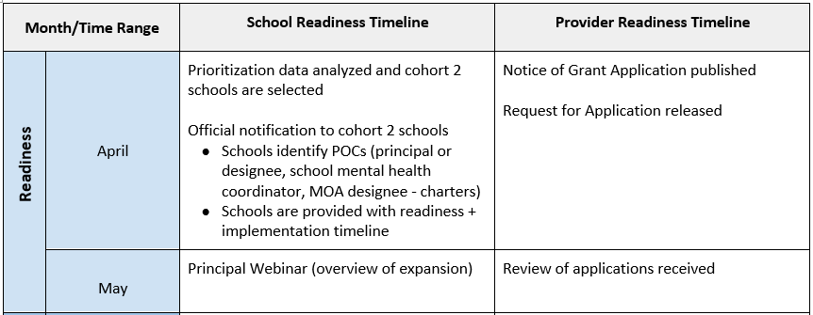
Cohort 2 Readiness Timeline

Slide 10
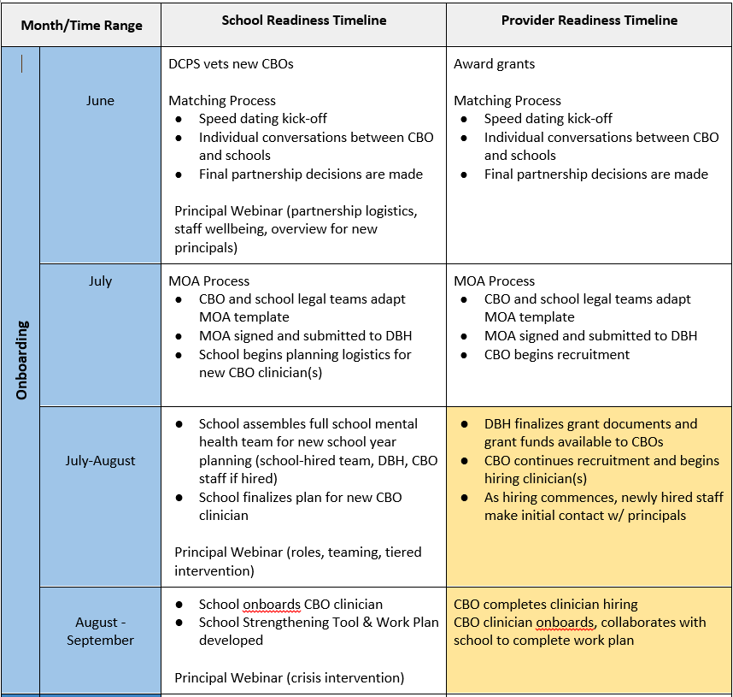
Cohort 2 Onboarding Timeline

Slide 11
Cohort 2 Implementation Timeline

Slide 12
Guide Implementation Elements
Provider Training & Support
Evaluation
Family & Youth Engagement
Provider Sustainability Update

Slide 13
Next Steps
Next Committee Meeting Tasks
Next Committee Meeting Dates

