Slide 1
District of Columbia
Department of Behavioral Health (DBH)
Pre-Application Conference
September 22, 2026, | 1:00 p.m. - 2:00 p.m.

Slide 2
District of Columbia
Department of Behavioral Health (DBH)
Pre-Application Conference
RFA Number: RM0 SBH091826
RFA Title: FY27 School Behavioral Health Services Comprehensive Expansion (District of Columbia Public Charter School Local Education Agency (LEA) Grant

Slide 3
Today’s Agenda
Welcome
Presenters
Charneta C. Scott, Ph.D.
Renee Evans Jackman
General Information
Overview, Background, and Purpose
Award Information
Source of Grant Funding, Award Funding Available and Performance and Funding Period
Eligibility Requirements
Performance Requirement
Experience Criteria, Target Population, Location of Services, Scope of Services and Scope of Work
Application Requirements
Project Narrative
Evaluation Criteria
Successful Packaging
Additional /Fillable Attachments
Evaluation Criteria Helpful Information
Key Dates, RFA Checklist, Tips and Contact Info
Questions & Answers

Slide 4



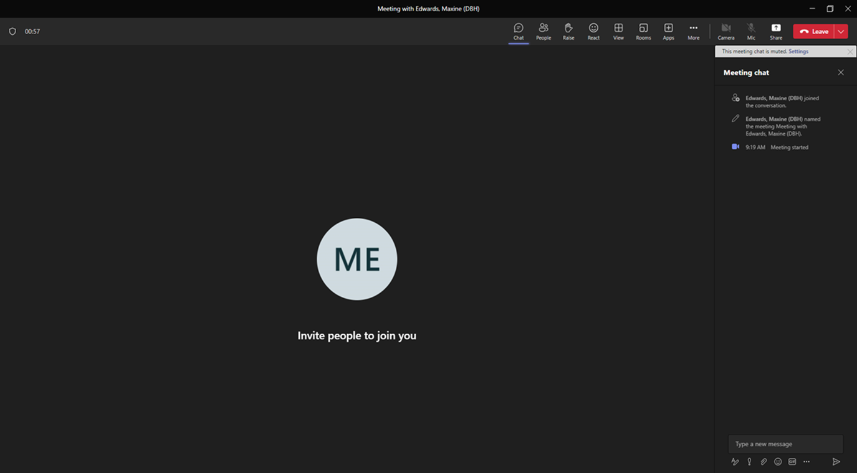




Please Note:

Slide 5
Overview (pgs. 11-12)
The Government of the District of Columbia, Department of Behavioral Health (DBH), Child, Adolescent, and Family Services, is soliciting applications from DC Public Charter Local Education Agencies (LEAs) to directly hire school behavioral health clinicians where the school has the capacity, willingness, ability to implement school behavioral health services; provided, that each clinician shall receive onsite clinical supervision and shall perform duties exclusively related to the School Behavioral Health Program and provide prevention, early intervention, and treatment services using the Comprehensive School Behavioral Health Model.
An LEA that meets both eligibility and experience requirements may apply to provide school behavioral health services based on its projected capacity to hire a licensed clinician and provide the required clinical supervision in alignment with the clinician’s professional licensing board requirements. This position is to supplement and not supplant existing school behavioral health services and the services provided by the licensed clinician are not identified in an IEP nor 504 Plan.
Core funding for a full-time licensed clinician is $120,000. A full-time clinician provides services 40 hours per week in one school. However, it is allowed to request funding for a clinician who is assigned to two (2) schools within the LEA. The total amount for FY27 is $480,000. The ceiling amount of the awards is $480,000. See attachment J for funding model examples.

Slide 6
Purpose (pg. 15)
DBH will allocate funding to develop and further expand the District’s Comprehensive School Behavioral Health System in the District’s schools. The school behavioral health services will be aligned with the behavioral health unmet needs/gaps within the school. The array of services includes prevention, early intervention and treatment. Additionally, the selected LEAs/schools will participate in the overall evaluation of the implementation.

Slide 7
Definitions (pg. 13)
Comprehensive School Behavioral Health Model – is a coordinated behavioral health system designed to create a positive school culture that promotes mental wellness and provides timely access to high-quality services for children, youth, and their families. The model uses a public health model approach as its organizing framework of promotion and primary prevention for all; focused group/individual interventions; and intensive treatment and support.
Comprehensive School Behavioral Health System – a strategic collaboration between school personnel, community behavioral health providers, students and families to create a positive school culture that provides timely access to high-quality, reliable supports for children, youth, and their families. Teams offer a full array of trauma-informed, culturally responsive, evidence-based tiered interventions to promote wellness, identify challenges early, and offer treatment services required so that all children and youth succeed and thrive.

Slide 8
Definitions (continued, pgs. 13-14)
Behavioral Health Coordination Team – comprised of representatives from all health-related organizations in the school and appropriate school health personnel. Team Lead will be assigned by principal. Team is responsible for ensuring data and updates are provided to DBH to inform the Coordinating Council on School Behavioral Health.
School Behavioral Health Clinician – an individual licensed by the DC Department of Health to provide mental health treatment services. This includes Licensed Independent Clinical Social Workers (LICSWs), Licensed Professional Counselors (LPC), Licensed Psychologist, Licensed Marriage and Family Therapists (LMFT), Licensed Graduate Social Workers (LGSW), Licensed Graduate Professional Counselors (LGPC), and Psychology Associate.
Fiscal Year – the District Government’s fiscal year runs from October 1– September 30.
Continuous Quality Improvement (CQI) – ensures a data-driven program implementation process.

Slide 9
Source of Grant Funding & Award Funding Available
(pg. 12)
Funding is made available from the District of Columbia Local Appropriated Funds.
This RFA will make available $480,000 for up to four (4) awards.

Slide 10
Eligibility Requirements (pg. 12)
1. A District of Columbia Public Charter (DCPCS) Local Education Agency (LEA).
2. A DCPCS LEA without a Department of Behavioral Health funded school behavioral health partnership.

Slide 11
Performance Requirements (pg. 17)
Experience Requirements
Applicants must have:
A minimum of two (2) years of successfully providing a full continuum of school-based prevention, early intervention and treatment services based on the needs within the school. These services include individual and group counseling, family engagement and support, early intervention groups, wellness workshops, and coordinated school-wide prevention activities. Justification includes:
Program history
A description of how long the LEA/school has provided behavioral health or wellness services; and
types of interventions offered. Provide evidence of infrastructure such as qualified social workers,
student support teams and referral processes. Evidence of infrastructure supporting therapy services,
such as qualified supervisors, clinical record-keeping systems, or partnerships with schools, child
welfare agencies, or community organizations.
b. Documentation of outcomes
Summaries of data showing improvements in student wellbeing, decreases in behavioral incidents,
attendance improvements, treatment or service plan completion rates, or results from climate surveys
and family feedback.
c. Service delivery statistics
Number of students served annually, types of services delivered (for example, individual therapy,
group therapy), average duration of services.

Slide 12
Performance Requirements (continued, pgs. 17-18)
2. A minimum of two (2) years of experience administering a grant or contract related to student behavioral health or social-emotional support services. Justification includes:
Reports
Can include monitoring summaries, compliance reports, and outcome or utilization data
summaries submitted to those funders showing successful performance and adherence
to grant or contract expectations.
3. A minimum of two (2) years of demonstrated experience providing clinical supervision to master’s-level clinicians, including the capacity to supervise prevention, early intervention, and treatment services for children, youth, and their families. Justification includes:
Licensure and qualifications
Copies or summaries of staff credentials, clinical licenses, certifications, and any
specialized training related to child/adolescent mental health, crisis intervention, or
supervising school-based clinicians.
b. Policies and procedures
Evidence of established student support protocols, supervision practices, ethical
guidelines, school mental health guidelines or trauma-informed policies demonstrating
clear oversight and professional support for school behavioral health clinicians.

Slide 13
Performance Requirements (continued, pgs. 18-19)
4. A minimum of two (2) years of experience in implementing staffing approaches designed to ensure culturally and linguistically responsive services for students and families. Highlight your school’s deep understanding of the children, youth, and families you serve, including how staff competencies align with community needs. Include any specialized training your team receives related to cultural responsiveness, trauma-informed care, or working with diverse populations. Additionally, describe recruitment and hiring strategies that support the engagement of clinicians and staff who reflect the cultures, languages, and lived experiences of the communities served. Justification includes:
Policies, procedures and written protocols
i. Formal written policy outlining culturally and linguistically responsive service standards.
ii. Standard operating procedures describing how behavioral health teams ensure cultural responsive and trauma-informed practice.
iii. Documentation showing language access supports (interpretation, translation, bilingual staffing assignments, communication protocols).
b. Training records and documentation
Attendance logs, certificates, or agendas from staff trainings over the past two (2) years related to:
1. Cultural humility and cultural responsiveness.
2. Trauma-informed care.
3. Anti-racism, equity, or implicit bias.
4. Working with multilingual or immigrant families.
5. LGBTQ+ competency or inclusive school climates.
ii. Training calendars or annual training plans that show these topics are integrated into recurring staff development.
iii. Staff Demographics and Language Capacity
iv. Recruitment and Hiring Materials
1. Job postings emphasizing cultural/linguistic competence, trauma-informed practice, and familiarity with local communities.
2. Recruitment plans that show targeted outreach to culturally specific professional networks, universities, or community organizations.
3. Evidence of partnerships with community-based organizations that help identify culturally aligned school mental health staff.

Slide 14
Target Population (pg. 19)
The target population will include students in DC Public Charter Schools.

Slide 15
Location of Services (pg. 19)
Services associated with this grant must take place in the District of Columbia. While most services are provided onsite in a school building, clinicians need to be flexible as some services may be implemented in the home setting.

Slide 16
Scope of Services (pg. 19)
The school-hired, licensed clinician shall be responsible for providing prevention, early intervention and treatment services. This position is to supplement and not supplant existing school behavioral health services and the services provided by the licensed clinician are not identified in an IEP nor 504 Plan. School leadership must ensure that the licensed clinician receives clinical supervision in alignment with the clinician's licensing board requirements. Licensed clinicians shall provide school behavioral health services that are aligned with the Public Health Model which include prevention, early intervention, and treatment.

Slide 17
Data Collection and Reporting (pgs. 19-20)
Grantees will be required to collect, track, and report information on all grant activities, services provided, and individuals served.
Reporting Frequency ranges from daily to monthly depending on the data being reported and prescribed by DBH. Grantee shall report on grant activities utilizing the form/format prescribed by DBH and within the timeframe prescribed by DBH for the data being reported.
Grantees will be required to collect, track, and report information on all grant activities, services provided, and individuals served. Daily reporting includes clinician service activity which is reported through the SBHP Activity Tracker. These data will be used, along with an assessment of other required deliverables to evaluate grantee performance.
Weekly Staffing reports shall consist of administrative data including hiring date of clinician(s), clinician resignation dates, school assignments, level of licensure , date of clinician placement in school, and schools pending clinician hire. The Weekly Staffing Report shall include the clinicians’ email and phone number and assigned supervisor, supervisors’ credentials and email address, and noting if the clinician speaks another language other than English. The Weekly Staffing reports are due to DBH each Monday by 12:00 PM.
Supervisors’ Monthly reports include Supervisor Activity Logs outlining supervisory activities within the provided supervision framework and meetings with school leadership. These activity logs are entered in the SBHP Activity Tracker and must be entered by the 15th day of the following month.
Monthly Expenditure reports along with supporting documentation for allowable costs, are to be submitted to the Monitor by the 15th of the month.
When a staffing change occurs, a personnel amendment form must be submitted to the Monitor immediately.
Monthly report of billing/claims submitted for reimbursement for School Behavioral Health Services are to be submitted to the Monitor by the 15th of the month.
The Grantee shall adhere to the DBH Policy 480.1A, Reporting a Major Unusual Incident (MUI) and an Unusual Incident (UI), and any succeeding policy, for reporting major unusual incidents and unusual incidents to DBH. Clinicians and supervisors will be trained in how to access and complete required reporting in the DBH E-Risk system. Please note that for each suicidal/homicidal risk assessment completed, an MUI report is required.
Clinicians shall complete an initial Child and Adolescent Functional Assessment Scale (CAFAS)/Preschool and Early Childhood Functional Assessment Scale (PECFAS) outcome tool for each child or youth on the treatment caseload. Follow-up assessments must be completed every 90 days and at discharge.

Slide 18
Data Collection and Reporting (continued, pgs. 20-21)
Data Collection and Tracking
Grantees will be responsible for ensuring that all individuals who deliver services under this funding opportunity receive supervision in accordance with the requirements of the clinician’s professional board and DBH requirements. This data shall be tracked and reported to DBH.
Grantees must also be have systems to internally track required reporting, expenditure data, and grantee performance (e.g. service delivery data, accomplishments, challenges).
Grantees must be able to track the cost of any services provided, billed and reimbursed.

Slide 19
Project Narrative (pg. 21)
1. Organizational Capacity
Applicants should include the following information to highlight their experience and capacity to maintain the grant activities:
a. Identify staff member responsible for maintaining services and oversight and provide organizational chart.
b. Identify the licensed clinician and licensed clinical supervisor in
alignment with the clinician’s licensing board’s requirements, the
credentials, responsibilities and roles of persons who will implement the
school behavioral health program. Include position descriptions, copies
of licenses, and resumes for the identified individuals. Identify staff with
skills to address the unique needs of special populations such as bi-
lingual youth, LGBTQIA youth or other populations with special mental
health needs.
c. If staffing is not yet established, discuss the plan to ensure staff are in place within 30 days of award. If staffing is already established, provide proof of the established staffing.

Slide 20
Project Narrative (pgs. 21-22)
2. Project Need
Briefly outline how the organization will implement the initiative and address program goals and objectives.
Describe the understanding of clinical supervision structure, supervisor capacity to provide supervision, and the importance of the license of supervisor aligning with the clinician’s licensing board’s requirements.
Describe the school’s strategies for implementing the school behavioral health services utilizing a culturally and linguistically responsive approach.
Describe the school’s experience complying with submitting required outcome data and use of data tools.
Describe a plan to address promotion of mental health literacy and why there is a need to enhance mental health literacy in students and their parents/caregivers.
Describe major school behavioral health challenges currently facing students and identify targeted strategies to address those school behavioral health challenges.
Describe a plan designed to enhance students’ feelings of connection to their peers, teachers, and the school community.

Slide 21
Project Narrative (pg. 22)
3. Project Description
Outline the process measures and targets to be used to track grant funds that will support the school to provide interventions and supports integral to a multi-tiered school behavioral health program, including but not limited to, teacher and parent consultation; whole classroom delivery of evidence-based manualized curriculum; social skills-building and problem-solving groups; school team meetings; care coordination, and crisis management.

Slide 22
Project Narrative (pg. 22)
4. Project Evaluation
Discuss the approach that will be used to track the progress of the work plan which should include information about how data will be collected and how such data will be utilized to manage, monitor, and enhance the school behavioral health services and student outcomes and other data requirements .

Slide 23
Evaluation Criteria (pg. 28)
Indicators have been developed for each review criterion to assist the applicant in presenting pertinent information and to provide the reviewer with a standard for evaluation. The five review criteria are outlined below with specific detail and scoring points. These criteria are the basis upon which the reviewers will evaluate the application. The entire proposal will be considered during objective review.

Slide 24
Evaluation Criteria (continued, pgs. 28-29)
Criterion 1: Capacity (Corresponds to Organizational Capacity Section) – 25 points
Applicants should:
The applicant identified the responsible staff member for maintaining services and oversight, and provided organizational chart. (10 points)
The applicant identified the licensed clinician and licensed clinical supervisor in alignment with the clinician’s licensing board’s requirements, the credentials, responsibilities and roles of persons who will implement the school behavioral health program. Included position descriptions, copies of licenses, and resumes for the identified individuals. If staffing is not yet established, discussed the plan to ensure staff are in place within 30 days of award. The applicant identified staff with skills to address the unique needs of special populations such as bi-lingual youth, LGBTQIA youth or other populations with special mental health needs. (10 points)
Proof of staffing already established to deliver required services. (5 points)

Slide 25
Evaluation Criteria (continued, pg. 29)
Criterion 2: Need (Corresponds to Project Need Section) – 55 points
The applicant should:
The applicant described the understanding of clinical supervision structure, supervisor capacity to provide supervision, and the importance of the license of supervisor aligning with the clinician’s licensing board’s requirements. (10 points)
The applicant described the organization’s strategies for implementing the school behavioral health services utilizing a culturally and linguistically responsive approach. (10 points)
The applicant described the school’s experience complying with submitting required outcome data and use of data tools. (10 points)
The applicant described a plan to address promotion of mental health literacy and why there is a need to enhance mental health literacy in students and their parents/caregivers. (10 points)
The applicant described major school behavioral health challenges currently facing students and identified targeted strategies to address those school behavioral health challenges. (5 points)
The applicant described a plan designed to enhance students’ feelings of connection to their peers, teachers, and the school community. (10 points)

Slide 26
Evaluation Criteria (continued, pg. 29)
Criterion 3: Strategic Approach (Corresponds to Project Description Section) – 10 points
The applicant outlined the process measures and targets to be used to track grant funds that will support the organization to provide interventions and supports integral to a multi-tiered school behavioral health program, including but not limited to, teacher and parent consultation; whole classroom delivery of evidence-based manualized curriculum; social skills-building and problem-solving groups; school team meetings; care coordination, and crisis management. (10 points)

Slide 27
Evaluation Criteria (continued, pgs. 29-30)
Criterion 4: Evaluation (Corresponds to Project Evaluation Section) – 5 points
      The applicant discussed the approach to tracking the progress of the work plan which should include information about how data will be collected and how such data will be utilized to manage, monitor, and enhance the school behavioral health services and student outcomes and other data requirements. (5 points)

Slide 28
Evaluation Criteria (continued, pg. 30)
Criterion 5: Project Budget and Justification – 5 points
The applicant provided a line-item budget and budget narrative justiﬁcation of the items included in their proposed budget:
The applicant provided a line-item budget and budget narrative justiﬁcation regarding the school’s rate for Personnel, Prevention, Early Intervention activities and Non-Billable activities (including sub-contractual agreements, or consultants, if applicable. (5 points)

Slide 29
Application Scoring (pgs. 30-31)
Pre-Screening Technical Review
All submitted applications will initially be reviewed by DBH Grants Management Office personnel for completeness, formatting, and eligibility and experience requirements prior to being forwarded to the review panel. Applications that did not adhere to the complete guidance, formatting provided, and eligibility and experience requirements will be considered “Incomplete” and will not advance to be reviewed. You may not request updates to this process, as DBH will notify applicants of all results after the review panel has closed.
Review Panel
The review panel will be composed of neutral, qualified, professional individuals who have been selected for their unique experiences in behavioral health fields, and the administrative requirements mandated by the source of funds, as applicable. The panel will review, score and rank each applicant’s proposal based on the criteria outlined in the RFA. Reviewers are required to provide a summary of strengths and weaknesses found in the application.
Internal Review Panel
DBH program managers will evaluate the individual and summary recommendations of the review panel. Program Managers will weigh the results of the review panel against other factors such as but not limited to; a past performance review, formal risk assessment, eligibility and experience assessment, including a review of assurances and certification, and business documents submitted by the applicant, as required in the RFA in making the final decision.
In this phase of the review process, DBH reserves the right to request clarifying supplemental information from applicants and request pre-decisional on-site reviews for those applicants being considered for award. Any request for supplemental information or on-site visits is not a commitment by DBH to fund the applicant.
The internal review panel will prepare and submit a formal recommendation of prospective awardees, funding levels and service/activities to the DBH Director for signature. The DBH Grants Management Office is responsible for certifying that all District rules and standards were followed for the RFA process.

Slide 30

Successful Packaging

Slide 31
Proposal Format and Content
  Notice of Eligibility and Experience Requirements (Attachment A) (Fillable PDF)
  Applicant Profile & Abstract (Attachment C) (Fillable-PDF)
  Table of Contents
  Narrative
      Administrative
      Proposed Work Plan
      Fiscal and Financial Management
      Program Reporting
  Work Plan Template (Attachment D) (Fillable-PDF)
  Staffing Plan (Attachment E) (Fillable-PDF)
  Budget Justification (Attachment F) (Fillable-Excel)
  Organizational Risk Self-Assessment (Attachment I)
  Required Documentation
  Signed Attachments – Certifications and Assurances 1-8 (Fillable-PDF)

Slide 32
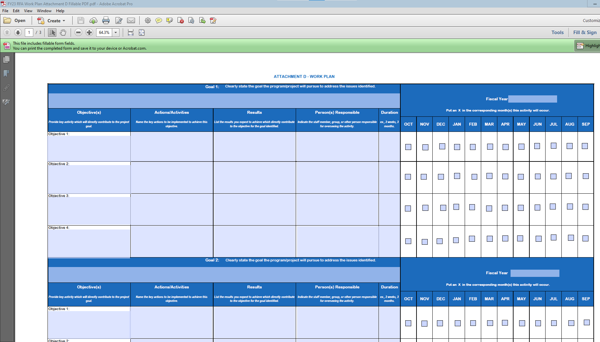
Work Plan (Attachment D)
The work plan template (see Attachment D) provided DBH is required.

Slide 33
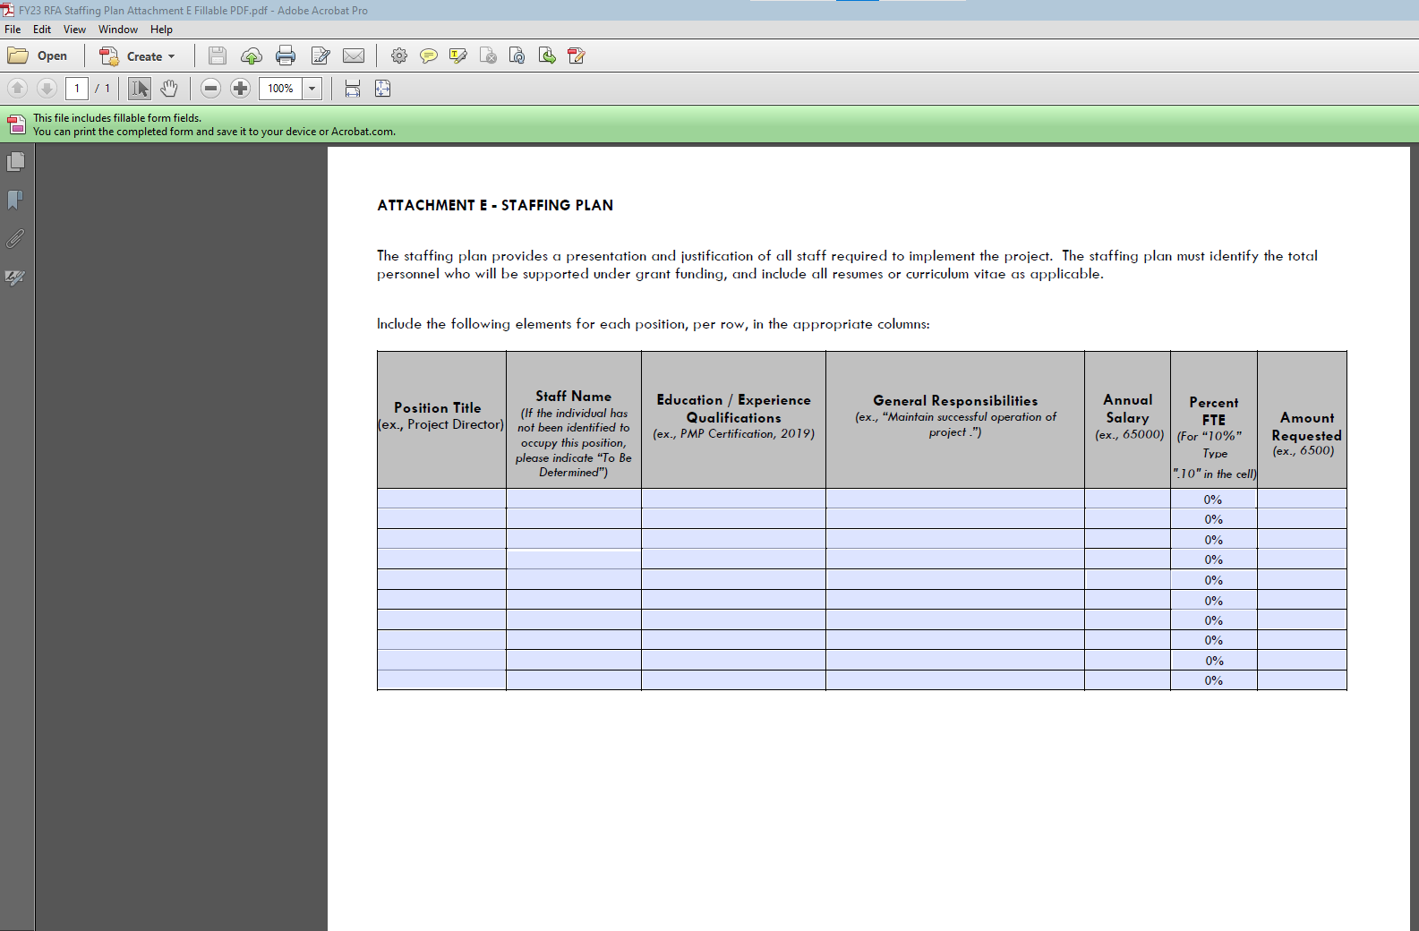
Staffing Plan (Attachment E)
The applicant’s staff plan template (See Attachment E) is required.

Slide 34
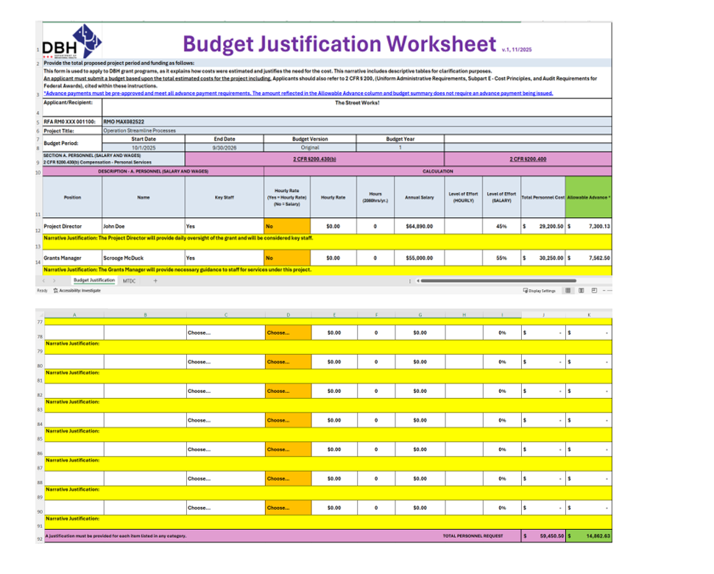



Budget Justification (Attachment F)
Demographics #1
Hourly rate #2
#3 Narrative just.
#4 subtotals
Use this DBH budget template to submit your project budget!!
Submit in an EXCEL FORMAT ONLY – NOT PDF

Slide 35
Budget Justification
The following categories and descriptions should be covered in the Budget/Justification:
  Section A -Personnel: Include the title of the position, name (or indicate vacancy), annual salary and level of effort (percentage of time) dedicated to this project.
  Section B -Fringe: Provide the position, name (or indicate vacancy), total fringe benefit rate used.
  Section C -Travel: Travel will not be approved for this grant.
  Section D -Equipment: Provide the item, quantity, amount, and percent charged to the grant.
  Section E - Supplies: Include the items being requested and rate. Description should also include how the supplies directly support the project.
  Section F - Contractual: Provide the name of entity and identify whether it’s a sub-recipient, contractor, consultant, or service. Also provide the entity’s rate.
  Section G - Other Direct Costs: List any costs not included in any of the other cost categories.
  Section I - Indirect Costs: Indirect costs should not exceed 10% of direct costs, unless the organization has a negotiated indirect cost rate agreement. Please reference 45 CFR §75.414.

Slide 36
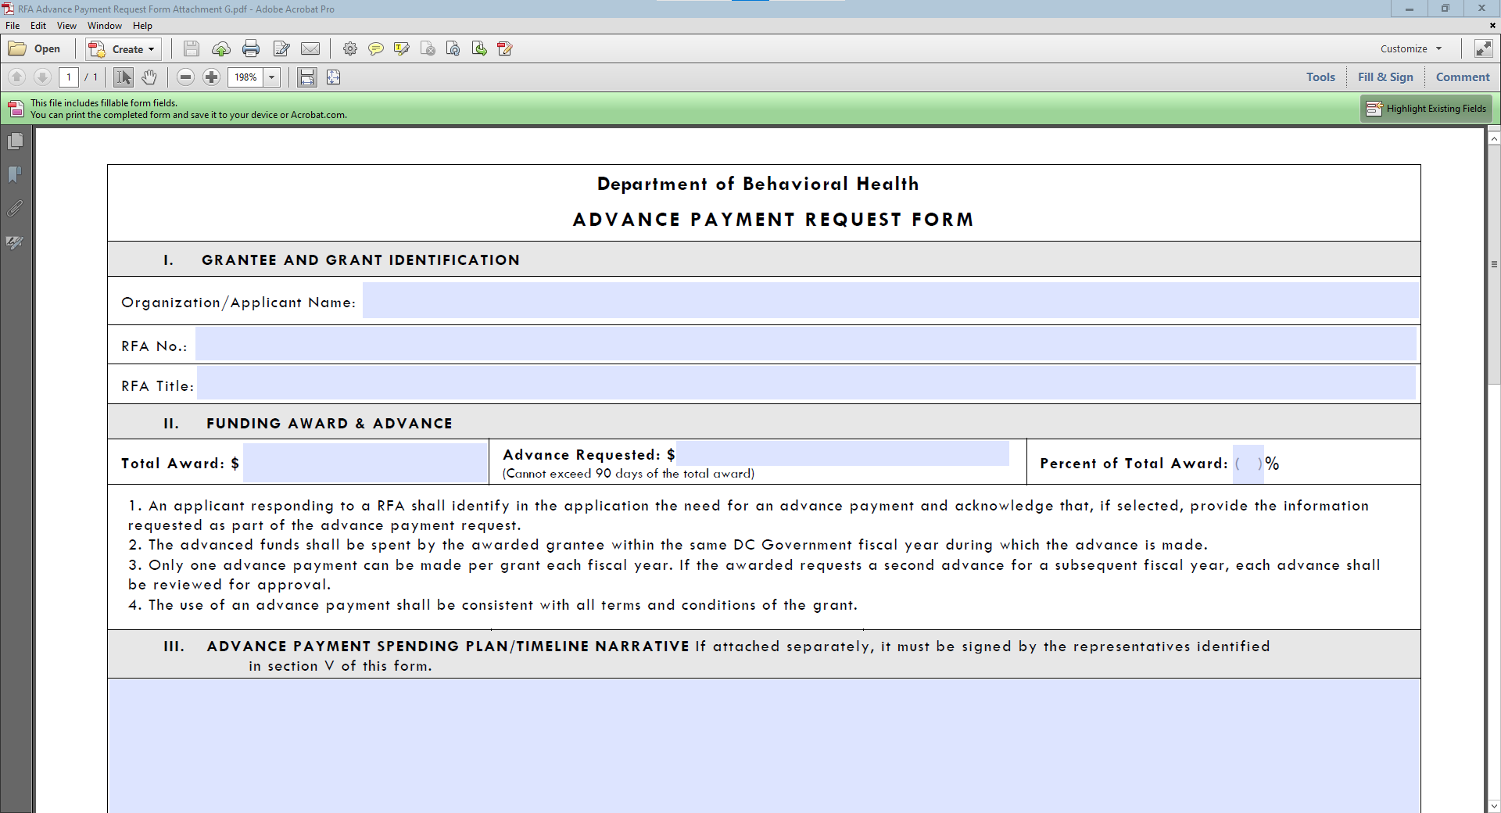
Advance Payment Form (Attachment G)

Slide 37
Advance Payment
An applicant seeking an advance, must submit a completed Advance Payment Request form (Attachment G) with the submitted application and be signed by the organization’s Chair of the Board of Directors and Executive Director, or equivalent positions. Applicants must detail the amount requested per budget category in the budget and justification (see Attachment F).
Advance payments are optional and an applicant is not required to submit the Advance Payment Request form. Failure to submit an Advance Payment Request form with the application eliminates the consideration for an advance payment. An advance payment will not be provided without prior official request and approval.
Advances shall not exceed one month/30 days or 25% of the total grant award.
The purpose of advance funding is to assist the grantee with start-up funding for the first month of the grant.
Only one advance payment can be made per grant. If an advances payment is needed in subsequent years, it must be for new deliverables requiring start-up funding.

Slide 38
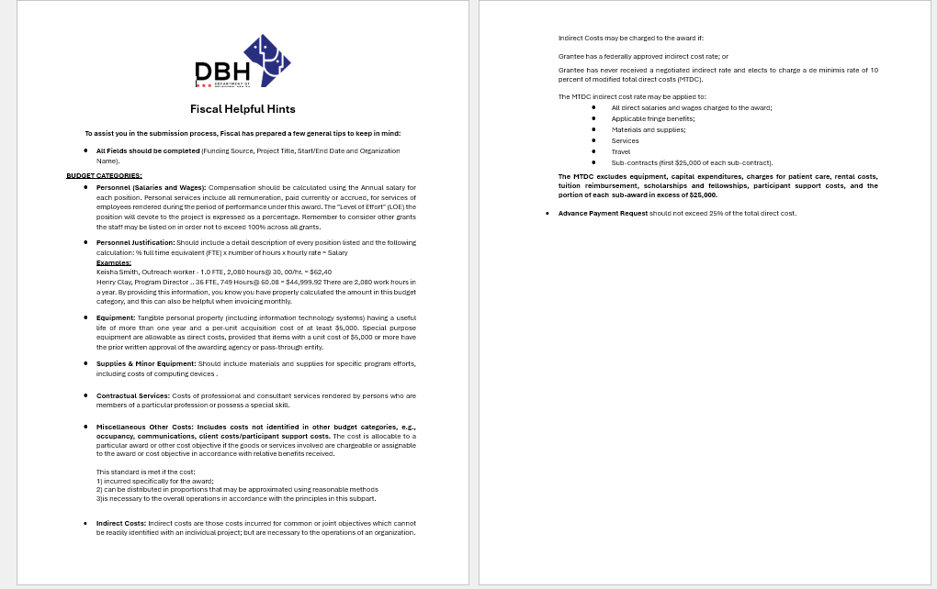
Fiscal Helpful Hints (Attachment H)

Slide 39
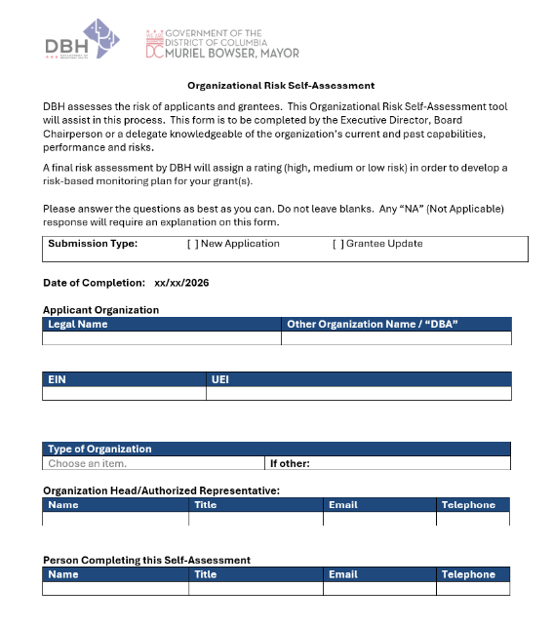
Organizational Risk Self-Assessment (Attachment I)

Slide 40
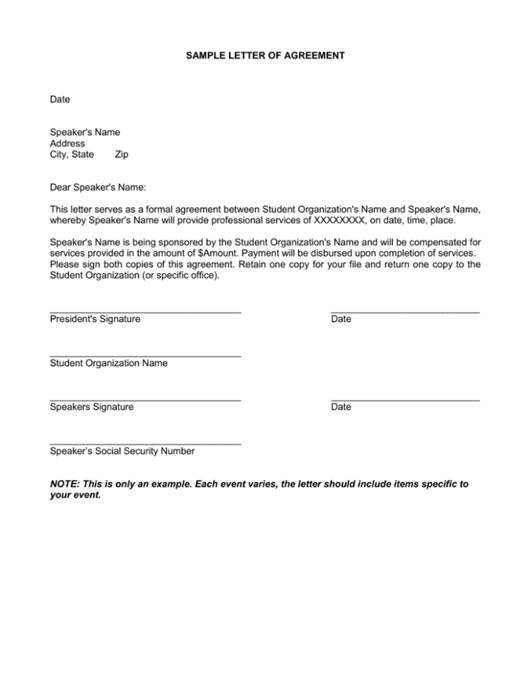
Letters of Agreement
(No Template Provided)

Slide 41
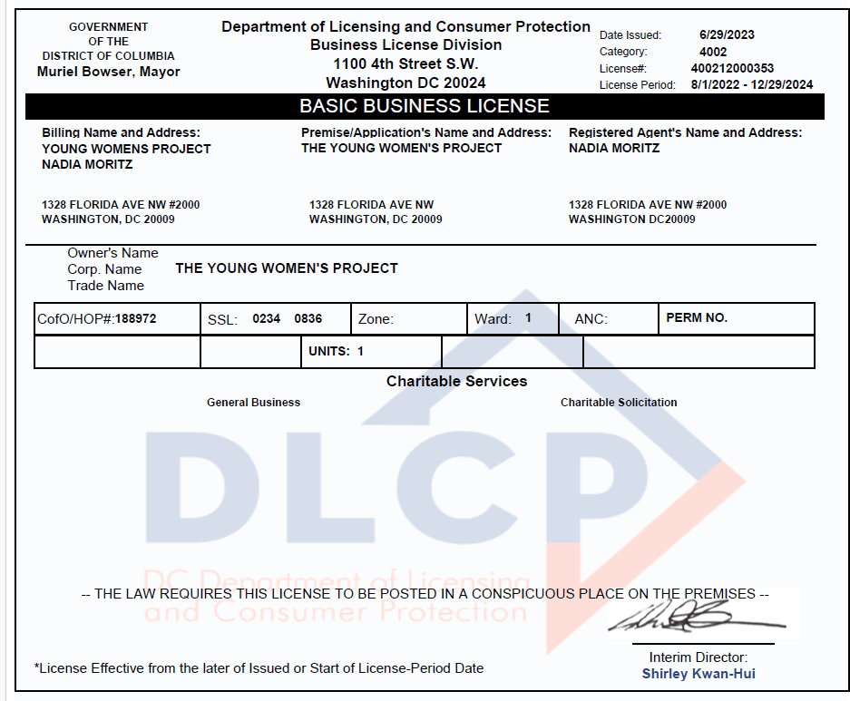

Business License

Slide 42
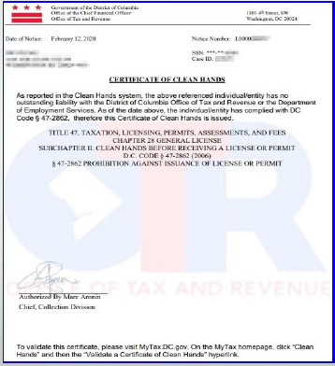
Clean Hands Certification
Each applicant must submit a valid current Clean Hands Certification from the District of Columbia Office of Tax Revenue. DBH requires that the submitted Clean Hands Certification reflect a date within a thirty-day period immediately preceding the application’s submission. Self-Certification is not acceptable.

Slide 43
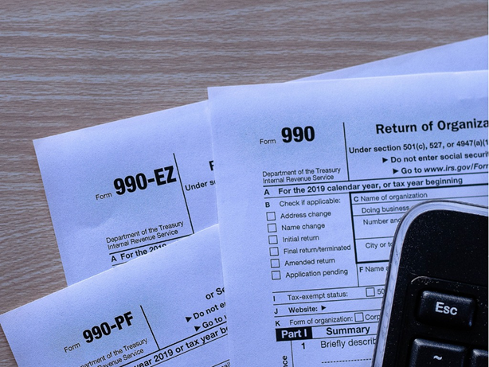
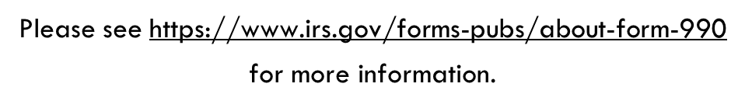
IRS 990 FORM
(Non-Profits Only)
The applicant must submit the organization’s 990 form from the most recent tax year.

Slide 44
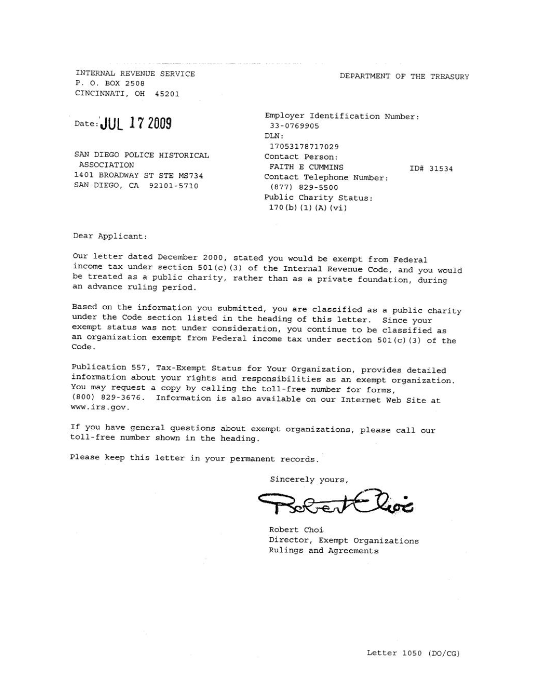

IRS Tax –Exempt Determination Letter & 501 (c)(3) Letter (Non-Profits Only)

Slide 45

Religious Organizations
Best Evidence of IRS Tax Exemption Examples:
  A letter from the leader of the organization verifying that the organization is a religious group;
  A letter from the group’s board chair or similar official, verifying that the organization is a religious group;
  The applicant’s most recently submitted state sales or other tax exemption form, if it exists (Form 164 in the District of Columbia); or
  The state’s issued tax exemption certificate or card, if it exists. (See IRS publication no. 1828, Tax Guide for Churches and Religious Organizations).

Slide 46
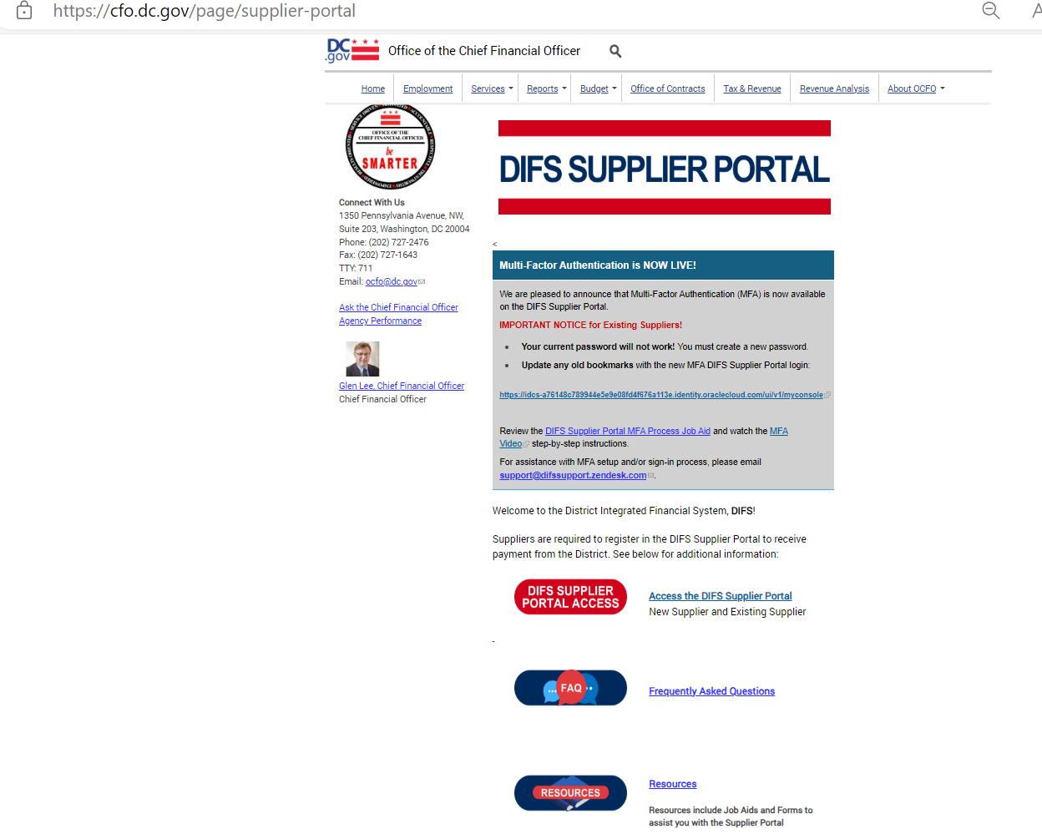

IRS W-9 Tax
If you are not currently registered as a vendor with DBH or if your existing information has changed, please visit the DIFS Supplier Portal at https://cfo.dc.gov/page/supplier-portal
to register or update your details.

Slide 47

Audited Financial Statements
If audited financial statements or reviews are not available, the applicant must provide:
    the Organizational Budget,
    Income Statement (Profit and Loss Statement),
    Certified Balance Sheet (certified by an authorized representative of the organization), and
    any letters, filings, etc. submitted to the IRS within the three (3) years before date of grant application.

Slide 48

Separation of Duties Policy
The applicant should state which of these situations apply and provide the following information
  Describe how financial transactions are handled and recorded;
  Provide the names and titles of personnel involved in handling money;
  Identify how many signatures the financial institution(s) require on the organization’s checks and withdrawal slips; and,
  Address other limits on staff and board members’ handling of the organization’s money.

Slide 49

Board of Directors
(No Template Provided)

Slide 50

System for Award Management (SAM)
Registration
(Active Unique Entity ID #)
Visit www.sam.gov for more information

Slide 51

Partner Documents

Slide 52

Commercial, General Liability, Professional Liability, Comprehensive Automobile and Worker’s Compensation
During the term of the grant, all organizations will be required to obtain and keep in force insurance coverage as listed below and must provide in writing the name of all its insurance carriers and the type of insurance provided:
The Organization shall carry employer's liability coverage of at least one hundred thousand dollars ($100,000), if applicable.
The Organization shall carry bodily injury liability insurance coverage written on the comprehensive form of policy of at least five hundred thousand dollars ($500,000) per occurrence.
The Organization shall carry automobile liability insurance written on the comprehensive form of policy, if applicable. The policy shall provide for bodily injury and property damage liability covering the operation of all automobiles used in connection with performing grant activities. Policies covering automobiles shall provide coverage of at least two hundred thousand dollars ($200,000) per person and five hundred thousand dollars ($500,000) per occurrence for bodily injury and one hundred thousand dollars ($100,000) per occurrence for property damage.

Slide 53
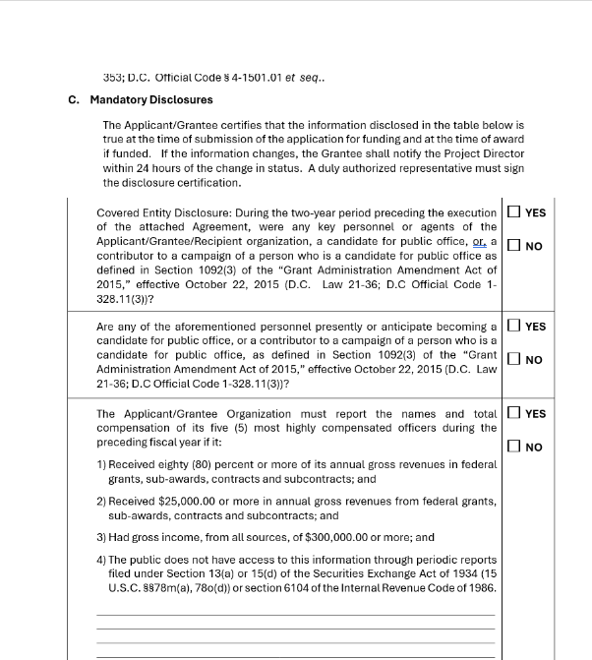
Fillable Attachments
Please note, ensure thorough completion of certifications and assurances by checking all applicable boxes, answering all relevant questions, and providing the required date and signature. The number of required certifications and assurances varies depending on the type RFA you’re applying for. All attachments are in a fillable PDF format. Please complete only the certifications and assurances relevant to the grant in the online application package. Below is an example of an attachment that requires you to check the applicable boxes. Make sure to answer it and do not skip this step.

Slide 54
Checklist For RFA Application
CHECKLIST FOR RFA APPLICATION
A complete DBH RFA Application Package shall adhere to the following guidance:
Documents requiring signature have been signed by the agency head or AUTHORIZED Representative of the applicant’s organization.
The application must have a UEI number to be awarded funds. Go to SAM.gov to apply for and obtain a UEI # if needed. (https://sam.gov/content/home)(https://sam.gov/content/home)
The Project Narrative is typed using the following formats: 8-½ by 11-inch paper, 1.0 spaced, Arial or Times New Roman font 12-point type (10-point font for tables and figures), and a minimum of one-inch margins. Applications that do not conform to these requirements will not be forwarded to the review panel.
The application proposal format conforms to the “Application Requirements” listed in the RFA.
The proposed budget is complete and complies with the allowable items provided in the RFA. All data is captured using the “Budget and Budget Justification” (Attachment F) provided with the RFA. The budget justifications are complete and describe the items proposed in each category.
The proposed work plan, staffing plan, Work Plan (Attachment D), Staffing Plan (Attachment E), and any other requested attachments are complete and comply with the forms and format provided in the RFA.
Submit your application via email to DBH Grants, DBH.Grants@dc.gov by ET on the deadline of . Applications will not be accepted late. Applicants are encouraged to submit their applications 24 hours prior to the deadline for any necessary electronic/technical troubleshooting.
A complete DBH RFA Application Package shall include the following:
Notice of Eligibility and Experience Requirements (Attachment A)
Application Profile (Attachment C)
Project Abstract (Attachment C)
Table of Contents
Project Narrative
Work Plan (Attachment D)
Staffing Plan (Attachment E)
Budget Justification (Attachment F)
Advance Payment Request Form, if applicable (Attachment G)
Organizational Risk Self-Assessment (Attachment I)
Letters of Agreement
Organizational Required Documents:
  Valid Business License
  Valid Certificate of Clean Hands
  IRS Tax-Exempt Determination Letter (for nonprofits only)
  IRS 990 Form from most recent tax year (for nonprofits only)
  IRS W-9 Form, if applicable
  Audited Financial Statements
  Separation of Duties Policy
  Board of Directors
  Active UEI Number (Unique Entity ID via System for Award Management (SAM))
  Partner Document(s) (if applicable)
  Proof of Insurance for Commercial, General Liability, Professional Liability, Comprehensive Automobile, Worker’s Compensation, and Cyber Liability Policy
Assurances, Certifications, & Disclosures (Attachment 2)
Program Income and Financial Disclosure (Attachment 3)
DC Contribution and Solicitation Certification (Attachment 4)
Federal Assurances and Certifications (Attachment 5)
Special Terms of Award Funding (Attachment 6)
DC Tax Certification (Attachment 7)
Sub-Grantee Single Audit Certification (Attachment 8)

Slide 55
Application Submission and Deadline
Applications are Due: Thursday, October 1, 2026, must be submitted no later than 12:00 PM ET.
Proper submission requires the applicant to attach all files as PDF’s and split documents within each as follows:
File #1 – Table of Contents, Notice of Eligibility and Experience Requirements, Applicant Profile, Abstract and Project Narrative.
File #2 – (Attachments D-J)Work Plan, Staffing Plan, Budget Justification, Advance Payment Request Form (if applicable), and Organizational Risk Self-Assessment.
File #3 – Letters of Agreement (if applicable), Partner Documents (if applicable), Business License, Active UEI Number, Certificate of Clean Hands.
File #4 – 501(c)(3) Letter, IRS W-9 Form (if applicable), IRS Tax Exemption Letter, Current Fiscal Year Budget or Financial Statements, Separation of Duties Policy, Board of Directors, Certificate of Insurance, and Cyber Liability Policy.
File #5 – Attachment 2*, Attachment 3*, Attachment 4*, Attachment 5*, Attachment 6*, Attachment 7*, Attachment 8* and Attachment 9* .
*These Attachments are in a fillable PDF. Complete the PDF, “Save” and provide PDF.
Please note: Attachment 1, Terms and Conditions does not have to be provided in the application submission.

Slide 56
Review and Scoring
Application submissions will be confirmed according to the date and time received in the Grants inbox.
EMAIL TIME STAMP: 11:59 AM
NUMBER OF FILES RECEIVED: 1 PD FILE
EMAIL NOTIFICATION ON THIS DATE: 2/14/2026
RECEIVED BY: Shelley Baker
*An automated reply email message will be sent to the submitting email address confirming only the “receipt” of a submission. Please reach out to GMO if you do not receive an email confirming receipt of application at DBH.grants@dc.gov.

Slide 57
Remember!
Read the entire RFA, including the attachments!
The last opportunity to submit questions is Friday, September 25, 2026 , one week prior to the RFA’s closing. Thursday, October 1, 2026
(When emailing questions please copy DBH.Grants@dc.gov )
Before submitting, review the Checklist and the Submission Requirements.
Have a second reader to review your application before submitting.
Don’t wait until the last minute to submit!

Slide 58
Remember!
RFA and Attachments can be found on either the Mayor’s Office of Community Affairs or Department of Behavioral Health websites:
  https://communityaffairs.dc.gov/content/community-grant-program#4
  https://dbh.dc.gov/page/request-applications-01
Complete and sign attachments as requested.
Email subject line should include RFA # and File #.
Applications are to be emailed to DBH.Grants@dc.gov
Meet the submission deadline Thursday, October 1, 2026, by 12:00 P.M. ET

Slide 59

Upcoming Key Dates
Application Submission Deadline:
Thursday, October 1, 2026
Anticipated Award Start Date:
Thursday, October 15, 2026

Slide 60
Program Contact Information
Charneta C. Scott, Ph.D.
Child, Adolescent and Family Services
charneta.scott@dc.gov
Tywana Reed
Fiscal Management Office
tywana.reed@dc.gov
Renee Evans Jackman
Grants Management Office
renee.evans@dc.gov

Slide 61

Questions

